Slide 1
Principles, Tools and Practices for Innovation for Inclusive Development (IID) in Southeast Asia
CASE STUDY - MALAYSIA
MA in International Development Studies, Faculty of Political Sciences, Chulalongkorn University, Bangkok, Semester 2, 2016-2017
Victor P. Karunan, Ph.D.
Visiting Lecturer
MAIDS – Chulalongkorn University, Bangkok
vkarunan2016@gmail.com
Thu 5 January 2017

Slide 2
Outline of Lecture
Defining “Innovation”
Innovation and Inclusive Development
Case Study: Social Innovation Lab – Malaysia (UNICEF)
Some useful Innovation Tools: RapidPro & U-Report
Lessons Learnt
Ways Forward
Reading List

Slide 3
Defining “Innovation”
“Turning an idea into a solution that adds value from a customer’s perspective” – Nick Sillicorn
“An innovation is a feasible relevant offering such as a product, service, process or experience with a viable business model that is perceived as new and is adopted by customers” – Gijs van Wulfen
“Creativity is thinking of something new. Innovation is the implementation of something new” – Paul Sloane

Slide 4
Key Steps in Innovation…
DISCOVER
SYNTHESISE
IDEATE
PROTOTYPE
EXECUTE

Slide 5
Definition: Innovation for Inclusive Development
“innovation that reduces poverty and enables all groups of people, especially the poor and marginalized to participate in decision making, create and actualize opportunities, and equitably share in the benefits of development” (IDRC, 2013:5)

Slide 6
Is Innovation the “new mantra”of Development?
Innovation is being promoted as a “new mantra” for development – it is often perceived as a “development shortcut”.
Innovation tends to underwrite or ignore the core development approaches and programmes carried out by social sector organisations for decades – based on community development, inclusive growth and sustainable development theories
Innovation has little external impact to show when it is enacted in unpredictable and sensitive contexts – even proven innovation often fail when transferred to a different context.
The hoped-for success factors for innovation that researchers and consultants have identified ignore the power of negative organizational factors, such as bad leadership, dysfunctional teams, and overambitious goals.
It is time to move from innovation as an “ideology” to innovation as a “process”—a transition that might be less glamorous but will be more productive and sustainable for development.

Slide 7
Innovation in Malaysia – The Approach
Throughout the world, UNICEF has established a network of Innovation Labs –collaborative incubators and accelerators that bring business, universities, governments and civil society together to create sustainable solutions to the most pressing challenges facing children and young people.
The recent expansion of Innovation Lab activities into middle- and upper-income countries, now offers exciting potential to develop new models for innovation in areas most impacting child development and well-being.
Four Focus Areas in Malaysia:
1. Research: Developing a comprehensive landscape mapping around key areas of focus, using design thinking and approaches to draw out community perspectives and experiences and identify key barriers and opportunities for innovation
2. Design: Convening multi-disciplinary teams to design, test and evaluate innovative approaches, with the aim of developing model(s) that can provide significant impact at scale
3. Monitoring: Introducing a framework for impact assessment, supported by real-time monitoring tools (RapidPro) to validate learning and monitor ongoing projects
4. Capacity-building: Building skills of civil society and corporate partners to co-create, test, evaluate and scale innovative approaches to key barriers to child development and well-being

Slide 8
9 Principles of Digital Development
ONE: DESIGN WITH THE USER › Develop context-appropriate solutions informed by user needs. › Include all user groups in planning, development, implementation, and assessment. › Develop projects in an incremental and iterative manner. › Design solutions that learn from and enhance existing workflows, and plan for organizational adaptation. › Ensure solutions are sensitive to, and useful for, the most marginalized populations: women, children, those with disabilities, and those affected by conflict and disaster.
TWO: UNDERSTAND THE ECOSYSTEM › Participate in networks and communities of like-minded practitioners. › Align to existing technological, legal, and regulatory policies.
THREE: DESIGN FOR SCALE › Design for scale from the start, and assess and mitigate dependencies that might limit ability to scale. › Employ a “systems” approach to design, considering implications of design beyond an immediate project. › Be replicable and customizable in other countries and contexts. › Demonstrate impact before scaling a solution. › Analyze all technology choices through the lens of national and regional scale. › Factor in partnerships from the beginning, and start early negotiations.
FOUR: BUILD FOR SUSTAINABILITY › Plan for sustainability from the start, including planning for long-term financial health, e.g., assessing total cost of ownership. › Utilize and invest in local communities and developers by default, and help catalyze their growth. › Engage with local governments to ensure integration into national strategy, and identify high-level government advocates.
FIVE: BE DATA DRIVEN › Design projects so that impact can be measured at discrete milestones with a focus on outcomes rather than outputs. › Evaluate innovative solutions and areas where there are gaps in data and evidence. › Use real-time information to monitor and inform management decisions at all levels. › When possible, leverage data as a by-product of user actions and transactions for assessments.
SIX: USE OPEN DATA, OPEN STANDARDS, OPEN SOURCE, OPEN INNOVATION › Adopt and expand existing open standards. › Open data and functionalities, and expose them in documented APIs (Application Programming Interfaces) where use by a larger community is possible. › Invest in software as a public good. › Develop software to be open source by default with the code made available in public repositories and supported through developer communities.
SEVEN: REUSE AND IMPROVE › Use, modify, and extend existing tools, platforms, and frameworks when possible. › Develop in modular ways favoring approaches that are interoperable over those that are monolithic by design.
EIGHT: ADDRESS PRIVACY & SECURITY › Assess and mitigate risks to the security of users and their data. › Consider the context and needs for privacy of personally identifiable information when designing solutions and mitigate accordingly. › Ensure equity and fairness in co-creation, and protect the best interests of the end-users.
NINE: BE COLLABORATIVE › Engage diverse expertise across disciplines and industries at all stages. › Work across sector silos to create coordinated and more holistic approaches. › Document work, results, processes, and best practices, and share them widely. › Publish materials under a Creative Commons license by default, with strong rationale if another licensing approach is taken.

Slide 9
Social Innovation Lab - Malaysia
Mission:
“We think that if we work to support implementers and design with instead of for our end users – children, parents, teachers, and more – we can help create approaches that are less top-down, more responsive, and ultimately more effective in addressing social challenges”.
The Context:
The state of Sabah is home to 1.2 million children under the age of 18 years. At least 50,000 of those children are undocumented. Undocumented children comprise 4% of Sabah’s child population and 0.5% of Malaysia’s child population.
Undocumented children in Malaysia are one of the most vulnerable populations in the country. They can be thrown into detention centres or deported at any time. Not being able to lawfully access healthcare, education, and employment systems means that they are often forced to turn towards informal sectors for survival.

Slide 10
The Process/Method
View Presentation
Social Innovation Lab - Malaysia

Slide 11

Some Useful Innovation Tools

Slide 12

How might we collect and use data to better serve children and communities?

Slide 13
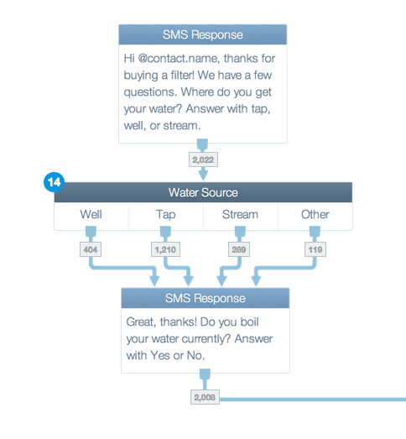
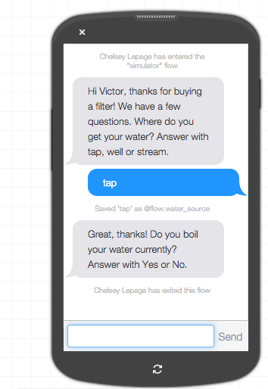
Building & Testing a Flow
Image / graph template
Maximum size of image / graph should stay within the grey box.
Delete grey box and this text box once your content is in place.
The image / graph should be in the center of the grey box vertically & horizontally.
Do NOT stretch the image / graph to make it fit.
Please stay within the ruler guides of each slide
Use this text box for image / graph titles
Notes:
IMAGE / GRAPH SLIDE

Slide 14
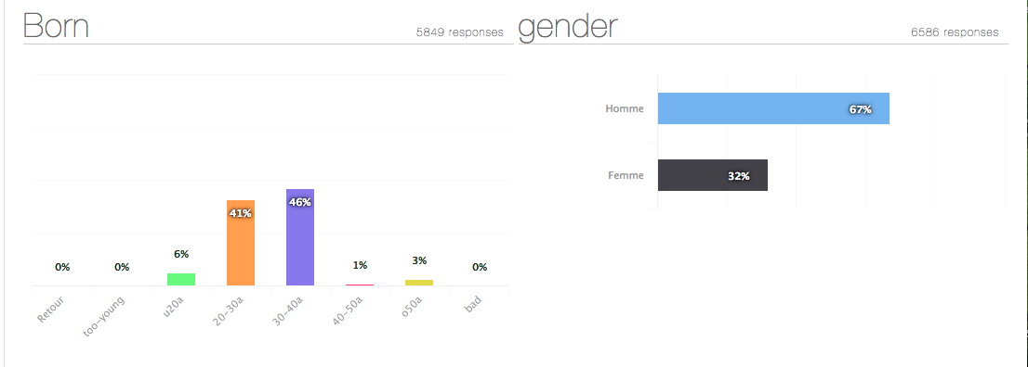
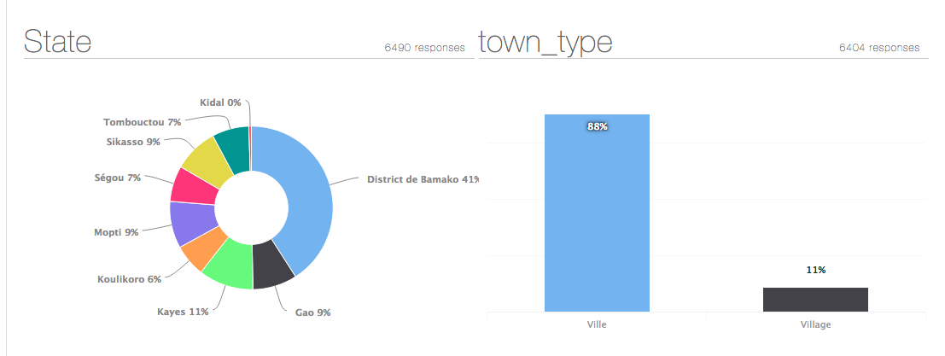
Real time information (polls + users)
Image / graph template
Maximum size of image / graph should stay within the grey box.
Delete grey box and this text box once your content is in place.
The image / graph should be in the center of the grey box vertically & horizontally.
Do NOT stretch the image / graph to make it fit.
Please stay within the ruler guides of each slide
Use this text box for image / graph titles
Notes:
IMAGE / GRAPH SLIDE

Slide 15
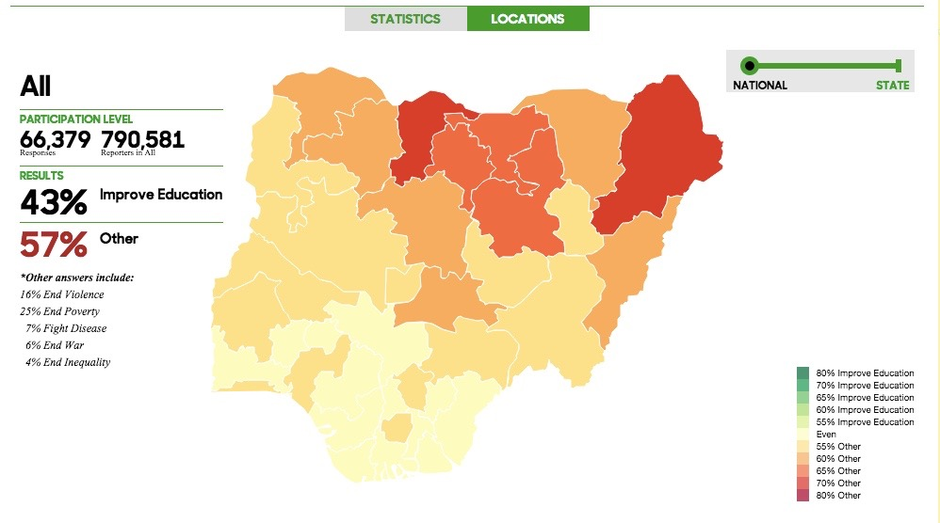
Real time mapping (advocacy + response)
Image / graph template
Maximum size of image / graph should stay within the grey box.
Delete grey box and this text box once your content is in place.
The image / graph should be in the center of the grey box vertically & horizontally.
Do NOT stretch the image / graph to make it fit.
Please stay within the ruler guides of each slide
Use this text box for image / graph titles
Notes:
IMAGE / GRAPH SLIDE

Slide 16
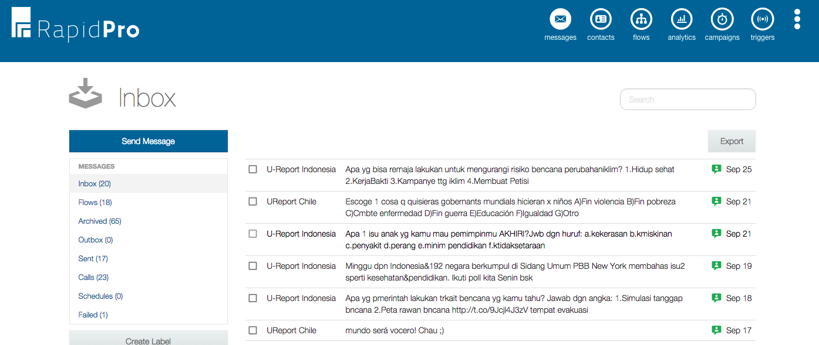
Anonymized dashboard
Image / graph template
Maximum size of image / graph should stay within the grey box.
Delete grey box and this text box once your content is in place.
The image / graph should be in the center of the grey box vertically & horizontally.
Do NOT stretch the image / graph to make it fit.
Please stay within the ruler guides of each slide
Use this text box for image / graph titles
Notes:
IMAGE / GRAPH SLIDE

Slide 17
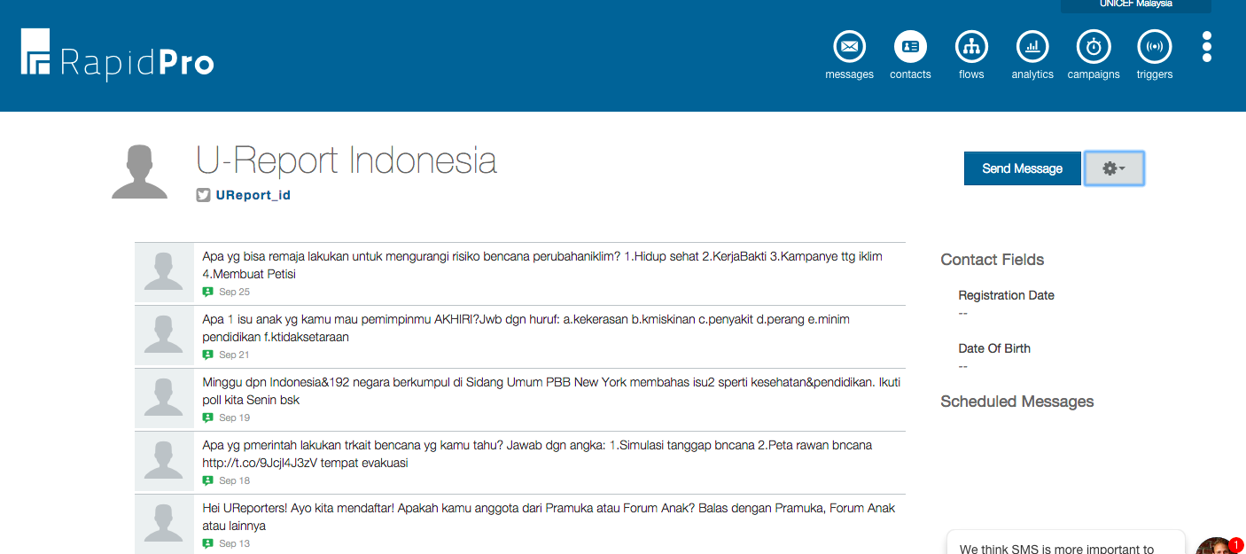
Real-time response (groups + individuals)
Image / graph template
Maximum size of image / graph should stay within the grey box.
Delete grey box and this text box once your content is in place.
The image / graph should be in the center of the grey box vertically & horizontally.
Do NOT stretch the image / graph to make it fit.
Please stay within the ruler guides of each slide
Use this text box for image / graph titles
Notes:
IMAGE / GRAPH SLIDE

Slide 18
Applications
HIV/AIDS counselling
Teacher monitoring
Stock monitoring
DDR: Crisis-alert, mapping & coordination, resilience
Monitoring tool for CSO and government partners
Single surveys
Real-time information campaigns
Communication for Development (C4D) tool
Please stay within the ruler guides of each slide
Notes:
BULLET POINT SLIDE: The text colour of this slide can be changed to the same colour as the title slide background.

Slide 19

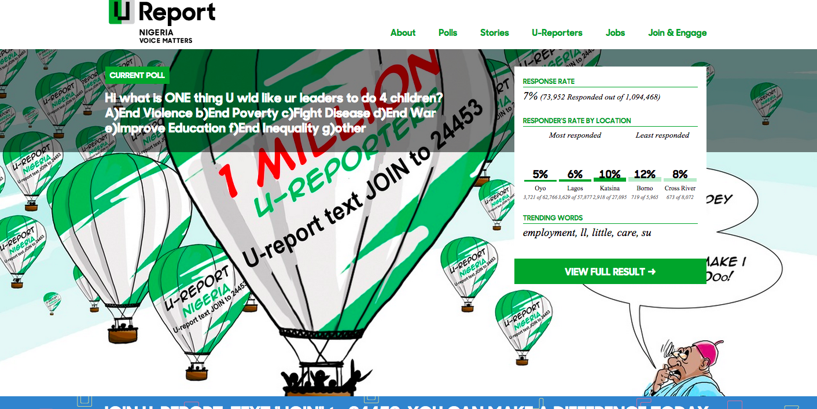
Weekly polls
Image / graph template
Maximum size of image / graph should stay within the grey box.
Delete grey box and this text box once your content is in place.
The image / graph should be in the center of the grey box vertically & horizontally.
Do NOT stretch the image / graph to make it fit.
Please stay within the ruler guides of each slide
Use this text box for image / graph titles
Notes:
IMAGE / GRAPH SLIDE

Slide 20
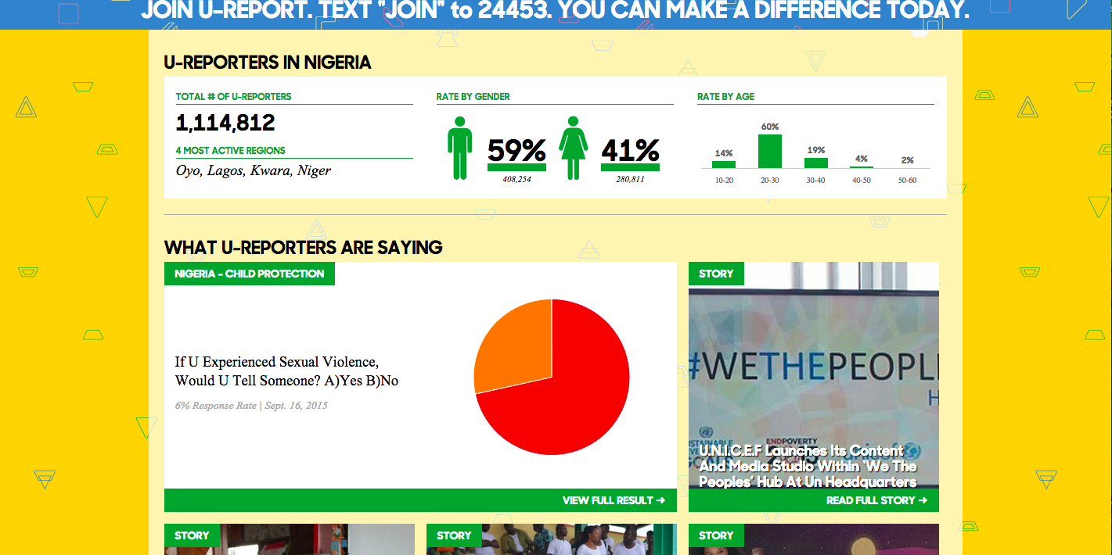
Real-time visualizations
Image / graph template
Maximum size of image / graph should stay within the grey box.
Delete grey box and this text box once your content is in place.
The image / graph should be in the center of the grey box vertically & horizontally.
Do NOT stretch the image / graph to make it fit.
Please stay within the ruler guides of each slide
Use this text box for image / graph titles
Notes:
IMAGE / GRAPH SLIDE

Slide 21
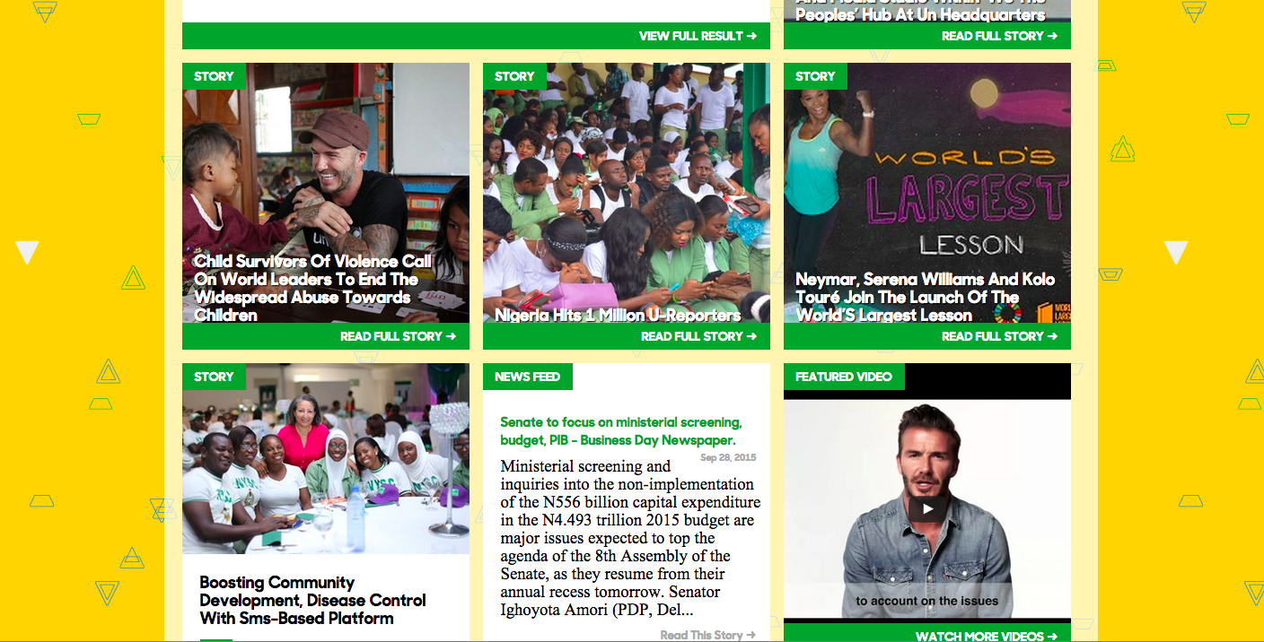
Amplifying ideas & concerns
Image / graph template
Maximum size of image / graph should stay within the grey box.
Delete grey box and this text box once your content is in place.
The image / graph should be in the center of the grey box vertically & horizontally.
Do NOT stretch the image / graph to make it fit.
Please stay within the ruler guides of each slide
Use this text box for image / graph titles
Notes:
IMAGE / GRAPH SLIDE

Slide 22
Lessons Learnt
Innovation is taking the tools used by private/corporate sector for decades to create products and services that people want to apply to the public space of development work
However, the dynamics of the “development space” are fundamentally different when compared to the “corporate space”.
For example – in the corporate world the users/customers are powerful because they have money to spend – in the development world, the users are often the most marginalized and powerless people – with no power to influence governments to listen to them
For example – the corporate world has clear ideas of the users and clear measures of success – the development world often does not have clear “bottom lines” or “benchmarks” – for governance, rule of law, violence, etc.
Design thinking mainly focuses on “outputs” – rather than “systems” or “systemic change” – “focuses on the edges – rather than the core – of development problems”. “We are facing ocean-sized problems armed with a teaspoon!!!”
Finally, design thinkers often seem to “know the right solution” – but, development and democracy requires people “thinking and driving themselves”.

Slide 23
Ways Forward
Treat innovation as a process, not primarily as an outcome. Efforts to explicitly link the characteristics and dynamics of organizational innovation to its consequences provide valuable evidence for decision making and enable organizations to identify areas for productive support as well as to fine-tune interventions and resource provision strategies.
Treat innovation as an independent variable, and reflect on multiple positive and negative outcomes during the innovation process. The focus on innovation within organizations enables an accurate assessment of the internal and external dimension of value created by innovation activities.
Recognize that innovation processes integrate different organizational and external factors. These factors include individuals (e.g., idea creation), groups (e.g., idea evaluation), organizations (e.g., resource allocation and formalization of new activities), and contexts (e.g., external power structures or collaboration partners). Evaluating innovation requires consideration of several levels of analysis concurrently.
Understand the prevailing cognitive, normative, and political dimensions within organizations to determine how they might enable or stifle innovation. This could allow younger organizations to better monitor and suppress emerging negative innovation factors and increase their learning and innovation capacity. And it could allow more mature organizations to develop more focused organizational redesigns, to rejuvenate processes, and to legitimize tough but necessary decisions.
Capture insights from successful and unsuccessful innovations in organizations over time. This approach to social innovation trumps prevailing approaches that generalize innovation factors based on static snapshots across organizations or based on single observations of innovation events. It also tests for the presence or absence of an important enabler of innovation: organizational learning.
Reflect on the differences in innovation processes, influencing factors, and outcomes across different cultures and geographies rather than on general innovation factors. We know very little about such innovation-related factors as creativity, idea evaluation, and learning in organizations as they apply to non-Western settings.
Source: Christian Seelos & Johanna Mair, Fall 2012, Stanford Social Innovation Review.

Slide 24
Reading List
Innovation and Inclusive Development – A Discussion of the Main Policy Issues – Caroline Paunova, OECD Science, Technology and Industry, Working Papers 2013/01
Design Thinking for Social Innovation – Tim Brown & Jocelyn Wyatt Winter, Stanford Innovation Review, Winter 2010
Why “Design for Development” is Failing on its Promise – Panthea Lee, 14 May 2015, http://www.fastcoexist.com/3045768/why-design-for-development-is-failing-on-its-promise
The Field Guide to Human-centred Design – Design Kit, IDEO, 2015, http://bestgraz.org/wp-content/uploads/2015/09/Field-Guide-to-Human-Centered-Design_IDEOorg.pdf
UNICEF – Stories on Innovation: http://www.unicefstories.org/about/reportsandbrochures/

