Slide 1
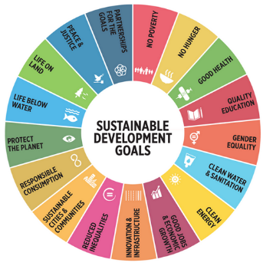
SUSTAINABLE DEVELOPMENT GOALS (SDG)
The Politics of Public Policy
M.A. in International Development Studies
Faculty of Political Science, Chualongkorn University, Bangkok
Trimester 2, 2016-2017
VICTOR P. KARUNAN, Ph.D.

Slide 2
MODULE OUTLINE
Overview and Introduction to Module
Key Learning Outcomes
Lecture 1 : The MDGs and the Post-2015 Development Agenda – Unfinished Business and Lessons Learnt
Lecture 2 : The SDGs – Overview of Purpose, Goals and Targets
Lecture 3 : The SDGs – Indicators, Monitoring and Reporting
Lecture 4: The SDGs and National Development Agendas – Roles of Development Partners and Stakeholders
Lecture 5: Sustainable Development – Opportunities and Challenges for Public Policy

Slide 3
OVERVIEW & INTRODUCTION
SDGs – the most comprehensive and holistic development approach adopted by the United Nations
SDGs – developed through a global participatory and inclusive process involving a wide range of partners and stakeholders (Post-2015 Development Consultations and Expert Groups)
SDGs – building on the unfinished business and lessons learnt in implementation and reporting on the MDGs over the past decade
National Development Agendas – influenced and aligned to the SDGs

Slide 4
KEY LEARNING OUTCOMES
1. To understand the context and background of the global development agenda based on the unfinished business and lessons learnt from the MDGs and leading towards the SDGs
2.To review and critically analyse the goals, targets and indicators of the SDGs vis-à-vis the national and global public policy context
3. To understand the roles and contributions of key global development actors in shaping the new global development agenda (SDGs)
4. To look at the emerging opportunities and challenges for Governments and development partners in adopting, implementing and reporting on the SDGs.

Slide 5
SUSTAINABLE DEVELOPMENT GOALS (SDG)
The Politics of Public Policy
M.A. in International Development Studies
Faculty of Political Science, Chualongkorn University, Bangkok
Trimester 2, 2016-2017
VICTOR P. KARUNAN, Ph.D.

Slide 6
LECTURE 1 MONDAY 9 JANUARY 2017
THE MDGS AND THE POST-2015 DEVELOPMENT AGENDA – UNFINISHED BUSINESS AND LESSONS LEARNT

Slide 7








MILLENNIUM DEVELOPMENT GOALS
MDG 1: Eradicate extreme poverty & hunger
3 targets; 9 indicators
MDG 5: Reduce maternal mortality
2 targets; 6 indicators
MDG 2: Achieve universal primary education
1 target; 3 indicators
MDG 6: Combat HIV/AIDS, malaria and other diseases
3 targets; 9 indicators
MDG 3: Promote gender equality & empower women
1 target; 3 indicators
MDG 7: Ensure environmental sustainability
4 targets; 10 indicators
MDG 4: Reduce child mortality
1 target; 3 indicators
MDG 8: Develop a Global Partnership for Development
7 targets; 7 indicators

Slide 8
MDGS – UNFINISHED BUSINESS & LESSONS LEARNT
Gender Inequality persists
Big gaps exist between the poorest and the richest households, and between rural and urban areas
Climate change and environmental degradation undermine progress achieved, and the poor people suffer the most
Conflict remains the biggest threat to human development
Millions of poor people still live in poverty and hunger, without access to basic services
Progress uneven across goals; within and across countries and regions.
Formulation of targets:
Some targets, for instance, may not have adequately taken into account country demographic change and the magnitude of certain social issues.
Globally set targets with limited consideration for national circumstances and differences in initial conditions.
Did not take into account vulnerability to natural hazards and other external shocks.
Did not adequately address cross-cutting issues.

Slide 9
POST-2015: THE UNFINISHED BUSINESS
Quality of development
Gender empowerment
Inclusiveness
Environment
Improving the quality of growth, recognizing multi-dimensionality of development
Stereotyped gender roles that continue to exist & have implications for other development achievements
A targeted & focused approach to assist pockets of development needs that remain
Pursuing sustainable consumption and development
Moving beyond basic needs; Focus on cost-effective outcomes
A strategic relook at the social protection system, bearing in mind that a multi-dimensional approach is needed
Gender empowerment that improves overall welfare of men and women
Green growth strategies and better management of natural resources

Slide 10
KEY ISSUES – NOT ADDRESSED IN MDGS
Social protection
Productive employment
Inequalities
Violence against women
Social exclusion
Biodiversity
Persistent malnutrition
Increase in non-communicable diseases
Reproductive health and complexities related to demographic dynamics,
Peace and security
Governance
Rule of law
Human Rights

Slide 11

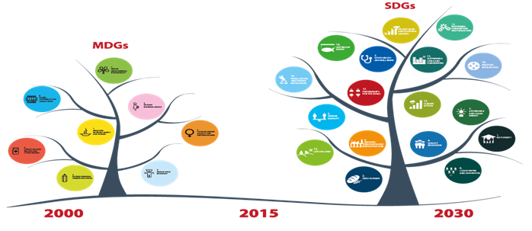

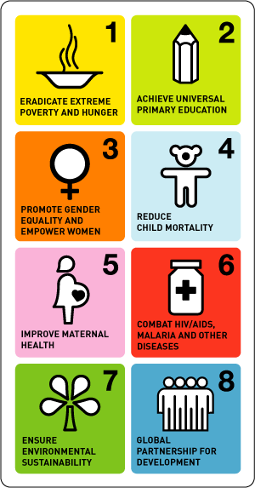

MDGs & SDGs
Introduction
The Sustainable Development Goals (SDGs): a set of universally applicable goals that balances the three dimensions of sustainable development: environmental, social, and economy
MDGs
SDGs
Period : 2016 – 2030
Involvement : April 2015
Focal Point : The coordination of the
development of SDGs indicators
Appointed as representative of
South-Eastern Asia in High Level Groups
(HLG) for SDGs
Provide inputs on assessment of SDGs
indicators to Philippines (IAEG-SDGs
representative of South-Eastern Asia)
in the development of SDGs indicators
Period : 2000 – 2015
Involvement : Since 2007- 2015
Focal Point : The coordination of the
compiling MDGs indicators
Member in Technical Working Groups
(TWG) for providing MDGs reports
at national, ASEAN and International level

Slide 12
THE POST-2015 DEVELOPMENT AGENDA PROCESS
A process initiated by the UN to help define the next set of development goals, to succeed the eight Millennium Development Goals (MDGs), which will end in December, 2015.
The MDGs were established following the Millennium Summit in 2000.
During the High Level Plenary Meeting of the UN General Assembly in 2010, governments called for accelerating progress of the MDGs and for thinking on ways to advance the development agenda beyond 2015.
Following this, the UN Secretary General initiated a number of initiatives.

Slide 13
POST-2015 DEVELOPMENT AGENDA INITIATIVES BY UNSG
UN System Task Team
High Level Panel of Eminent Persons
Est:
July, 2012
11 Global Thematic & National Consultations in 88 Countries
2012- 2013
2nd Round of Post-2015 Consultations
April ‘14 – April ‘15

Slide 14
POST-2015 DEVELOPMENT AGENDA REPORTS/OUTPUTS TO DATE
Report: “Realizing the Future We Want for All” (June, 2012)
Serves as input to the work of the High Level Panel
UN System Task Team
Report: “A New Global Partnership: Eradicate Poverty and Transform Economies through Sustainable Development” (May, 2013)
Consideration of the findings of national and thematic consultations at regional and national levels
High Level Panel
Report: “A Million Voices: The World We Want” (Sept 2013) – based on perspectives of over 1 million people collected by the UNDG
Crowdsourcing for inputs, via meetings and conferences, online discussions, and larger public debates
Thematic Global & National Consultations

Slide 15
2ND ROUND OF POST-2015 CONSULTATIONS – FACILITATED BY UNDG
The dialogues will run from April 2014 –April 2015
These will be a series of public meetings and on-line discussions where policy planners, civil society representatives, academics, community and private sector leaders can discuss how to best deliver the next sustainable development agenda that will build on the success of the Millennium Development Goals (MDG).
Dialogues on Implementation will explore six themes:
Localizing the post-2015 agenda
Helping to Strengthen Capacities and Build Effective Institutions
Participatory Monitoring for Accountability
Partnerships with Civil Society
Engaging with the Private Sector
Culture and Development

Slide 16

THEME OF THE NATIONAL CONSULTATIONS
Malaysia We Want:
How can our institutions help us deliver this?
Malaysia Yang Kita Mahu:
Bagaimanakah institusi kita
boleh membantu kita mencapai matlamat ini?

Slide 17
MALAYSIA- BACKGROUND OF POST-2015 AGENDA – NATIONAL CONSULTATION PROCESS
Part of a larger post-2015 comprehensive global consultation on defining new global development goals.
First phase focused on potential issues and areas to included in post-2015 development agenda
Findings of first round summarised in the Million Voices Project
Second phase seeks to continue inclusive dialogues on the “means of implementation” – the “hows” to ensure that the ‘whats’ are realised
UN seeks to create space for direct engagement of civil society & other stakeholders in a conversation about our common future.
In Malaysia, additional opportunity to influence the 11th Malaysia Plan.

Slide 18
OVERALL GOALS & OBJECTIVES
TO IDENTIFY EMERGING PRIORITIES
UNFINISHED BUSINESS
CHALLENGES & GAPS IN ACHIEVING REMAINING MDG TARGETS
RECOMMENDA-TIONS FOR FUTURE DEVELOPMENT POST-2015

Slide 19
Proposed Theme of National Consultations
The Malaysia We Want: How can our institutions help us deliver this?

Slide 20
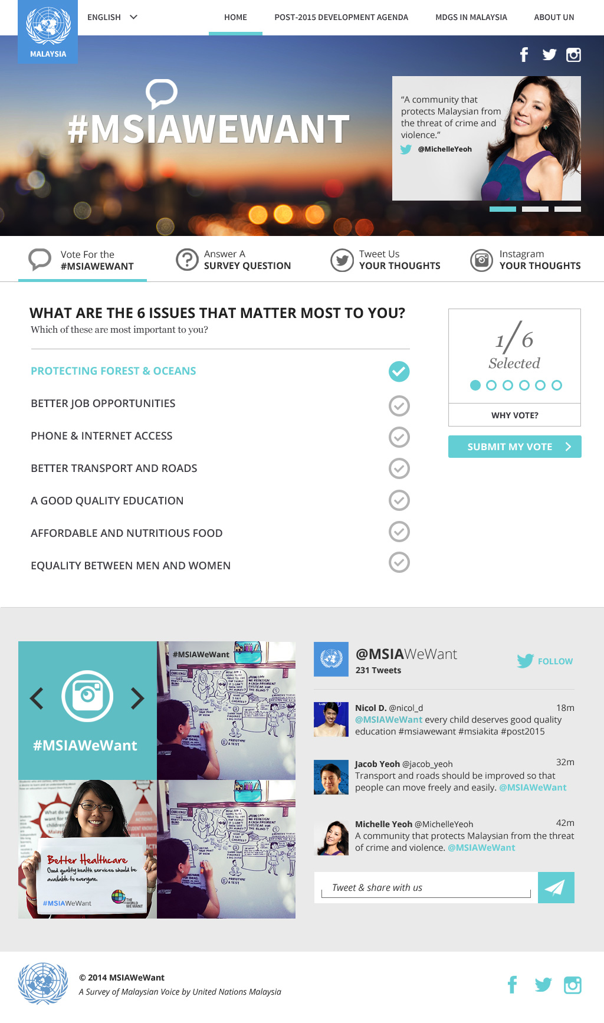


Slide 21
WorldWeWant Survey – Global Votes (2.3 million)
Top Priorities:
Good Education
Better Healthcare
Honest & Responsive Government
Better job opportunities
Access to clean water & sanitation
Affordable & nutritious food

Slide 22
WorldWeWant Survey – Malaysian Votes (3,000)
Top Priorities:
Good Education
Honest & Responsive Government
Protection against crime & violence
Better Healthcare
Protecting forests, rivers and oceans
Freedom from discrimination and persecution

Slide 23

Post-2015 Inclusive Dialogues….how innovative?
Collective wisdom
inclusive
Lessons learnt
Create spaces for Genuine Dialogue
Transparent
People-centred

Slide 24
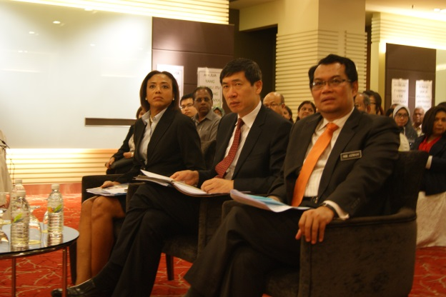
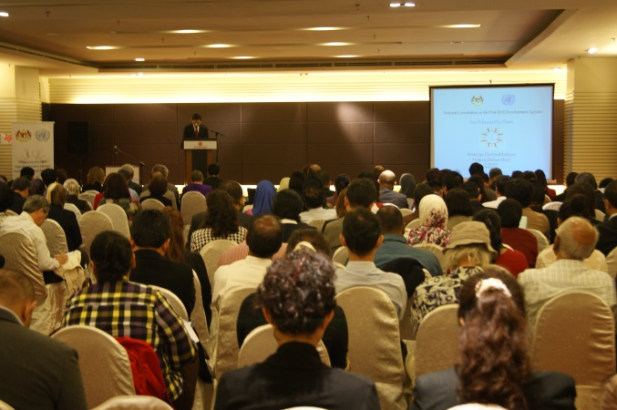
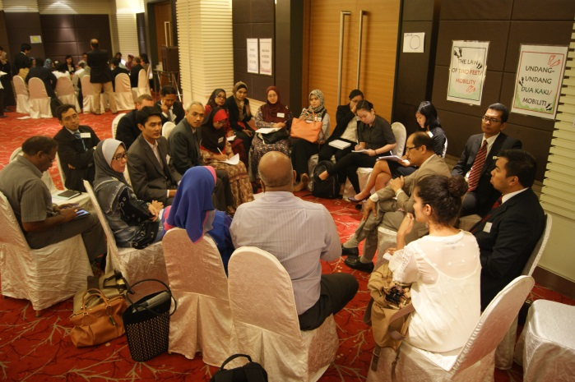
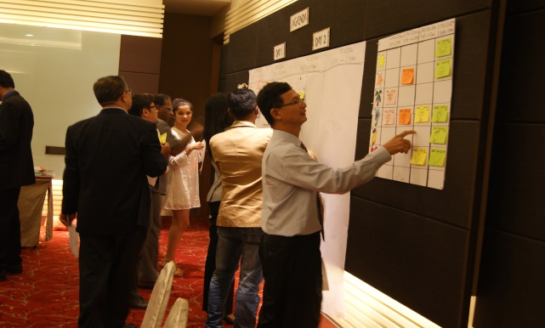
KL (2&3 July)
Mr. Haoliang Xu, Assistant Secretary-General, UN, Chair of Regional UNDG Asia-Pacific, Assistant Administrator, UNDP at the Launch
Participants at the launch of the Post -2015 National Consultation in KL
Participants using the methodology “Open Space Technology” at the consultation.
Workshop in progress

Slide 25
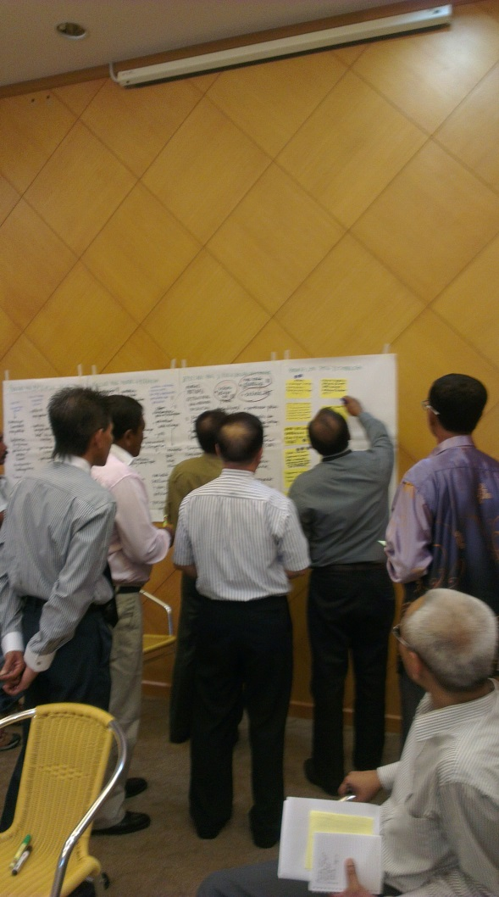
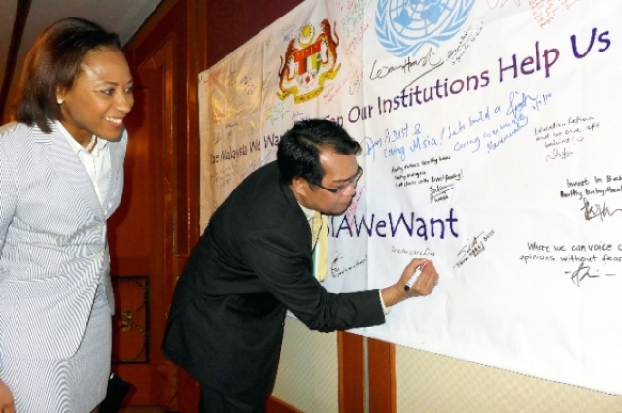
Sarawak (7 & 8 July):
Deputy Director-General (Policy), EPU, signing the “MSIAWeWant” campaign at the Sarawak Post-2015 National Consultation, 7-8 July 2014
Participants scheduling the workshops that they will convene

Slide 26
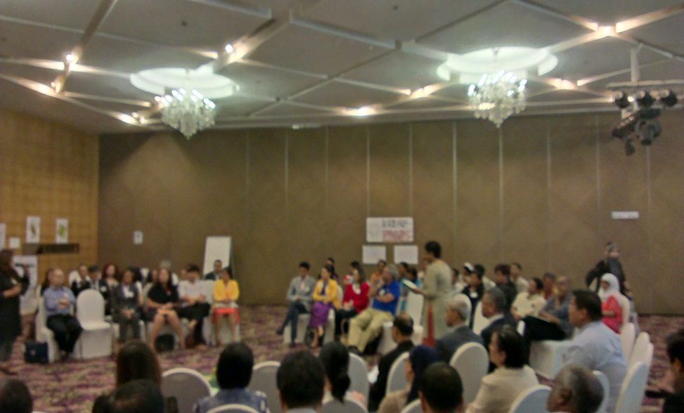
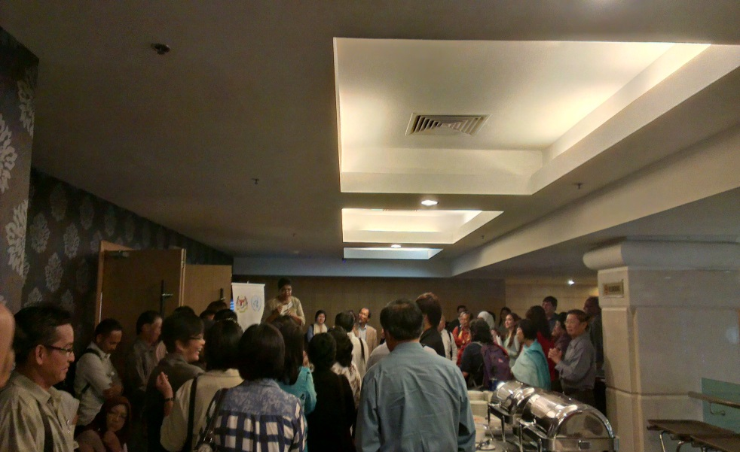
Sabah (14 & 15 July):
Opening Circle
Ice-breaking session

Slide 27
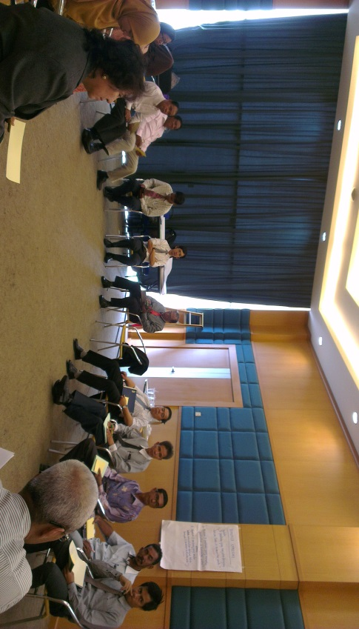
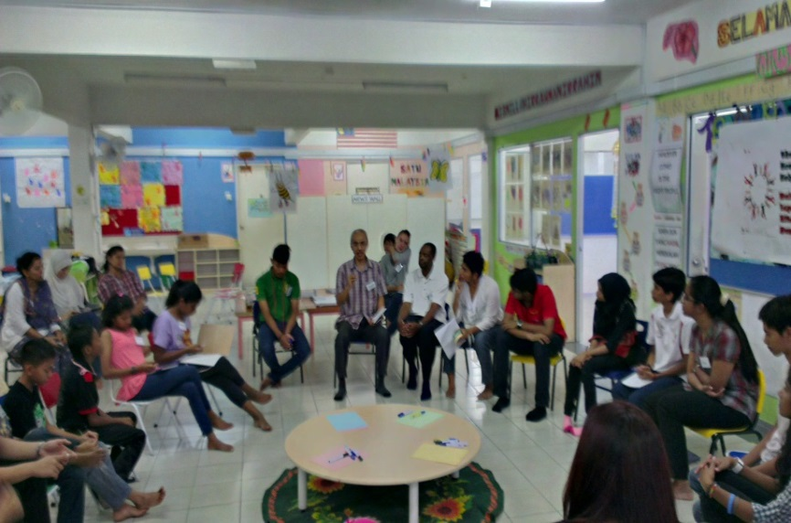
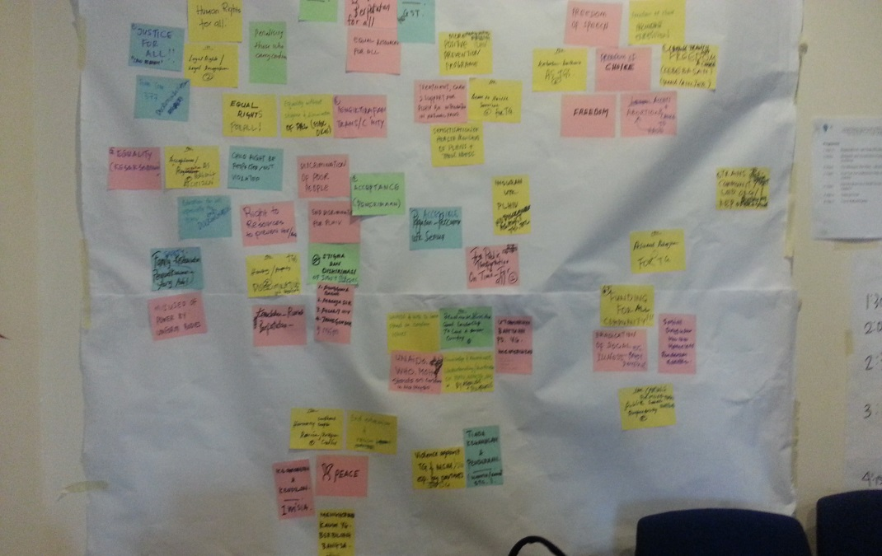
Mini Dialogues
Mini dialogue with Orang Pulau on 16 July 2014
Mini dialogue with Disadvantaged children on 26 July 2014
Mini dialogue with Stakeholders of the Malaysian AIDS Council on 10 July 2014

Slide 28
CONCLUSIONS: SUMMARY POINTS
SDGs: (3P’s): “PEOPLE” – “PLANET” – “PROSPERITY”
SDGs: most comprehensive development agenda – building on the unfinished business and lessons learnt from MDGs
Process: participatory and inclusive – wide range of stakeholders (“old” and “new”)
Importance of integrating SDG goals/targets in National Development Plans
Major challenges in relation to data/evidence
Importance of capacity-development to deliver on SDGs
“Strategic Partnerships” – old and new partners, especially at local/community levels.
Monitoring and Reporting

