Slide 1
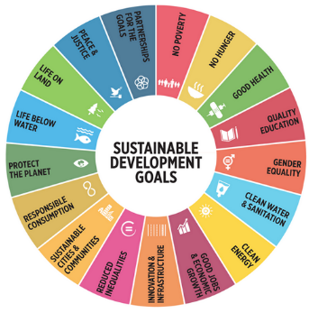
Sustainable development goals (SDG)
The Politics of Public Policy
M.A. in International Development Studies
Faculty of Political Science, Chualongkorn University, Bangkok
Trimester 2, 2016-2017
VICTOR P. KARUNAN, Ph.D.

Slide 2
Lecture 2 Monday 16 January 2017
THE SDGs – OVERVIEW OF PURPOSE, GOALS AND TARGETS

Slide 3
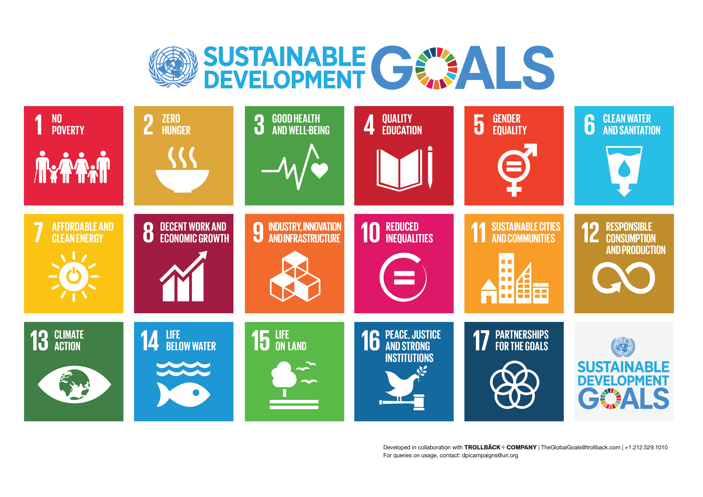

Slide 4
Difference – MDG & SDG
The SDG agenda is fundamentally different to the MDGs
Targets are universal and closely interconnected
Global goals and targets are ‘aspirational’. Individual countries expected to adapt and apply according to context
169 targets, 99 relate to outcomes, 70 relate to means of implementation
This implies a large number of global indicators (over 130)
Calls for significant investment in national capacity for data collection and analysis
Calls for cross-sectoral collaboration – especially among government agencies/departments
Calls for wide range of stakeholders involvement and participation in planning, implementation, monitoring and reporting

Slide 5
Context From MDGs to SDGs
MDGs |  | SDGs
8 | Goals | 17
18 | Targets | 169
48 | Indicators | 230
Less comprehensive | Scope | Comprehensive
Macro Level Halve Targets | Aspirations | Leave no one behind Zero Targets
Individual Goals | Trade-offs | Interconnected and Indivisible

Slide 6

Agenda 2030 requires one, holistic approach
Agenda 2030
Main Objectives:
Build and improve on the MDGs by integrating the three pillars of development within one framework;
Address inequities within and among countries;
Pursue sustainable and inclusive economic growth;
Combat climate change and loss of biodiversity;
Change consumption and production patterns that are not sustainable;
Recognize how peace and democracy are integral to development.
Sustainable Development Goals
COP 21
(Paris)
World Humanitarian Summit
(Istanbul)
Disaster Risk Reduction
(Sendai)
Financing for Development
(Addis)

Slide 7
VIDEO: sdgS
https://www.youtube.com/watch?v=kR-YRC5D-QY&feature=youtu.be&app=desktop

Slide 8
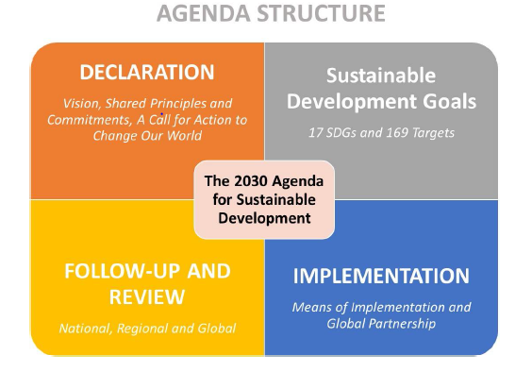

Slide 9
STRUCTURE/FORMAT OF SDGs
I. Preamble and Declaration
II. Goals and Targets
III. Means of Implementation
Includes some elements of Financing for Development Conference
Focus on national strategies & "enabling international economic environment”
IV. Follow-up and Review
Global level through High Level Political Forum, with national and regional review mechanisms
Positive references to: Inclusion and participation, disaggregated data, etc.

Slide 10

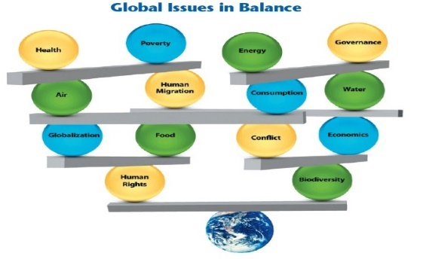
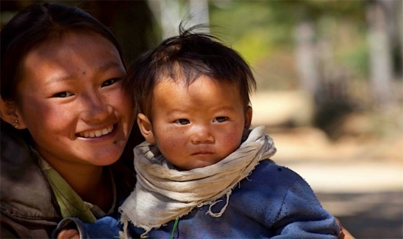

2030 Agenda Principles
UNIVERSALITY
INTEGRATION
‘NO ONE LEFT BEHIND’
Implies that goals and targets are relevant to all governments and actors: integration
Universality does not mean uniformity. It implies differentiation
Policy integration means balancing all three SD dimensions: social, economic growth and environmental protection
An integrated approach implies managing trade-offs and maximizing synergies across targets
The principle of ‘no one left behind’ advocates countries to go beyond averages.
The SDGs should benefit all – eradicating poverty and reducing inequalities.
Promotion and use of disaggregated data is key

Slide 11
moving forward on the SDgs
To create awareness and better understanding on development of SDGs – with Governments, civil society, stakeholders and the general public
Collaboration from all related government agencies is needed in order to ensure the monitoring & measurement of SDGs indicators are on tracks:
Alignment of SDG targets/indicators with national workplans;
Commitment;
Budget Allocation; and
Coordinating Government Agency and mechanisms
National Comprehensive Data Gaps
Gap Study at National level

Slide 12
ENSURING POLICY COHERENCE
Interdependence of goals and targets – needs a holistic approach
Importance of policy coherence – national vs sectoral policies
Recognition of synergies and trade-offs - comparative advantage and risk factors
Agenda requires breaking down silos – multi-stakeholder partnerships – Governments with civil society, private sector, academics, community level groups, etc.

Slide 13
VIDEO: introducing the sdgs – Jeffrey sachs, earth institute
https://www.youtube.com/watch?v=kR-YRC5D-QY&feature=youtu.be&app=desktop

Slide 14
ADDITIONAL READINGS
1. Achieving Diverse Development Goals: How can different goals be pursued together? – IDS Policy Briefing, Issue # 125, September 2016
2. Poverty, Social Exclusion and the MDGs: The Challenge of “Durable Inequalities” in the Asian Context – Naila Kabeer, IDS Bulletin, Vol.37, Number 3, May 2006.

