Slide 1

Sustainable development goals (SDG)
The Politics of Public Policy
M.A. in International Development Studies
Faculty of Political Science, Chualongkorn University, Bangkok
Trimester 2, 2016-2017
VICTOR P. KARUNAN, Ph.D.

Slide 2
LECTURE 3
MONDAY 23 JANUARY 2017
THE SDGs – INDICATORS, MONITORING AND REPORTING

Slide 3
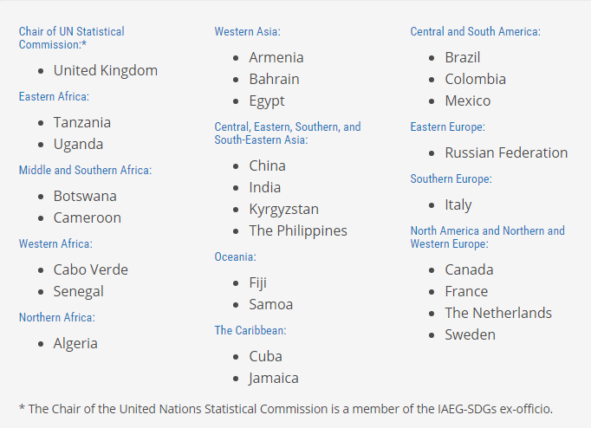
Interagency Group on SDG Indicators
(IAEG-SDG)
Established: May 2015
28 member states representing all regions
150 “observers” – UN agencies, regional commissions, academia, civil society
Co-chairs: Mexico and the Philippines
Secretariat: UN Statistics Division

Slide 4
IAEG-SDG Meetings
June 2015
October 2015
March 2016
New York
Initial list of 300+ indicators compiled by UNSD, with inputs from agencies
Bangkok
Discussion on color-coded indicators – as green, yellow and grey
Result: 159 green and 65 grey indicators
Mexico City
Discussions on compilation of global indicators, establishment of the tier system, disaggregation, methodological work for Tier III indicators
Inputs from IAEG-SDG members and observers
Open consultation with civil society and academia
Regional and country consultations
Consultations on grey indicators and further refinement of green indicators
Preparation of IAEG-SDG Report for UN Statistical Commission (submitted 17 Dec, revised Feb 19)
Tiers and custodian agencies defined for (almost) all indicators

Slide 5
Wide Scope of SDG Indicators
Goal | Indicators
1 Poverty | 9
2 Hunger | 15
3 Health | 25
4 Education | 11
5 Gender | 14
6 Water | 10
7 Energy | 6
8 Economy and Labour | 15
9 Infrastructure and Innovation | 12
10 Inequality | 12
11 Cities | 13
12 SCP | 12
13 Climate Change | 5
14 Oceans | 10
15 Biodiversity | 15
16 Peace and Justice | 21
17 Means of Implementation | 24
TOTAL | 229
Dimensions | Indicators
People | 74
Prosperity | 58
Planet | 52
Peace and Justice | 21
Means of Implementation | 24

Slide 6
DATA ACCESSIBILITY
SDGs Data Management
Inter Agency Expert Group (IAEG)
High Level Group (HLG)
Develop an indicator framework and a list of indicators for the monitoring of the Goals and targets of the post-2015 development agenda at the global level
Representative from South-East Asia: Philippines
Provide strategic leadership for the SDG implementation process as it concerns statistical monitoring and reporting
Representative from South-East Asia: Malaysia
47th Session United Nations Statistical Commission (UNSC)
on 8-11 March 2016.
The UN will review the proposal and submit it to Economic and Social Council (ECOSOC) and General Assembly (GA) for adoption.

Slide 7



ROLE OF NATIONAL STATISTICAL OFFICE
(NSO)
Role of Department of Statistics (DOS)
General
Compilation of Statistics
In SDGs (DOS & Stakeholders)
Coordinate
Dissemination/Statistics Communication
Measure Development Progress
Effectively Participation in National Monitoring Programme
Analysis/
Interpretation
17 GOALS
Support government in development planning & monitoring by providing evidence-based statistics
169 TARGETS
241 INDICATORS
193 Countries

Slide 8
Preliminary Review of Malaysia’s SDGs Indicators
SDGs (229 indicators)
GREEN (149 indicators)
GREY (80 indicators)
Available (76 indicators)
Available (7 indicators)
DOSM
32 indicators
(42%)
Agencies
44 indicators
(58%)
DOSM
4 indicators
(57%)
Agencies
3 indicators
(43%)
Not available and need further development of indicators
(73 indicators)
Not available and need further development of indicators
(73 indicators)
DOSM
6 indicators
(8%)
Agencies
67 indicators
(92%)
DOSM
3 indicators
(4%)
Agencies
70 indicators
(96%)

Slide 9
An assessment of global SDG indicators
Disaggregation of indicators is not specified, unless the indicator specifically calls for disaggregation (“by sex”, “for children” etc)
Only global indicators have been identified so far – countries will re-assess their targets, add indicators; regional and thematic indicators will be identified
Many indicators will need further methodological work – viz, establishing baselines, adjusting household surveys, census data, civil registration systems and administrative data
Some indicators need conceptual clarification and definition – e.g., SDG-4: “life-long learning”.

Slide 10
ISSUES & CHALLENGES AHEAD
… of SDGs indicators compilation to suit the needs of global sustainable development
Coordination
Data limitation
Capacity gaps
Capacity building/
Support needed
Financing
MDGs Lesson Learnt
Better Decision Making
More socio-economic indicators
Big Data
Data collection
& management activity
Requires major investment
More environmental–related indicators
Technology in statistical instrument
Better Targeting
Open Data
Data tapping

Slide 11
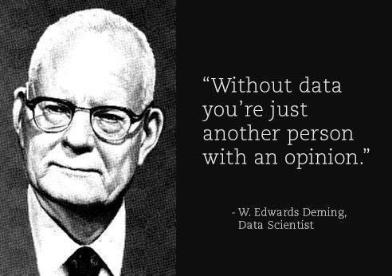

Slide 12
LECTURE 4
MONDAY 30 JANUARY 2017
THE SDGs & NATIONAL DEVELOPMENT AGENDAS – ROLES OF DEVELOPMENT PARTNERS AND STAKEHOLDERS

Slide 13
Recommendations to national governments
Undertake a process to align the SDGs with the National Development Plans including consultations with lead agencies to contextualize the goals and targets.
Utilise the SDGs as a reference and guideline for new policies including revisions to improve policy integration and avoid negative interactions
Organise a periodic National Stakeholder Forum in bringing on board stakeholders from various areas to increase meaningful interaction on a regular basis
Draft an SDGs National Implementation Plan as a plan of action and in preparation for the SDGs follow up and review reporting

Slide 14

Aligning Planning and Budgeting
  Coherence of national plan and SDGs?
  Coherence of sector and sub-national plans?
  Institutional arrangements for horizontal and vertical integration
Integrated Assessments: mapping of SDGs (goals and targets) against national/sub-national priorities (based on the analysis of National Vision Strategy, National Development Plans, Sectoral Plans, Local Development Agendas) to determine the readiness of a country to embark on SDG implementation
Institutional mechanism with vision that:
  Facilitates horizontal and vertical integration and policy coherence
  Balances between sectoral and cross-sectoral actions
  Facilitates appropriate budgeting processes
Learn from the ‘forgotten’ MDGs (those goals/targets that were the least mainstreamed into national or local development strategies/plans

Slide 15
Mainstreaming SDGs at Sub-National and Local Level
 |  |  | Countries
 | Centre macro level | Sub-national/local priorities to inform national SDG Plans/Budgets | Bangladesh; Bhutan
 |  | M&E: Disaggregated data by government tiers/locations | Indonesia
 |  | Central/Local SDG coordination mechanisms (incl. oversight and M&E) | Bangladesh, Bhutan
 | Sub-national and local level | Advocacy and Multi-stakeholder partnerships for SDGs (local governments, deconcentrated units, elected councils, local parliaments, citizens, CSO/NGOs, private sector) | Indonesia
 |  | Clarifying Central/local responsibilities (and resource allocations) | Pakistan
 |  | Defining priorities and local indicators | Indonesia (Regency level)
 |  | Integrating SDGs in sub-national/local development plans and budgets | Philippines; Lao PDR, Indonesia
 |  | Enhancing local fiscal administration (incl. anti-corruption) | PNG; Solomon Islands
 |  | MPs oversight | Mongolia
 |  | Building on existing local civil society partnerships and social monitoring | Maldives
 |  | Using Multi-Dimension Poverty Index for the SDGs at local/urban level | Vietnam; China
 |  | Building Resilience city plans | Mekong region

Slide 16

Integrating 2030 Agenda into Budgets
  Matching planned priorities with expenditures and resources
Results-Based Budgeting
Allocation of fiscal resources along the lines of high-level goals.
Budgeting for Outcomes
Process for defining outcomes that citizen’s want as the first step in budgeting process.
Participatory Budgeting
Involving citizens directly in budgeting process.
Budget Mainstreaming
Integration of specific issue areas into fiscal budgets (e.g. gender; environment).
Sub-national Budgets:
Linking national and sub-national budgets; ensuring budget allocations to sub-national results.

Slide 17



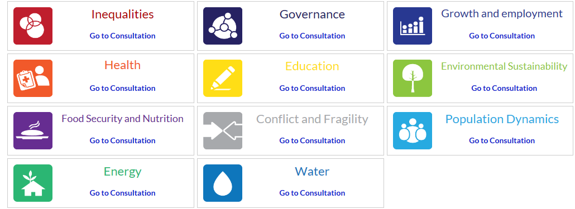

Key players and voices in developing the SDGs
Individuals/Citizens
UN System
Civil Society
Private Sector
Academia
Member States
The Media

Slide 18

Institutional Coherence: MULTI-STAKEHOLDER PARTNERSHIPS
Goals
Knowledge gaps
Governance Jurisdiction
Communication gaps
Stakeholders
Science-Policy Interface
Academic
International (i.e. UN)
Global bodies and networks
Policy
Scientific
Regional (i.e. ASEAN)
Academics
Public-Private Interface
Local Community-Government Interface
Technical
Federal Government
Commercial/ Market
Businesses
State Government
Communities
Local
Local Authority
Social Impacts and benefits
Household

