Slide 1

Sustainable development goals (SDG)
The Politics of Public Policy
M.A. in International Development Studies
Faculty of Political Science, Chualongkorn University, Bangkok
Trimester 2, 2016-2017
VICTOR P. KARUNAN, Ph.D.

Slide 2
LECTURE 4
MONDAY 30 JANUARY 2017
THE SDGs & NATIONAL DEVELOPMENT AGENDAS – ROLES OF DEVELOPMENT PARTNERS AND STAKEHOLDERS

Slide 3
Recommendations to national governments
Undertake a process to align the SDGs with the National Development Plans including consultations with lead agencies to contextualize the goals and targets.
Utilise the SDGs as a reference and guideline for new policies including revisions to improve policy integration and avoid negative interactions
Organise a periodic National Stakeholder Forum in bringing on board stakeholders from various areas to increase meaningful interaction on a regular basis
Draft an SDGs National Implementation Plan as a plan of action and in preparation for the SDGs follow up and review reporting

Slide 4

Aligning Planning and Budgeting
  Coherence of national plan and SDGs?
  Coherence of sector and sub-national plans?
  Institutional arrangements for horizontal and vertical integration
Integrated Assessments: mapping of SDGs (goals and targets) against national/sub-national priorities (based on the analysis of National Vision Strategy, National Development Plans, Sectoral Plans, Local Development Agendas) to determine the readiness of a country to embark on SDG implementation
Institutional mechanism with vision that:
  Facilitates horizontal and vertical integration and policy coherence
  Balances between sectoral and cross-sectoral actions
  Facilitates appropriate budgeting processes
Learn from the ‘forgotten’ MDGs (those goals/targets that were the least mainstreamed into national or local development strategies/plans

Slide 5
Mainstreaming SDGs at Sub-National and Local Level
 |  |  | Countries
 | Centre macro level | Sub-national/local priorities to inform national SDG Plans/Budgets | Bangladesh; Bhutan
 |  | M&E: Disaggregated data by government tiers/locations | Indonesia
 |  | Central/Local SDG coordination mechanisms (incl. oversight and M&E) | Bangladesh, Bhutan
 | Sub-national and local level | Advocacy and Multi-stakeholder partnerships for SDGs (local governments, deconcentrated units, elected councils, local parliaments, citizens, CSO/NGOs, private sector) | Indonesia
 |  | Clarifying Central/local responsibilities (and resource allocations) | Pakistan
 |  | Defining priorities and local indicators | Indonesia (Regency level)
 |  | Integrating SDGs in sub-national/local development plans and budgets | Philippines; Lao PDR, Indonesia
 |  | Enhancing local fiscal administration (incl. anti-corruption) | PNG; Solomon Islands
 |  | MPs oversight | Mongolia
 |  | Building on existing local civil society partnerships and social monitoring | Maldives
 |  | Using Multi-Dimension Poverty Index for the SDGs at local/urban level | Vietnam; China
 |  | Building Resilience city plans | Mekong region

Slide 6

Integrating 2030 Agenda into Budgets
  Matching planned priorities with expenditures and resources
Results-Based Budgeting
Allocation of fiscal resources along the lines of high-level goals.
Budgeting for Outcomes
Process for defining outcomes that citizen’s want as the first step in budgeting process.
Participatory Budgeting
Involving citizens directly in budgeting process.
Budget Mainstreaming
Integration of specific issue areas into fiscal budgets (e.g. gender; environment).
Sub-national Budgets:
Linking national and sub-national budgets; ensuring budget allocations to sub-national results.

Slide 7



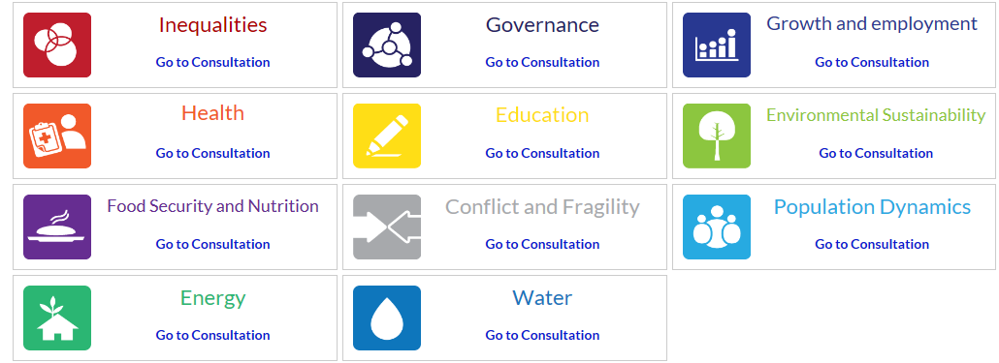

Key players and voices in developing the SDGs
Individuals/Citizens
UN System
Civil Society
Private Sector
Academia
Member States
The Media

Slide 8

Institutional Coherence: MULTI-STAKEHOLDER PARTNERSHIPS
Goals
Knowledge gaps
Governance Jurisdiction
Communication gaps
Stakeholders
Science-Policy Interface
Academic
International (i.e. UN)
Global bodies and networks
Policy
Scientific
Regional (i.e. ASEAN)
Academics
Public-Private Interface
Local Community-Government Interface
Technical
Federal Government
Commercial/ Market
Businesses
State Government
Communities
Local
Local Authority
Social Impacts and benefits
Household

