Slide 1

Sustainable development goals (SDG)
The Politics of Public Policy
M.A. in International Development Studies
Faculty of Political Science, Chualongkorn University, Bangkok
Trimester 2, 2016-2017
VICTOR P. KARUNAN, Ph.D.

Slide 2
LECTURE 5
MONDAY 6 FEBRUARY 2017
SUSTAINABLE DEVELOPMENT – OPPORTUNITIES AND CHALLENGES FOR PUBLIC POLICY

Slide 3
Opportunities and challenges
Importance of localizing at sub-national level vis-à-vis universalization and harmonization of indicators
Consider global agenda as “minimum standard” (benchmarks) and add national priorities
Importance of disaggregating data – by income, age, race, ethnicity, immigration status, disability, etc.
Multi-stakeholder partnerships facilitated development of an integrated list of indicators, more efforts needed to attract private sector
Importance of drawing on a range of data sources – incl. administrative data, experiential, factual and perception based surveys and expert assessments
Source: UNDP, Final Report on illustrative work to pilot governance in the context of the SDGs, 2016.

Slide 4
KEY LOCAL GOVERNANCE CHALLENGES FOR GOVERNMENTS ASIA & PACIFIC
1. Unfinished De-centralisation reforms:
  political, administrative and fiscal de-centralisation in countries in Asia Pacific are uneven and incomplete
  the power of central governments, local governments have little authority to plan, finance and drive local development
2. Poor accountability and awareness of SDGs:
  Limited downward accountability
  Weak demand from citizens for participation and transparency
  Limited interest from private/corporate sector and non-State actors to support SDGs
  3. Data Gaps:
  Disaggregated data not available
  Local governance indicators not used in national planning process

Slide 5
Concluding remarks
SDGs can be used as a tool for transformation to initiate policy and institutional reform
National Readiness – requires strong effort especially meeting higher order of goals to achieve the SDGs unlike the MDGs where meeting basic needs were already a national priority since at least the 1970’s
Implementation Gaps
  Requires strong political commitment and leadership to be effective
  Looking beyond government to include networks and actors that work within the margins and interfaces to catalyse implementation o
  Social mobilisation needs to be understood better in how to get the masses to take ownership of SDGs and sustainable development issues
As a way forward, the SDGs presents an opportunity as a device to link key actors towards the overall sustainable development agenda, including Civil Society Organisations, the Judiciary, Political parties and leaders, and the private sector.

Slide 6
SOME USEFUL RESOURCES

Slide 7
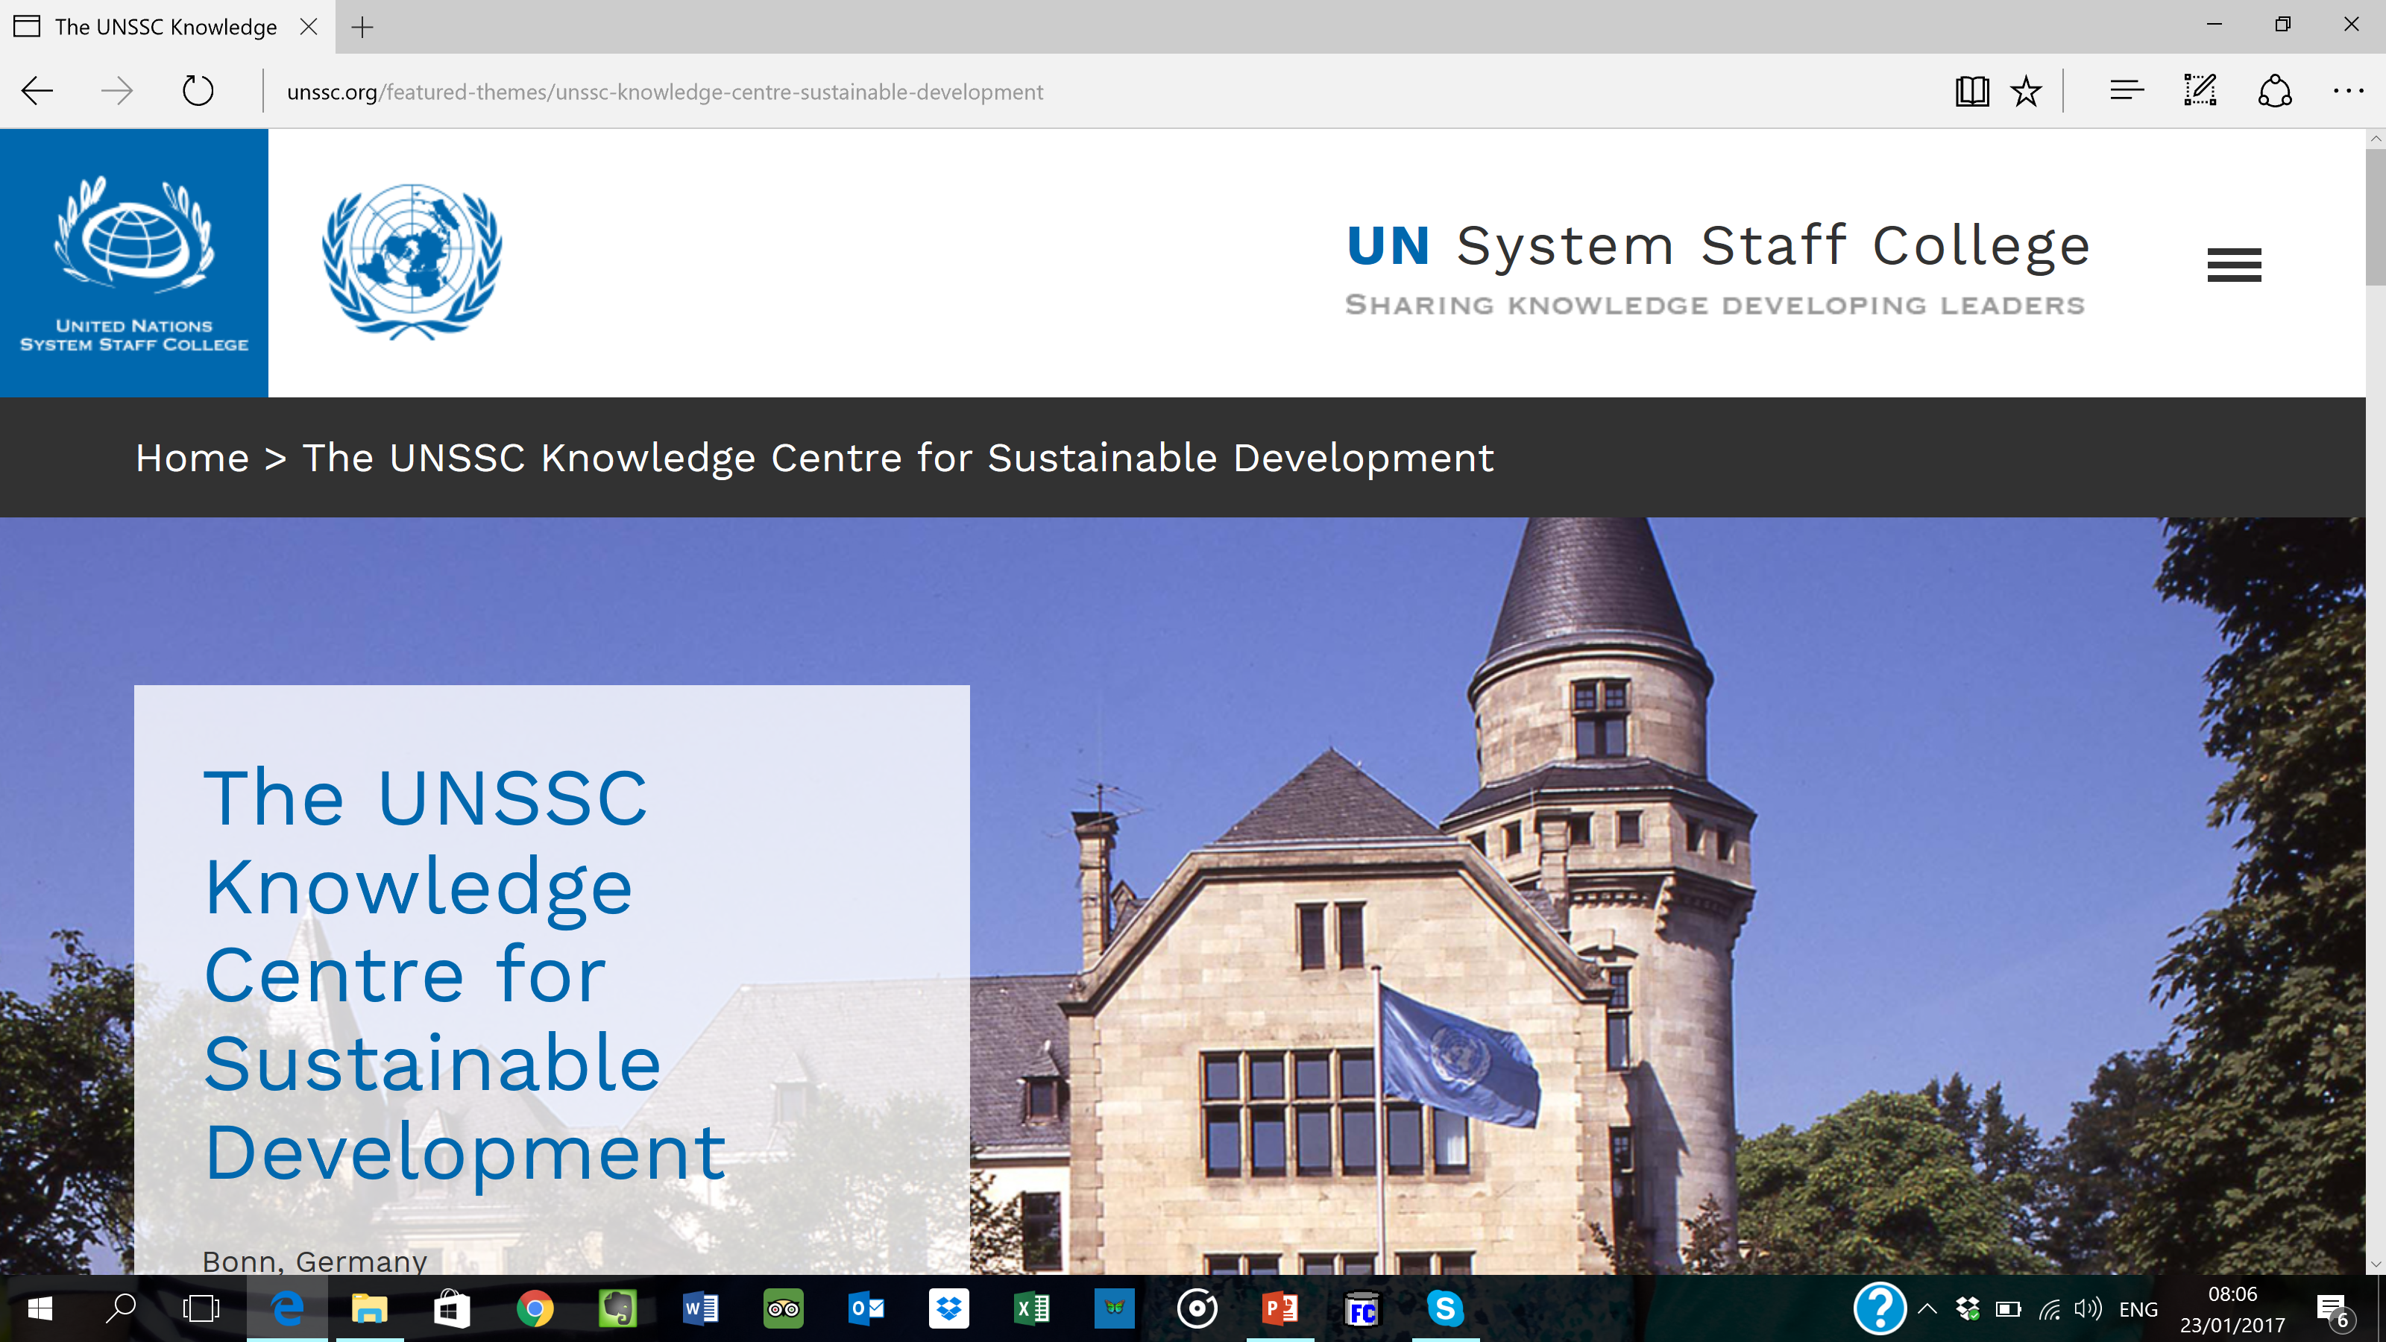

Slide 8
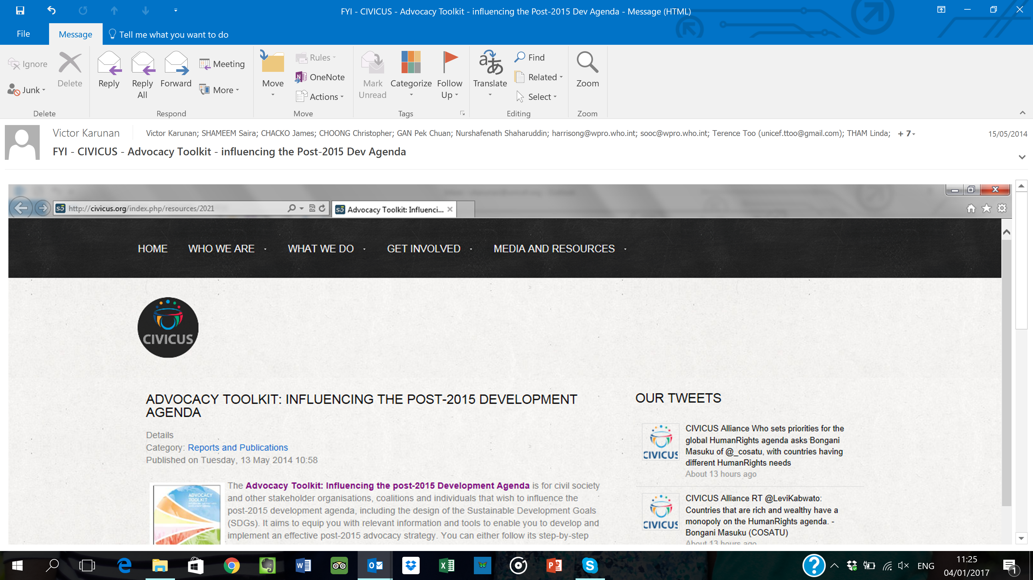

Slide 9
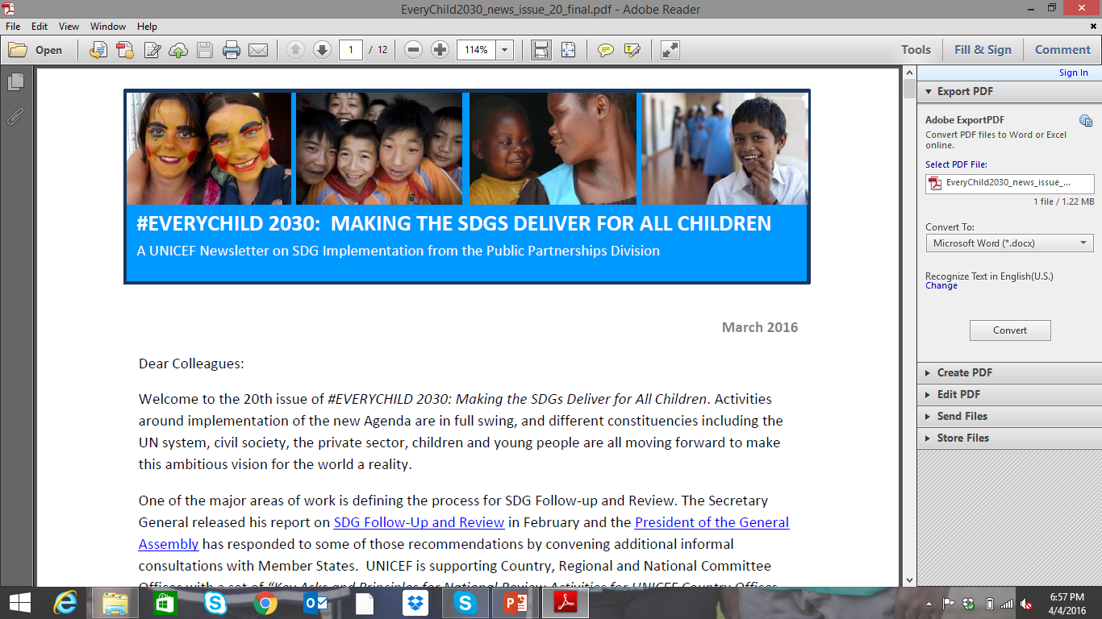

Slide 10
