Slide 1
Main elements of social policy, their interconnections, and how it fits together
Training of Trainers (TOT) - Social Policy and Social Protection
SPRI – SPD/Thammasat University, Bangkok
Dr. Prof. Chris de Neubourg

Slide 2
Social policy some questions ??
What is social policy?
What are the objectives of social policy?
What makes a good society?
Who is responsible?
Who should care about these things?
Is social policy about poverty?
Is social policy about inequality?
Is social policy about economic growth?
Is social policy the same as social protection?

Slide 3
Social Policy
Social policy is about economic growth
Making sure everybody makes good investments in human capital to ensure economic growth
Social Policy is about reducing/alleviating poverty
Making sure that everybody can survive in a decent way
Social Policy is about reducing inequality
Making sure that nobody is left behind

Slide 4
The main instruments of social policy
Taxation
Provision of basic social services: education, health, housing
Provision of social- and labour laws that avoids exploitation, that avoids leaving people behind
Provision of social transfers: contributory and non-contributory = Social Protection

Slide 5
Social Protection: some questions ??
What are the main elements of the social protection system in Bhutan?
What are the main problems of the social protection system in Bhutan?
Who benefits of social protection in Bhutan?

Slide 6
Social policy and protection are more than cash transfers: Social Protection System in Europe: the Life cycle framework
UCA = Universal child allowance
EA = Educational allowance
ILI = Income loss insurance
SA = Social Assistance
CSP = Contributory survivors pension
CP = Contributory pension
UP = universal pension
PP = private pension
UCA, age 0 - 16
EA, age 16 - 24
ILI; SA; CSP, age 24– 60+
UP; CP+CSP; PP; SA
DA for people disabled from birth as well as for those who are permanently or temporarily disabled
Investment in human capital/educational system
Re-training, employment protection, minimum standards, wage
Health, disasters, family protection, care facilities all age groups and handicapped

Slide 7
Social Protection

Slide 8
Social Protection is about having enough resources to survive
During the life cycles there may be periods during which people do not have enough resources
These risks are linked to
Specific periods
Specific events
Crises
Livelihood circumstances

Slide 9
Need for minimum resources for subsistence
Y
Ymin
Yt
age

Slide 10
Linked at investments in human capital over generations
Y
Ymin
Yt
age

Slide 11
Reproduction of inequality
welfare
Time

Slide 12
Subsistence at times of shocks
Y
Ymin
Yt
age

Slide 13
Acute problems of investment in own welfare or in human capital of children
Y
Ymin
Yt
age

Slide 14
Instruments of Social Protection

Slide 15
The Welfare Pentagon
Private
Markets
Social Private
Families
Social networks
Public Social Protection
Membership institutions
Public authorities

Slide 16
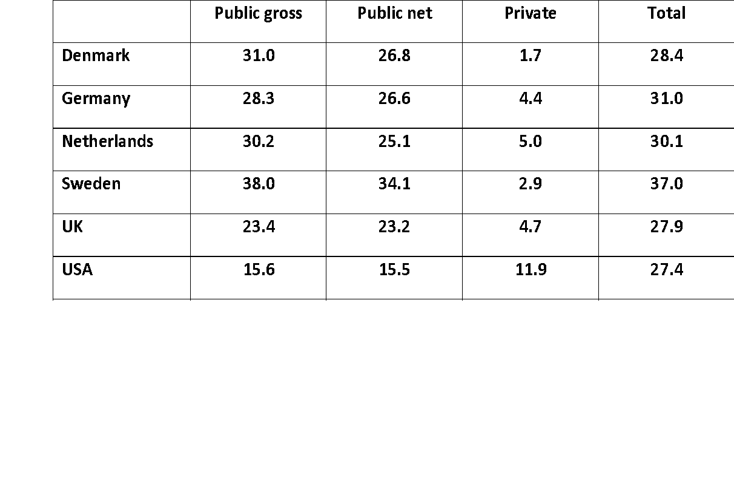
The channels of the welfare pentagon are substitutes Gross and net public and private expenditures for social protection (including health care) as % of GDP

Slide 17
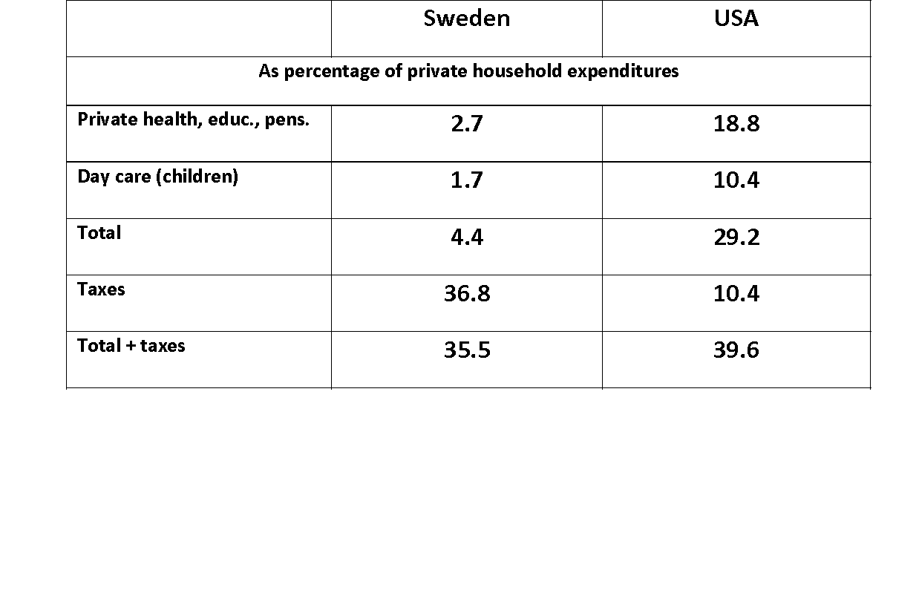
The channels of the welfare pentagon are substitutes Public and private social spending Sweden and the USA

Slide 18
Public Social Protection
Contrary to private social protection, public social protection wants to be:
predictable
Regular
relevant
Linked to (human) rights and legal arrangements
More effective due to risk sharing
Not linked to family and social network privileges

Slide 19
Principal functions of Social Protection interventions
Transformation: assisting families to overcome their vulnerabilities; no poverty traps
Promotion: Helping families to reduce their risks and risk exposure
Prevention: preventing adoption negative risk coping strategies
Survival: help to overcome crisis

Slide 20
Main objective of social protection =
Changing the income distribution to eradicate poverty
Investing in human capital in order to change the productivity distribution

Slide 21
Reproduction of inequality
Welfare
Time

Slide 22
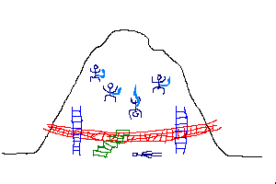
Social Policy Instruments

Slide 23
Social protection toolbox
Social Transfers: in cash, in kind, in assistance, in vouchers
Social Insurance: contributvef, risk sharing
Health coverage,
Old age pensions, …
Social Services
Regulation and legislation

Slide 24
Social protection toolbox 2
For whom?
Universal (or categoric)
Targeted: for specific groups in function of the characteristics of the groups
Conditionnal or not? Only provided to those people who respect certain behaviourial conditions (sending children to school, for health checks, participation in education, public works

Slide 25
Main principle of social protection SYSTEM
Principle r 1 : taking life cycle into consideration
Principle 2 : taking vulneranbilitym poverty,risk management and main objectives of social protection into consideration
Principle 3 : Systemic approach

Slide 26
Main principle of social protection SYSTEM 2
Principle r 4 : pragmatic – limitations and constraints
Principle 5 : Human rights based
Principle 6 : settings priorities but having a universalist goal
Principle 7: paying attention to investments and long term effects

Slide 27
Conceptualization of social protection
World Bank (2001):
“interventions that assist poor individuals, households and communities to reduce their vulnerability by managing risks better”
African Union (2008)
SP include … the pursuit of an integrated policy approach with a strong developmental focus, such as job creation, equitable and accessible health and other services, social welfare, quality education and so on”
(Government of Mali, 2002)
“a collective system (state or private) for managing risks (unemployment , old age, extreme or chronic poverty) faced by individuals”

Slide 28
Conceptualizations of social protection
Benin (2002)
“social protection comprises all systems and measures that provide social assistance and various social services to the different social and professional groups”
Tanzania (2008)
“traditional family and community support structures, and interventions by state and non-state actors that support individuals, households and communities to prevent, manage, and overcome the risks.

Slide 29
Social protection
Social Protection 🡪 All income transfers (or benefits) in kind and in cash that a society affords to its individual members in order to:
avoid or alleviate poverty; or
assist them in coping with a series of life contingencies or risks which, if they occurred, might otherwise lead to a loss of income (losing one’s job, losing one’s earnings capacity through invalidity or old age, having to obtain expensive medical care in the event of illness or impairment); or
reduce or correct inequalities created through the primary (pre-transfer) income distribution.

Slide 30
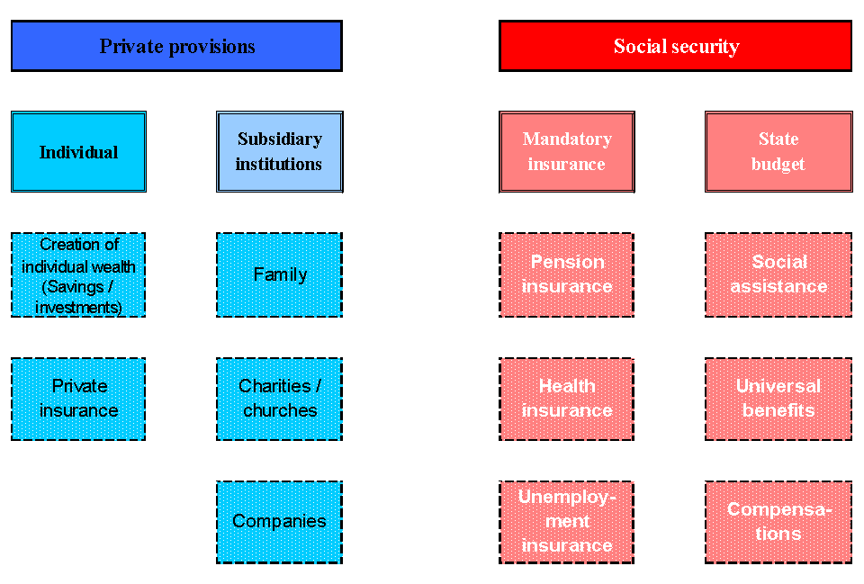
A very general picture of SP

Slide 31
Concepts

Slide 32
Concepts: Contingencies
Contingencies: events that might or might not occur (having an accident or winning the lottery, for example).

Slide 33
Concepts: Risks
Risks: contingencies that are perceived as having a negative effect on individuals, groups or societies or even more complex entities, such as the environment.
1. Sickness/Health care
2. Disability
3. Old age
4. Survivors
5. Family/children
6. Unemployment
7. Housing
8. Social exclusion not elsewhere classified.

Slide 34
Concepts: Risks
Insurable risk: a certain risk with a known probability of occurrence (can be calculated) and with big potential damage.
Risk exposure: You are exposed to a risk if a certain event can occur and affect you with a certain degree of probability

Slide 35
Concepts: Vulnerability
Vulnerability: You are vulnerable to a certain risk if you have no means of coping with the consequences of that risk once it has occurred

Slide 36
Concepts: Social Security
Social protection makes you less vulnerable to the financial consequences should the risks materialize. It provides some social security.

Slide 37
Social risk management
The whole portfolio of strategies and arrangements ranging from risk reduction, avoidance or prevention to risk mitigation and risk coping, and consisting of informal arrangements of the individual or the family, market-based arrangements and public provisions (WB)

Slide 38
Social risk management sequence
risk identification 🡪
risk prevention or risk reduction 🡪
risk mitigation 🡪
risk coping

Slide 39
In the narrow definition used here, social protection is not concerned with the avoidance or reduction of risks
Instead, it focuses on helping societies to organize the financing of the mechanisms that help people to mitigate or cope with risks.

Slide 40
Social protection in economic and financial terms
Set of measures that a society employs to give its members some form of income security.
Limited to measures that can be characterized as transfers of income (also known as benefits) in cash or in kind.
Transfers can be formal or informal
These measures necessarily have a profound impact on income distribution in the country

Slide 41
Insurance benefits as income transfers
The difference between insurance benefits and universal unconditional transfers (benefits) or targeted means-tested transfers is simply the legal nature of entitlements (i.e. being entitled to benefits as a contributor, a resident, or a resident fulfilling a certain targeting condition, for example poverty)
Also, this difference has cultural/values roots (a separate lecture is coming)

Slide 42
Social Protection through Social Transfers

Slide 43
Social transfers
Social (income) transfers reallocate income both within and among households.
Their purpose – which is the other essential element in the definition of social protection as social transfers – is to:
guarantee a minimum level of consumption for people living in poverty or on the threshold of it, or
replace wholly or in part income lost as a result of a certain contingency, or g
achieve a higher level of income equality.

Slide 44
Social transfers
Social transfers transform ethical norms into cash or in-kind income flows, which in turn are translated into (real) consumption levels.
NB. It is not important the amount but what you can buy with that amount.
A society can choose whether to redistribute income:
formally (defined by law or contractual arrangements)
Informally (defined on an ad hoc basis according to traditional or general legal obligations within family units)

Slide 45
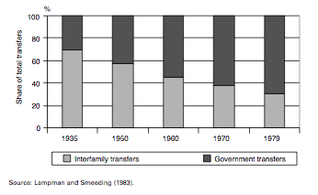
In economic terms, formal and informal transfer systems substitute for each other!
Shift from interfamily to government transfers, United States,%1935–80

Slide 46
Social transfers
Societal values and norms dictate that people in need should receive a certain level of assistance.
Societal preferences, experience and administrative capabilities then determine whether these transfers should be organized formally through established laws or whether they should be left to private initiative.
If it has been decided to formalize a certain kind of transfer, then the scheme has to go through a filter of economic, fiscal and financial affordability as well as a filter of administrative deliverability.

Slide 47
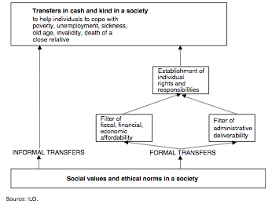
Principal mechanics of the redistributive process
Social protection transforms ethical norms into transfers

Slide 48
Transfer systems
All transfer systems, whether formal or informal, have four components:
financiers;
rules governing entitlements;
an organization operating redistributive flows and/or providers of goods and services; and
Recipients
In formal schemes, all these components must be defined by law or contractual arrangements
In informal schemes, one, two, or all these components are defined adhoc based on traditions or family units

Slide 49
Informal transfers systems
Informal intra-family and intra-community transfers can be broken down into a variety of different types:
child transfers
active-age transfers
old-age transfers
Developing countries have up to 80% of informal social transfer

Slide 50
Risks for Informal Transfers
Family size
Stability of the economic situation
Harvest, weather.
Reliance on family or community norms to receive help (dignity issue)
migration (rural-urban; national, international)
AIDS

Slide 51
Measuring Informal Transfers
The equity in intra-household and intra-community consumption sharing is measured by the level and quality of food consumption
Unequal food distribution in developing countries
More unequal for girls
If educated women in the HH => more equity in distribution of food.

Slide 52
Combining formal and informal transfers
Basic universal pension (as less as 1$/day) paid to the elderly in the family proved to increase children weight and height, and improve their school performance (Namibia, Brazil, South A.)
Formal transfers act as informal agents for social assistance in the HH.
Sound management of the formal transfers is crucial for the success of a combined solution

Slide 53
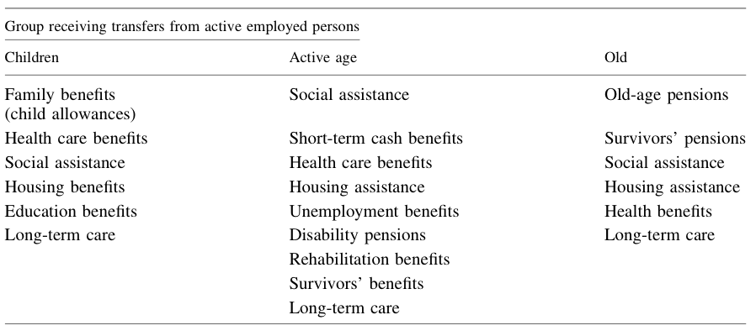
Formal transfers systems
They are all intended to enable the inactive group to consume goods and services either according to need or at a level previously financed by income from employment or self-employment.

Slide 54
Elements of social protection systems
social security schemes: employment-related benefit schemes, such as employment-related pensions, short-term cash benefits, employment injury and unemployment benefits, and perhaps some form of health care benefits
universal social benefit schemes: benefit schemes for all citizens, including tax-financed family benefits and health care benefits
social assistance schemes: poverty alleviation systems for citizens and residents in special need
supplementary benefit schemes: as stipulated in collective or community- based agreements or individual contracts mandated by law, usually operated by co-operative or private sector entities

Slide 55
Social protection institutions
A social protection scheme is a distinct body of rules, supported by one or more institutional units, governing the provision and financing of social protection transfers.
The institutions usually involved are:
social insurance schemes
central, state or local governments
autonomous and self-administered pension funds
insurance companies
mutual-benefit (insurance) societies
public and private employers
private welfare
assistance institutions
All of these institutions make the National Social Protection System (NSPS)

