Slide 1
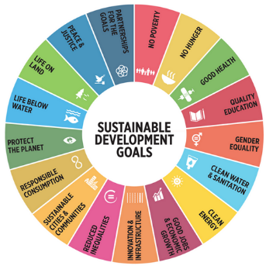
SUSTAINABLE DEVELOPMENT GOALS (SDG) IN THE ASIA PACIFC REGION
Presentation – VICTOR P. KARUNAN, Ph.D.
Peace Studies and Conflict Transformation
Celebrating Diversity for Peace and Solidarity
International Institute of Peace and Development Studies – IIPDS
Asian Resource Foundation – ARF
Bangkok
Friday 10 February 2017

Slide 2
PRESENTATION OUTLINE
Overview and Introduction
The MDGs and the Post-2015 Development Agenda – Unfinished Business and Lessons Learnt
The SDGs – Overview of Purpose, Goals and Targets
The SDGs – Indicators, Monitoring and Reporting
The SDGs and National Development Agendas – Roles of Development Partners and Stakeholders
Sustainable Development – Opportunities and Challenges for Governments in the Asia Pacific region

Slide 3
OVERVIEW & INTRODUCTION
SDGs – the most comprehensive and holistic development approach adopted by the United Nations
SDGs – developed through a global participatory and inclusive process involving a wide range of partners and stakeholders (Post-2015 Development Consultations and Expert Groups)
SDGs – building on the unfinished business and lessons learnt in implementation and reporting on the MDGs over the past decade
National Development Agendas – influenced and aligned to the SDGs

Slide 4








MILLENNIUM DEVELOPMENT GOALS
MDG 1: Eradicate extreme poverty & hunger
3 targets; 9 indicators
MDG 5: Reduce maternal mortality
2 targets; 6 indicators
MDG 2: Achieve universal primary education
1 target; 3 indicators
MDG 6: Combat HIV/AIDS, malaria and other diseases
3 targets; 9 indicators
MDG 3: Promote gender equality & empower women
1 target; 3 indicators
MDG 7: Ensure environmental sustainability
4 targets; 10 indicators
MDG 4: Reduce child mortality
1 target; 3 indicators
MDG 8: Develop a Global Partnership for Development
7 targets; 7 indicators

Slide 5
MDGS – UNFINISHED BUSINESS & LESSONS LEARNT
Gender Inequality persists
Big gaps exist between the poorest and the richest households, and between rural and urban areas
Climate change and environmental degradation undermine progress achieved, and the poor people suffer the most
Conflict remains the biggest threat to human development
Millions of poor people still live in poverty and hunger, without access to basic services
Progress uneven across goals; within and across countries and regions.
Formulation of targets:
  Some targets, for instance, may not have adequately taken into account country demographic change and the magnitude of certain social issues.
  Globally set targets with limited consideration for national circumstances and differences in initial conditions.
  Did not take into account vulnerability to natural hazards and other external shocks.
  Did not adequately address cross-cutting issues.

Slide 6
POST-2015: THE UNFINISHED BUSINESS
Quality of development
Gender empowerment
Inclusiveness
Environment
Improving the quality of growth, recognizing multi-dimensionality of development
Stereotyped gender roles that continue to exist & have implications for other development achievements
A targeted & focused approach to assist pockets of development needs that remain
Pursuing sustainable consumption and development
Moving beyond basic needs; Focus on cost-effective outcomes
A strategic relook at the social protection system, bearing in mind that a multi-dimensional approach is needed
Gender empowerment that improves overall welfare of men and women
Green growth strategies and better management of natural resources

Slide 7
KEY ISSUES – NOT ADDRESSED IN MDGS
    Social protection
    Productive employment
    Inequalities
    Violence against women
    Social exclusion
    Biodiversity
    Persistent malnutrition
    Increase in non-communicable diseases
    Reproductive health and complexities related to demographic dynamics,
    Peace and security
    Governance
    Rule of law
    Human Rights

Slide 8
THE POST-2015 DEVELOPMENT AGENDA PROCESS
A process initiated by the UN to help define the next set of development goals, to succeed the eight Millennium Development Goals (MDGs), which will end in December, 2015.
The MDGs were established following the Millennium Summit in 2000.
During the High Level Plenary Meeting of the UN General Assembly in 2010, governments called for accelerating progress of the MDGs and for thinking on ways to advance the development agenda beyond 2015.
Following this, the UN Secretary General initiated a number of initiatives.

Slide 9
POST-2015 DEVELOPMENT AGENDA INITIATIVES BY UNSG
UN System Task Team
High Level Panel of Eminent Persons
Est:
July, 2012
11 Global Thematic & National Consultations in 88 Countries
2012- 2013
2nd Round of Post-2015 Consultations
April ‘14 – April ‘15

Slide 10
POST-2015 DEVELOPMENT AGENDA REPORTS/OUTPUTS TO DATE
  Report: “Realizing the Future We Want for All” (June, 2012)
    Serves as input to the work of the High Level Panel
UN System Task Team
  Report: “A New Global Partnership: Eradicate Poverty and Transform Economies through Sustainable Development” (May, 2013)
    Consideration of the findings of national and thematic consultations at regional and national levels
High Level Panel
  Report: “A Million Voices: The World We Want” (Sept 2013) – based on perspectives of over 1 million people collected by the UNDG
    Crowdsourcing for inputs, via meetings and conferences, online discussions, and larger public debates
Thematic Global & National Consultations

Slide 11
2ND ROUND OF POST-2015 CONSULTATIONS – FACILITATED BY UNDG
The dialogues will run from April 2014 –April 2015
These will be a series of public meetings and on-line discussions where policy planners, civil society representatives, academics, community and private sector leaders can discuss how to best deliver the next sustainable development agenda that will build on the success of the Millennium Development Goals (MDG).
Dialogues on Implementation will explore six themes:
  Localizing the post-2015 agenda
  Helping to Strengthen Capacities and Build Effective Institutions
  Participatory Monitoring for Accountability
  Partnerships with Civil Society
  Engaging with the Private Sector
  Culture and Development

Slide 12

THEME OF THE NATIONAL CONSULTATIONS
Malaysia We Want:
How can our institutions help us deliver this?
Malaysia Yang Kita Mahu:
Bagaimanakah institusi kita
boleh membantu kita mencapai matlamat ini?

Slide 13
OVERALL GOALS & OBJECTIVES
TO IDENTIFY EMERGING PRIORITIES
UNFINISHED BUSINESS
CHALLENGES & GAPS IN ACHIEVING REMAINING MDG TARGETS
RECOMMENDA-TIONS FOR FUTURE DEVELOPMENT POST-2015

Slide 14
Proposed Theme of National Consultations
The Malaysia We Want: How can our institutions help us deliver this?

Slide 15



Slide 16
WorldWeWant Survey – Global Votes (2.3 million)
Top Priorities:
Good Education
Better Healthcare
Honest & Responsive Government
Better job opportunities
Access to clean water & sanitation
Affordable & nutritious food

Slide 17
WorldWeWant Survey – Malaysian Votes (3,000)
Top Priorities:
Good Education
Honest & Responsive Government
Protection against crime & violence
Better Healthcare
Protecting forests, rivers and oceans
Freedom from discrimination and persecution

Slide 18


Slide 19
DIFFERENCE – MDG & SDG
The SDG agenda is fundamentally different to the MDGs
  Targets are universal and closely interconnected
  Global goals and targets are ‘aspirational’. Individual countries expected to adapt and apply according to context
  169 targets, 99 relate to outcomes, 70 relate to means of implementation
  This implies a large number of global indicators (100-300)
  Calls for significant investment in national capacity for data collection and analysis

Slide 20
AGENDA 2030 REQUIRES ONE, HOLISTIC APPROACH
Agenda 2030
Main Objectives:
  Build and improve on the MDGs by integrating the three pillars of development within one framework;
  Address inequities within and among countries;
  Pursue sustainable and inclusive economic growth;
  Combat climate change and loss of biodiversity;
  Change consumption and production patterns that are not sustainable;
  Recognize how peace and democracy are integral to development.
Sustainable Development Goals
Disaster Risk Reduction
(Sendai)
Financing for Development
(Addis)
World Humanitarian Summit
(Istanbul)
COP 21
(Paris)

Slide 21
STRUCTURE/FORMAT OF SDGS
I. Preamble and Declaration
II. Goals and Targets
III. Means of Implementation
  Includes some elements of Financing for Development Conference
  Focus on national strategies & "enabling international economic environment”
IV. Follow-up and Review
  Global level through High Level Political Forum, with national and regional review mechanisms
  Positive references to: Inclusion and participation, disaggregated data, etc.

Slide 22

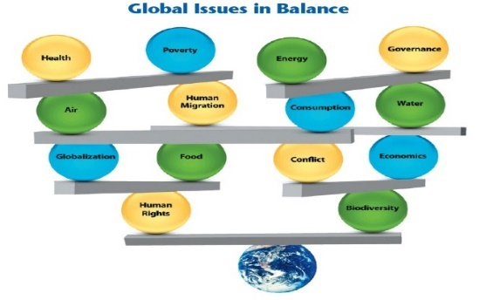


2030 Agenda Principles
UNIVERSALITY
INTEGRATION
‘NO ONE LEFT BEHIND’
Implies that goals and targets are relevant to all governments and actors: integration
Universality does not mean uniformity. It implies differentiation
Policy integration means balancing all three SD dimensions: social, economic growth and environmental protection
An integrated approach implies managing trade-offs and maximizing synergies across targets
The principle of ‘no one left behind’ advocates countries to go beyond averages.
The SDGs should benefit all – eradicating poverty and reducing inequalities.
Promotion and use of disaggregated data is key

Slide 23
CONTEXT
FROM MDGS TO SDGS
MDGs |  | SDGs
8 | Goals | 17
18 | Targets | 169
48 | Indicators | 230
Less comprehensive | Scope | Comprehensive
Macro Level Halve Targets | Aspirations | Leave no one behind Zero Targets
Individual Goals | Trade-offs | Interconnected and Indivisible

Slide 24
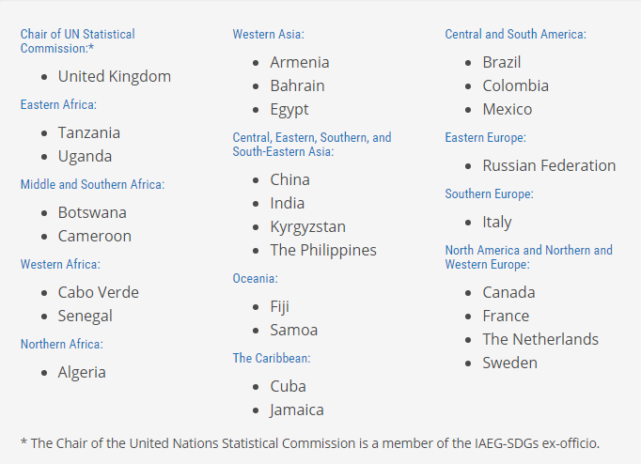
Interagency Group on SDG Indicators
(IAEG-SDG)
Established: May 2015
28 member states representing all regions
150 “observers” – UN agencies, regional commissions, academia, civil society
Co-chairs: Mexico and the Philippines
Secretariat: UN Statistics Division

Slide 25
IAEG-SDG Meetings
June 2015
October 2015
March 2016
New York
Initial list of 300+ indicators compiled by UNSD, with inputs from agencies
Bangkok
Discussion on color-coded indicators – as green, yellow and grey
Result: 159 green and 65 grey indicators
Mexico City
Discussions on compilation of global indicators, establishment of the tier system, disaggregation, methodological work for Tier III indicators
Inputs from IAEG-SDG members and observers
Open consultation with civil society and academia
Regional and country consultations
Consultations on grey indicators and further refinement of green indicators
Preparation of IAEG-SDG Report for UN Statistical Commission (submitted 17 Dec, revised Feb 19)
Tiers and custodian agencies defined for (almost) all indicators

Slide 26
WIDE SCOPE OF SDG INDICATORS
Goal | Indicators
1 Poverty | 9
2 Hunger | 15
3 Health | 25
4 Education | 11
5 Gender | 14
6 Water | 10
7 Energy | 6
8 Economy and Labour | 15
9 Infrastructure and Innovation | 12
10 Inequality | 12
11 Cities | 13
12 SCP | 12
13 Climate Change | 5
14 Oceans | 10
15 Biodiversity | 15
16 Peace and Justice | 21
17 Means of Implementation | 24
TOTAL | 229
Dimensions | Indicators
People | 74
Prosperity | 58
Planet | 52
Peace and Justice | 21
Means of Implementation | 24

Slide 27



ROLE OF NATIONAL STATISTICAL OFFICE
(NSO)
Role of Department of Statistics
General
In SDGs (DOS & Stakeholders)
Compilation of Statistics
Analysis/
Interpretation
Dissemination/Statistics Communication
Coordinate
Measure Development Progress
Effectively Participation in National Monitoring Programme
17 GOALS
Support government in development planning & monitoring by providing evidence-based statistics
169 TARGETS
241 INDICATORS
193 Countries

Slide 28
PRELIMINARY REVIEW OF MALAYSIA’S SDGS INDICATORS
SDGs (229 indicators)
GREEN (149 indicators)
GREY (80 indicators)
Available (76 indicators)
Available (7 indicators)
DOSM
32 indicators
(42%)
Agencies
44 indicators
(58%)
DOSM
4 indicators
(57%)
Agencies
3 indicators
(43%)
Not available and need further development of indicators
(73 indicators)
Not available and need further development of indicators
(73 indicators)
DOSM
6 indicators
(8%)
Agencies
67 indicators
(92%)
DOSM
3 indicators
(4%)
Agencies
70 indicators
(96%)

Slide 29
AN ASSESSMENT OF GLOBAL SDG INDICATORS
Disaggregation of indicators is not specified, unless the indicator specifically calls for disaggregation (“by sex”, “for children” etc)
Only global indicators have been identified so far – countries will re-assess their targets, add indicators; regional and thematic indicators will be identified
Many indicators will need further methodological work – viz, establishing baselines, adjusting household surveys, census data, civil registration systems and administrative data
Some indicators need conceptual clarification and definition – e.g., SDG-4: “life-long learning”.

Slide 30
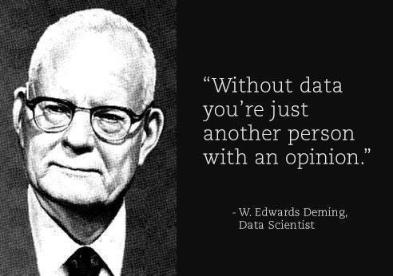

Slide 31
RECOMMENDATIONS TO NATIONAL GOVERNMENTS
Undertake a process to align the SDGs with the National Development Plans including consultations with lead agencies to contextualize the goals and targets.
Utilise the SDGs as a reference and guideline for new policies including revisions to improve policy integration and avoid negative interactions
Organise a periodic National Stakeholder Forum in bringing on board stakeholders from various areas to increase meaningful interaction on a regular basis
Draft an SDGs National Implementation Plan as a plan of action and in preparation for the SDGs follow up and review reporting

Slide 32

Aligning Planning and Budgeting
  Coherence of national plan and SDGs?
  Coherence of sector and sub-national plans?
  Institutional arrangements for horizontal and vertical integration
Integrated Assessments: mapping of SDGs (goals and targets) against national/sub-national priorities (based on the analysis of National Vision Strategy, National Development Plans, Sectoral Plans, Local Development Agendas) to determine the readiness of a country to embark on SDG implementation
Institutional mechanism with vision that:
  Facilitates horizontal and vertical integration and policy coherence
  Balances between sectoral and cross-sectoral actions
  Facilitates appropriate budgeting processes
Learn from the ‘forgotten’ MDGs (those goals/targets that were the least mainstreamed into national or local development strategies/plans

Slide 33
Mainstreaming SDGs at Sub-National and Local Level
 |  |  | Countries
 | Centre macro level | Sub-national/local priorities to inform national SDG Plans/Budgets | Bangladesh; Bhutan
 |  | M&E: Disaggregated data by government tiers/locations | Indonesia
 |  | Central/Local SDG coordination mechanisms (incl. oversight and M&E) | Bangladesh, Bhutan
 | Sub-national and local level | Advocacy and Multi-stakeholder partnerships for SDGs (local governments, deconcentrated units, elected councils, local parliaments, citizens, CSO/NGOs, private sector) | Indonesia
 |  | Clarifying Central/local responsibilities (and resource allocations) | Pakistan
 |  | Defining priorities and local indicators | Indonesia (Regency level)
 |  | Integrating SDGs in sub-national/local development plans and budgets | Philippines; Lao PDR, Indonesia
 |  | Enhancing local fiscal administration (incl. anti-corruption) | PNG; Solomon Islands
 |  | MPs oversight | Mongolia
 |  | Building on existing local civil society partnerships and social monitoring | Maldives
 |  | Using Multi-Dimension Poverty Index for the SDGs at local/urban level | Vietnam; China
 |  | Building Resilience city plans | Mekong region

Slide 34



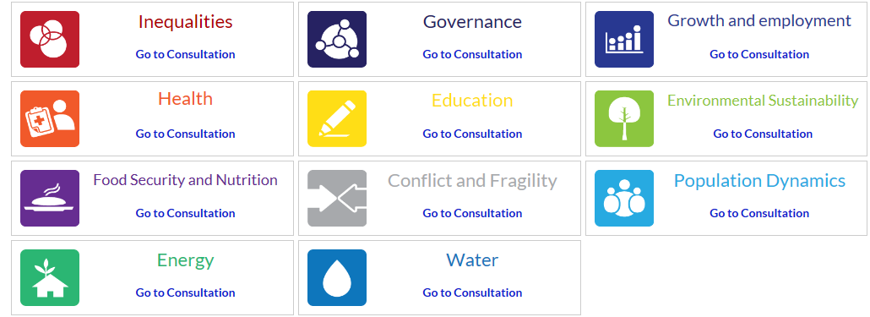

Key players and voices in developing the SDGs
Individuals/Citizens
UN System
Civil Society
Private Sector
Academia
Member States
The Media

Slide 35

INSTITUTIONAL COHERENCE: MULTI-STAKEHOLDER PARTNERSHIPS
Goals
Knowledge gaps
Governance Jurisdiction
Communication gaps
Stakeholders
Science-Policy Interface
Academic
International (i.e. UN)
Global bodies and networks
Policy
Scientific
Regional (i.e. ASEAN)
Academics
Public-Private Interface
Local Community-Government Interface
Technical
Federal Government
Commercial/ Market
Businesses
State Government
Communities
Local
Local Authority
Social Impacts and benefits
Household

Slide 36
OPPORTUNITIES AND CHALLENGES
Importance of localizing at sub-national level vis-à-vis universalization and harmonization of indicators
Consider global agenda as minimum standard and add national priorities
Importance of disaggregating data – by income, age, race, ethnicity, immigration status, disability….
Multi-stakeholder partnerships facilitated development of an integrated list of indicators, more efforts needed to attract private sector
Importance of drawing on a range of data sources – incl. administrative data, experiential, factual and perception based surveys and expert assessments
Source: UNDP, Final Report on illustrative work to pilot governance in the context of the SDGs, 2016.

Slide 37
SUMMARY POINTS
SDGs: (3P’s): “PEOPLE” – “PLANET” – “PROSPERITY”
SDGs: most comprehensive development agenda – building on the unfinished business and lessons learnt from MDGs
Process: participatory and inclusive – wide range of stakeholders (“old” and “new”)
Importance of integrating SDG goals/targets in National Development Plans
Major challenges in relation to data/evidence
Importance of capacity-development to deliver on SDGs
“Strategic Partnerships” – old and new partners, especially at local/community levels.
Monitoring and Reporting – major challenge

Slide 38
KEY LOCAL GOVERNANCE CHALLENGES FOR GOVERNMENTS ASIA & PACIFIC
1. Unfinished De-centralisation reforms:
  political, administrative and fiscal de-centralisation in countries in Asia Pacific are uneven and incomplete
  the power of central governments, local governments have little authority to plan, finance and drive local development
2. Poor accountability and awareness of SDGs:
  Limited downward accountability
  Weak demand from citizens for participation and transparency
  Limited interest from private/corporate sector and non-State actors to support SDGs
  3. Data Gaps:
  Disaggregated data not available, or, not used by planners
  Local governance indicators not used in national planning process

Slide 39
CONCLUDING REMARKS
SDGs can be used as a tool for transformation to initiate policy and institutional reform
National Readiness – requires strong effort especially meeting higher order of goals to achieve the SDGs unlike the MDGs where meeting basic needs were already a national priority since at least the 1970’s
Implementation Gaps
  Requires strong political commitment and leadership to be effective
  Looking beyond government to include networks and actors that work within the margins and interfaces to catalyse implementation o
  Social mobilisation needs to be understood better in how to get the masses to take ownership of SDGs and sustainable development issues
As a way forward, the SDGs presents an opportunity as a device to link key actors towards the overall sustainable development agenda, including Civil Society Organisations, the Judiciary, Political parties and leaders, and the private sector.

Slide 40
SOME USEFUL RESOURCES

Slide 41


Slide 42
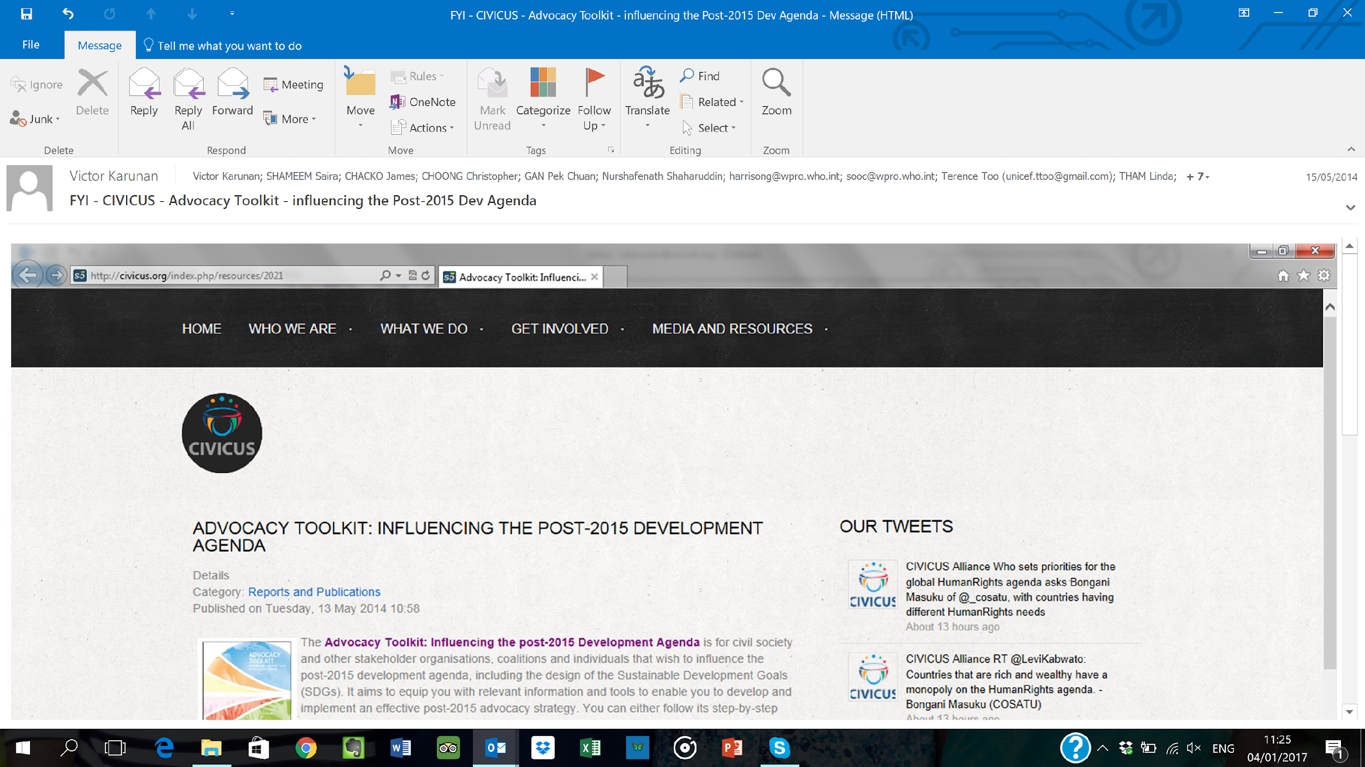

Slide 43
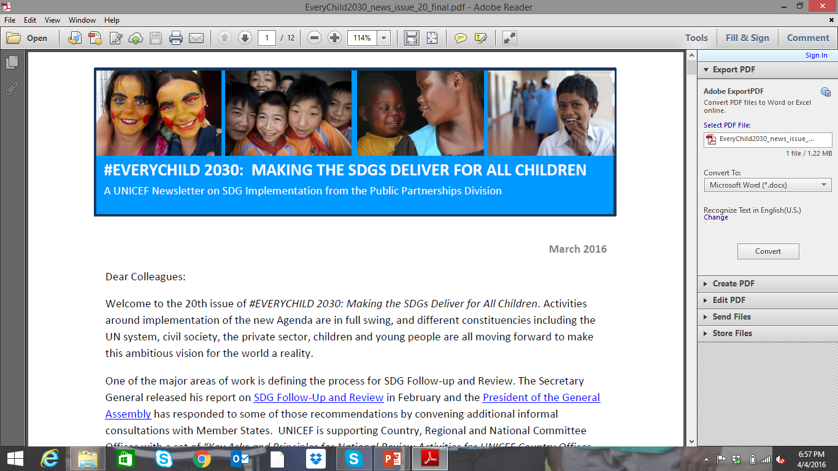

Slide 44
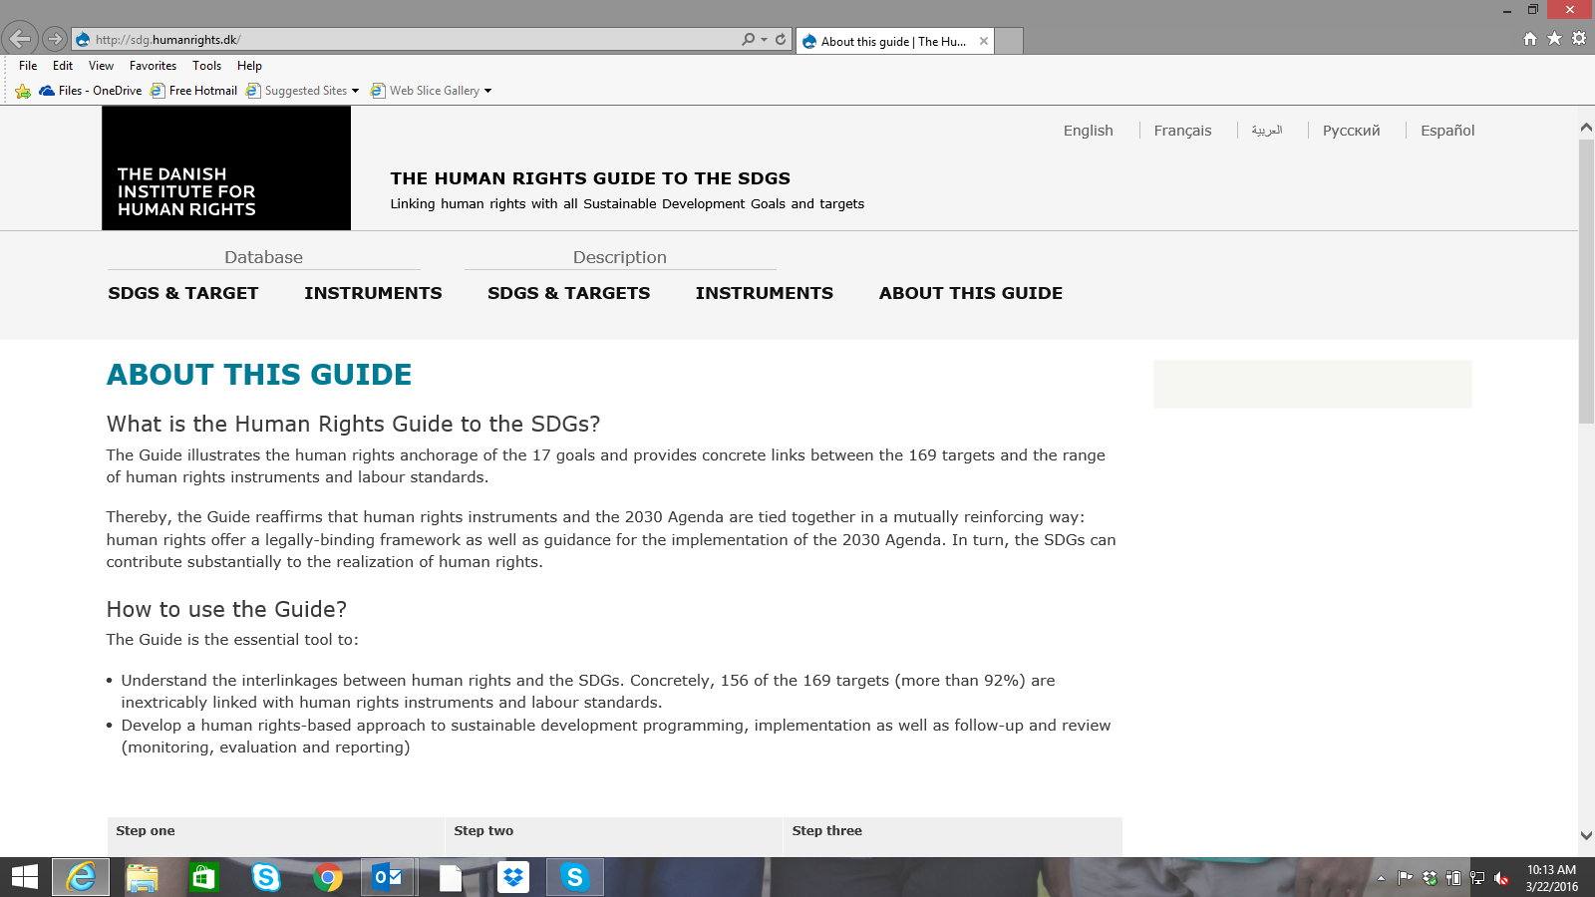

Slide 45
SOME USEFUL RESOURCES ON SDGs
UN SYSTEM STAFF COLLEGE: Knowledge Center on Sustainable Development
http://www.unssc.org/featured-themes/unssc-knowledge-centre-sustainable-development/
2. CIVICUS: Advocacy Toolkit – Influencing the Post-2015 Development Agenda
http://civicus.org/images/stories/SD2015%20Post-2015%20Advocacy%20Toolkit_FINAL.pdf
3. The Danish Institute for Human Rights – The Human Rights Guide to the Sustainable Development Goals – SDGs:
http://sdg.humanrights.dk/
4. Sustainable Development Solutions Network – A Global Initiative for the United Nations:
http://unsdsn.org/

Slide 46
THANK YOU
Q & A

