Slide 1
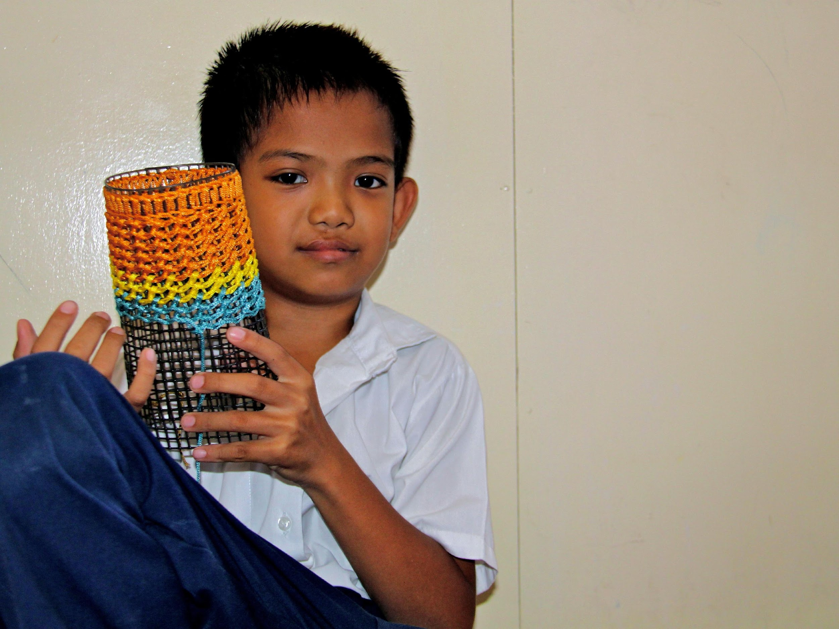
National Consultation
Public Finance for Children – PF4C
MOF-UNICEF Malaysia
26 January 2015

Slide 2
Background to National Consultation
MOF and UNICEF – common purpose to strengthen links between “development” and “operational” spending – as part of the OBB framework in Malaysia
Public Finance for Children – UNICEF’s framework and strategy to promote the rights of children and support Governments to allocate adequate resources for children and deliver them in efficient and effective manner
In the context of the 11th Malaysia Development Plan 2016-2020 and its aspirations of Vision 2020 – it is necessary to take stock, build on the achievements of OBB and identify critical areas that need further advice and support to maximize the results for children in Malaysia.

Slide 3
Purpose/Objectives of Consultation
To identify the achievements of Ministries in implementing OBB and the remaining challenges for effective planning and budgeting for children
Expose Ministry policy and budget officials to experiences in implementing OBB or performance based budgeting from other countries
Familiarise Ministries with potential strategies and tools for enhancing planning and budgeting for children
Develop priorities and a plan of support for OBB rollout and improving results for children

Slide 4
Introduction to Agenda
Building Blocks
Conceptual Overview – MoF & UNICEF
Ministry Presentations – MoH, MWFCD, MoE
Observations/Comments – Discussants
International Experiences in Performance-based Budgeting (PBB) – The Philippines, South Africa and UNICEF Global
Small group work – applying international experiences to Ministry priorities and OBB
Report back
Summary Conclusions and Next Steps – MoF & UNICEF

Slide 5
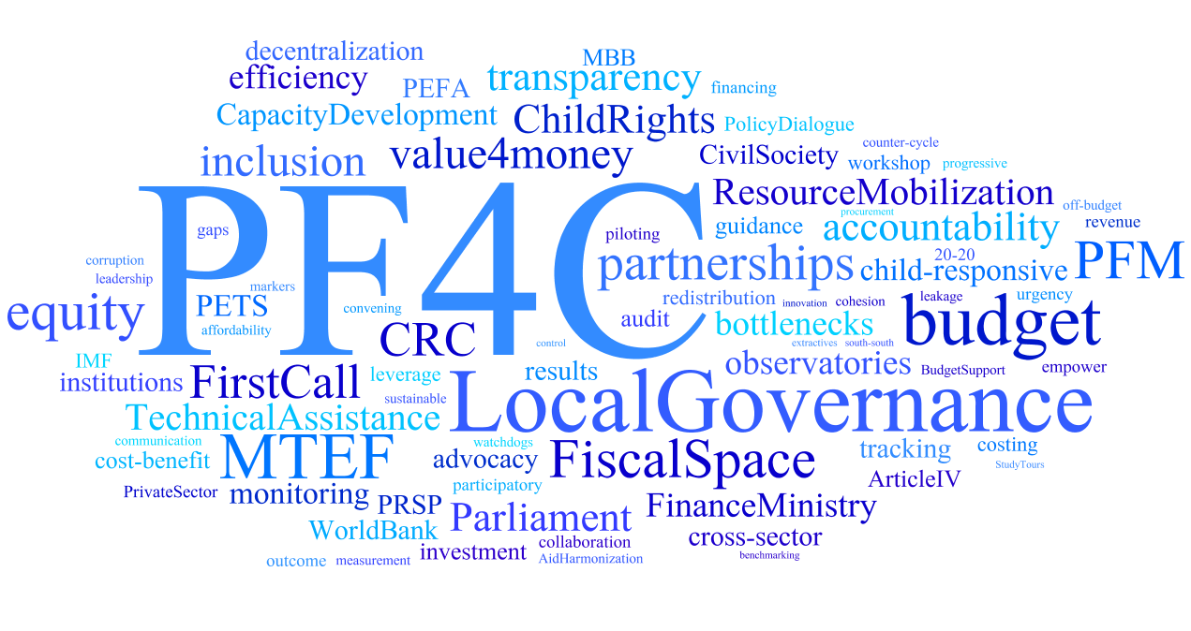

Slide 6
For more information, please contact
Dr. Victor Karunan
Senior Social Policy Specialist
UNICEF Malaysia
Tel: +60-320915191
E-Mail: vkarunan@unicef.org
Cover photo © UNICEF/NYHQ2005-2242/Pirozzi

