Slide 1

Public finance for children in Malaysia: analysis and strategy development
Dr. Victor P. Karunan
Senior Social Policy Specialist
UNICEF MALAYSIA
UNICEF Global Social Policy Meeting
19-22 May 2015, HQ-New York

Slide 2
PF4C study in Malaysia: strategic orientation
Study supported by UNICEF Regional (East Asia and Pacific) and Malaysia UNICEF Country Office
Undertaken with support of MOF Malaysia (documents, facilitating initial appointments, extracts from budget system MIS)
Strategic Orientation:
Malaysia as an upper middle income country
    Lessons learned relevant for development of strategies and approaches for working with MI and HI countries to address persisting child rights challenges (regionally and beyond)
Malaysia Ministry of Finance is well regarded and is an active participant in regional PFM network – PEMNA – Public Expenditure Management Network Asia-Pacific & Asian Development Bank - COP
    Potential for dissemination of PF4C work in Malaysia through regional PFM networks
Previous collaboration with Ministry of Finance on planning and budgeting for children
    Presentations/participation in regional meetings, study tours
Implementation of PFM system reform in Malaysia – Outcome Based Budgeting (OBB)
    Keen interest in adopting performance based budgeting on the part of a number of countries in the region – lessons learned on how to integrate a child-focus into the reforms

Slide 3
PF4C study in Malaysia - 2015:
Specific Objectives
Describe the public budgeting process in Malaysia from the perspective of outcomes for children – highlighting enabling factors and bottlenecks;
Highlight results so far and key lessons learned from the implementation of Outcome Based Budgeting;
Identify strategic points of engagement (technical, advocacy, partnership) for building on the OBB reforms in Malaysia for ensuring that public spending for children in Malaysia is transparent, efficient, equitable and adequate

Slide 4
PF4C study in Malaysia: inputs/data
Review of documentation:
  Reference material on global experience in: Child-focused budgeting; Performance Based Budgeting
  Malaysia documentation: Malaysia Plans (9th, 10th), Strategic Plan MOH, Government Transformation Program Reports; National Audit Reports; Education Blueprint; National Heath Accounts, Profile of Children in Malaysia, Mapping of Social Protection Programmes in Malaysia, Social Sector Budget and Expenditure Review; others
  Budget documentation: National Budgets (various years); Treasury Circulars; reporting formats
  Extract of new OBB MIS (myResults): Selected ministry programs/activities in Health; Education; Women, Family and Community Development
Interviews:
  MOF Budget Office officials including Budget Review Officers who work with implementing ministries in developing budget proposals;
  Policy development officials and program level planners in key program areas in the Ministry of Health; Ministry of Education and Ministry of Women, Family and Community Development;
  Finance unit officials in the same ministries;
  Officials in Economic Planning Unit – Prime Minister’s Department and Public Service Department
  UNICEF and UNDP programme staff

Slide 5
PF4C study in Malaysia: inputs/data (cont.)
National Consultation on Public Finance for Children in Malaysia:
  Cohosted by Malaysia MOF and UNICEF Country Office (26 January 2015)
  Objectives of National Consultation:
    Identify the achievements of ministries in implementing Outcome Based Budgeting (OBB) and the remaining challenges for effective planning and budgeting for children
    Expose ministry policy and budget officials to experiences in implementing OBB or performance based budgeting from other countries
    Familiarize ministries with potential strategies and tools for enhancing planning and budgeting for children Develop priorities and a plan for OBB rollout and improving results for children
  Participants: Ministry of Finance, Economic Planning Unit, Public Service Department; implementing ministries (Education; Health and Women, Family and Community Development), international experts involved in PFM reforms in other countries (South Africa and Philippines) and regional and global UNICEF Social Policy specialists.

Slide 6
PF4C study in Malaysia: inputs/data (cont.)
Follow up
  Follow up meetings with 3 social sector ministries (Health; Education; Women Family and Community Development) to provide inputs into proposed support
  Review of draft findings and proposed support with MOF

Slide 7
Findings
1) The Malaysia PFM system has important features that provide a strong foundation for child-focused planning and budgeting
A formal process for establishing national long term goals and medium term (five-year) development outcomes --- rather than each government entity having a separate process and plan
Most National Outcomes in the five year plans are multisectoral and there is a strong social commitment – including explicit targeting of equity (socio-economic, rural/urban)
Previous budget system reforms established: a program classification of the budget; performance agreements between ministries and MOF; managerial authority in committing resources, and an expenditure review as part of the budget preparation process.
In OBB all ministry priorities (outcomes) are formally linked to national development priorities (National Outcomes) – harnessing government investment to achieve national priorities
The formal vertical linkages also result in horizontal linkages (shared outcomes across programs, activities and ministries) –This cross cutting perspective is especially important for meeting the multidimensional needs of children across the stages of development

Slide 8
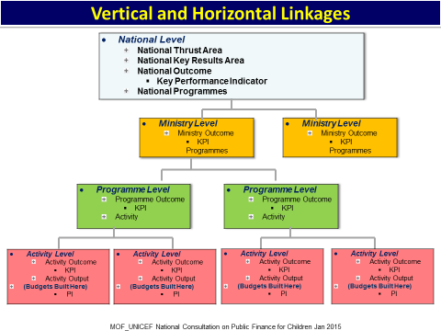
In OBB formal links between all ministry, outcomes, outputs and KPIs to a National Outcome
OBB MIS (myResults)
vertical linkages
The vertical linkages also establish horizontal cross cutting links – including links across ministries
Horizontal cross cutting links Important for planning/budgeting for children (example):
Cross cutting linkages
Poor maternal/child health
Does not participate or low quality ECCD-
Drop out Secondary or poor results
Alienated youth/ risky behaviors/ early pregnancy/ etc.
Household poverty/ deprivation
Poor performance in Primary school
Youth unemployment /low productivity/ lower economic growth – more poverty
Poor physical/ cognitive development -

Slide 9
Findings
2) Individual ministry actions and spending can be evaluated for their coherence with the established national priorities. However the mechanisms to evaluate how the individual ministry investments work together to achieve outcomes – and outcomes for children - are yet to be developed.
Coherence between ministry outcomes, outputs and national priorities can be assessed
Process for assessing how well actions and spending work together (cross cutting) not yet developed. In National Consultation meeting referred to as lack of a “champion” to lead the process
Across all ministries:
child focused actions and spending
Ministry
Program/
Activity
Outcomes,
Outputs
KPIs
11th Malaysia Plan
National Outcome
Within one National Outcome
Outcome
Output
Spending
Outcome
Output
Spending
Outcome
Output
Spending
Outcome
Output
Spending
National Outcome
National Outcome
How do ministry outcomes, outputs, KPIs, spending address multidimensional needs of children?
Are investments and outcomes equitable?
Is there inefficient overlap?
Are there important gaps?
National Outcome
National Outcome
National Outcome
National Outcome
National Outcome
National Outcome
National Outcome
National Outcome
National Outcome

Slide 10
Findings
2) The adoption of OBB will only have an impact on resource allocation over time as the reform process proceeds. Internal implementing ministry policy and strategy priorities provide more immediate short term opportunities to improve resource allocation for children
  Little impact of OBB on resource allocation - not to be expected in just the first year of implementation (2015).
  While outcomes are linked vertically– budgeting is still largely incremental and corresponds to institutional structure
  Lessons from other countries suggest implementation of performance based budgeting reforms is a long term process
  MOF views the immediate challenge in implementing OBB remains 1) improving the prioritization of outcomes and activities in ministry plans and budgets and 2) planning /budgeting for shared outcomes
  Ministries do face pressures to improve efficiency and results– but not directly from OBB implementation
    Internal pressures: strategic plans, proposed new strategies
    External pressures: reviews by other entities (PERs, Audit findings, etc.) : Are resources well targeted? Poor results for investment? etc.
  Supporting these ministry planning and budgeting priorities is an opportunity to improve resource allocation and results for children

Slide 11
Findings
3) The capacity of the system for analyzing spending (including spending for children) is underutilized
The Ministry of Finance summarizes total public sector planned spending in broad categories of General Administration, Economy, Social, Security, and Other Obligations in an introductory section of each year’s budget book. (Social sector spending has averaged about 34% of total public spending since 2010)
The broad “social” category does not provide a means for assessing the coherence of public investment with the critical needs of children like protection; health and nutrition; basic material needs; and developing supportive peer and family relations
The MIS developed for OBB (myResults) facilitates the analysis of spending for children by bringing together ministry outcomes, outputs and KPIs with disaggregated budget information from the government financial management system in one source
The enhanced capacity for spending analysis would enable decision makers to :
      Assess gaps – investment inadequate to meet policy goals
      Identify where spending may be in excess of requirements
      Highlight areas where the relationship between spending and results is poor
      Evaluate the equity of spending
      (others)

Slide 12
Proposed PF4C support/engagement
The proposed UNICEF support and engagement:
  Builds on the strong foundations of the Malaysia PFM system and the OBB reforms: - P4FC support is intended to strengthen existing government policies and processes rather than create additional parallel demands
  Prioritizes inclusion and equity – child rights challenges in Malaysia
  Long-term support (Malaysia UNICEF Country Programme 2015-2020)
  Provided through collaboration and partnership with Ministry of Finance

Slide 13
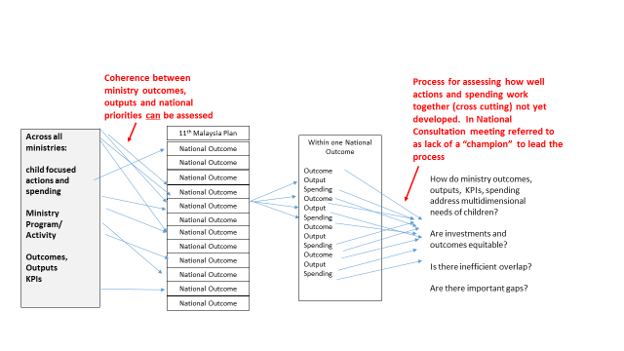
Proposed PF4C support/engagement
1) Piloting a model of cross cutting thematic planning and budgeting for children
Rationale:
While shared outcomes and “boundary partners” are identified in the planning and budgeting process (OBB); the lack of a model for this cross cutting planning and budgeting was highlighted in the National Consultation meeting. The challenge of planning and budgeting for shared outcomes is also recognized by MOF. The multidimensional needs of children require effective cross cutting planning and budgeting
Across programs/activities in ministries and across ministries:
What are the bottlenecks and gaps in support for children?
(carries on the work of Inter Agency Planning Groups)

Slide 14
Proposed PF4C support/engagement
1) Piloting a model of cross cutting thematic planning and budgeting for children (cont.)
Goals:
  Coordinated government actions and efficient, adequate and equitable investment for ensuring the rights of all Children in Malaysia
  A model for managing performance based planning, budgeting and results monitoring for shared outcomes for possible use in other sectors
Partners:
  Ministry of Finance; Economic Planning Unit; Implementing Ministries; Non-Government Partners;
  UNICEF
Process/Milestones (tentative 36 months)
  Develop/adapt framework (alternatives) for mapping GoM support to children.
    Framework draws on existing models (Child Well-Being, CRC, whole child, life cycle, Multiple Overlapping Deprivation Analysis, and others) -

Slide 15
Proposed PF4C support/engagement
1) Piloting a model of cross cutting thematic planning and budgeting for children (cont.)
  Desk exercise mapping GoM support for children against cross cutting thematic framework
    Using facility of OBB MIS (myResults)
  Consultation process -
    Desk exercise mapping reviewed and revised by ministries
    Consultative group identifies:
      Gaps, overlaps, equity concerns
      Technical tasks and support required (examples)
        Targeted evaluation, developing benchmark financial requirements, Public Expenditure Reviews (PER), budget incidence analysis, Public Expenditure Tracking, developing systems for community based reporting, capacity development in planning and budgeting and others as needed.
  Revision of mapping of GoM support for children and ministry program/activities, outcomes, outputs KPIs and budgets (where needed to address gaps, bottlenecks and other constraints identified in the thematic consultation process)

Slide 16
Thematic cross cutting planning and budgeting
Malaysia Child
Well-Being*
1
Develop/adapt a thematic framework
Assess government actions and spending against needs of children
Material well-being
  Poverty
  Living Condition
3
Child focused
Ministry
Program/
Activity from across government ministries
Outcomes,
Outputs
KPIs
Other non program support for households and children (i.e. BR1M)
Annual Spending
Boundary Partners
(source: myResults, ministry documentation)
National Outcomes
11th Malaysia Plan
Collaborative thematic crosscutting planning & budgeting:
Are there gaps? Is there inefficient overlap? Are outcomes the correct outcomes? What are the results – are investments effective? Are actions and spending promoting equity and inclusion? Is spending adequate to meet objectives?
2
Education & Development
  School completion
  Educational Achievement
  Educational and Employment Opportunities
  Access to Early Childhood Care and Education
Map GoM support for children
National Outcome
Outcomes, outputs, KPIs
National Outcome
National Outcome
National Outcome
Health
  Child mortality
  Low birth weight
  Breastfeeding
  Maternal health
  Immunization
  Teenage births
  Reproductive health
  HIV/AIDS
  Obesity
  Smoking
  Injury
  Disability
National Outcome
National Outcome
4
Revising strategies, outcomes, budgets
National Outcome
Revised outcomes, outputs, KPIs
National Outcome
National Outcome
Tools/strategies:
Targeted evaluation, costing/financial impact analysis of unmet needs, Public Expenditure Review, analysis of budget incidence and expenditure tracking (equity), establishment of a system to track spending and results over time
National Outcome
National Outcome
Only possible to assess coherence with National Outcomes..not needs of children
What does thematic assessment of child-focused actions and planning suggest for changes in ministry level activities and spending to improve efficiency and equity?
Subjective well-being
  Subjective health well-being
  Subjective school well-being
Family and peer relationships
  Family relations
  Peer relations
* Example – draft child well-being framework developed with Malaysia partners

Slide 17
Proposed PF4C support/engagement
2) Provide support to near term sectoral ministry needs through collaboration with MOF
  Ministry priorities are typically driven by external reviews (PERs, Audits, etc.) and commitments to policy changes rather than implementation of OBB
  Provide support to sector ministries with MOF as active participant to link support to ministries to overall improvements in child-focus of sectoral planning and budgeting and roll out of OBB
  Incorporate PF4C perspective into other ongoing UNICEF CO support to sectoral ministries (advocacy, communication, policy development – incorporate planning, budgeting and OBB aspects)
  Some possibilities identified through initial consultation:
      Equity in spending for secondary education;
      Targeting of welfare grants;
      Policy reforms in juvenile justice.

Slide 18
Proposed PF4C support/engagement
3) Developing a child spending analysis tool
Rationale:
  The broad category of “social” spending regularly reported by MOF or individual ministry budgets do not provide a means for assessing the coherence of public spending with the multidimensional needs of children across the life cycle stages.
  The development of the OBB MIS (myResults) facilitates the analysis of spending for children by bringing together ministry outcomes, outputs, KPIs and planned spending (imported from GFMAS) in one source. A child spending analysis tool would provide decision makers a means of:
    Assessing gaps – investment inadequate to meet policy goals;
    Identifying where spending may be in excess of requirements;
    Highlighting areas where the relationship between spending and results is poor;
    Evaluating the equity of spending;
    Tracking the impact of policy on spending for children over time

Slide 19
Proposed PF4C support/engagement
3) Developing a child spending analysis tool (cont.)
Goal:
  Elaboration of a child spending analysis tool that reflects child priorities in Malaysia and is based on a methodology developed through consensus with key Malaysia stakeholders.
Objectives:
  A baseline child spending analysis for Malaysia that captures public spending in categories useful for the analysis of efficiency, equity and adequacy in meeting the needs of children (could be government wide and/or sectoral)
  A well-documented methodology (perhaps code for the analysis) for the child spending analysis tool that can be replicated over time to support ongoing tracking of investments for children
Partners:
  Ministry of Finance; Economic Planning Unit; Implementing Ministries; Non-Government Partners;
  UNICEF

Slide 20
Proposed PF4C support/engagement
3) Developing a child spending analysis tool (cont.)
Process/Milestones (tentative 16 months)
Advocacy: presentation of models of child spending analysis to important Malaysia stakeholders
Initial model development - presentation of initial model to key stakeholders and revision based on feedback
Desk exercise- draft child spending analysis (likely several alternatives for discussion)
  Specification of data requirements and structure (primarily myResults and GFMAS)
  Develop draft child spending analysis – also involves meeting/presentation with some ministries to refine the draft model
Formal consultation/feedback with key stakeholders group on initial draft child spending analysis
    Feedback from key stakeholders on attribution decisions and methodology
Finalization of child spending analysis tool and methodology
Documentation of methodology and analysis

Slide 21
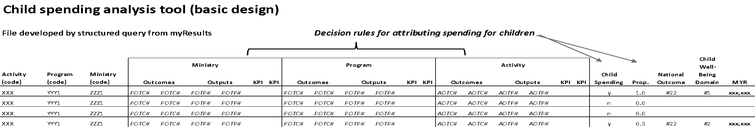
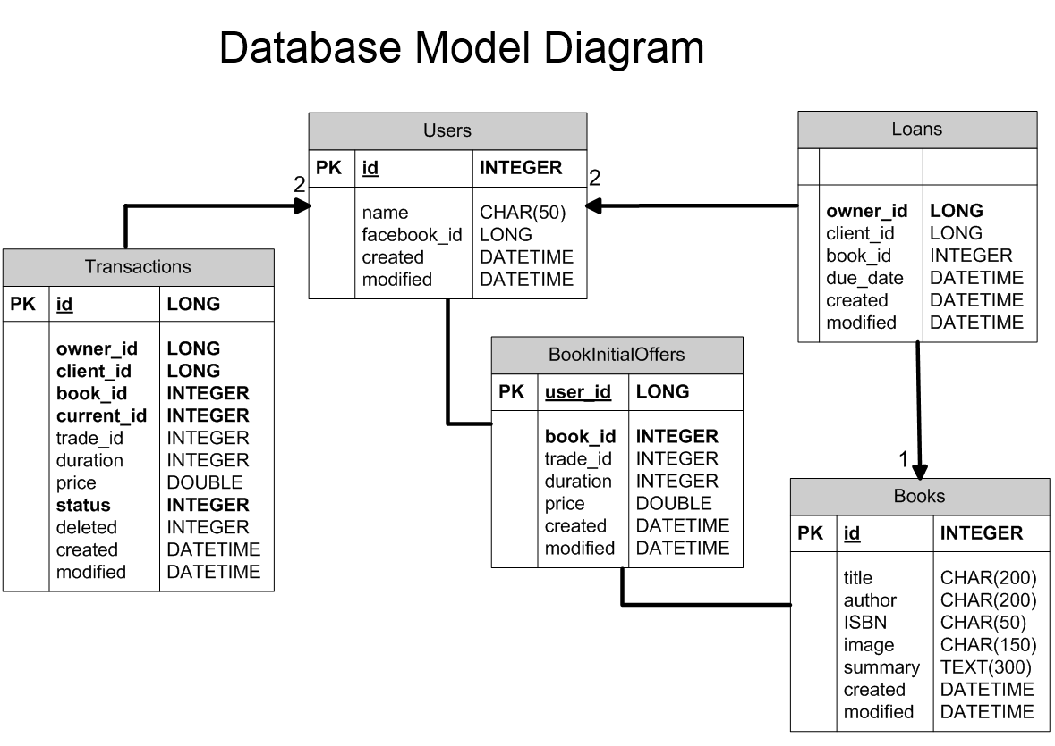
Proposed PF4C support/engagement
3) Developing a child spending analysis tool (cont.)
Use ministry elaborated outcomes, outputs and KPIs to attribute spending for children – both yes/no and proportion
2
With myResults managers define queries to produce analyzable file
Categorize spending – depending on goal of the analysis (examples – life cycle, well-being domains, CRC domains, etc.)
1
3

Slide 22
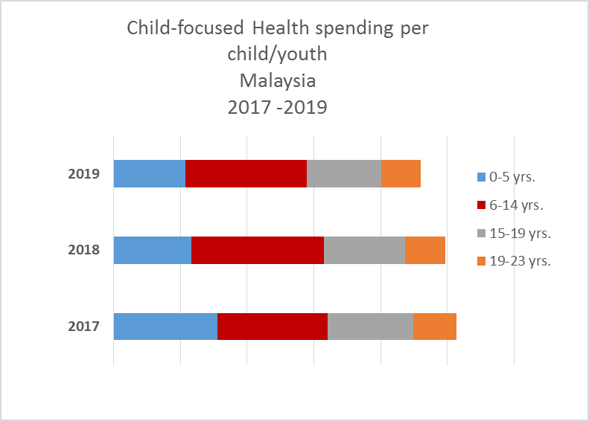
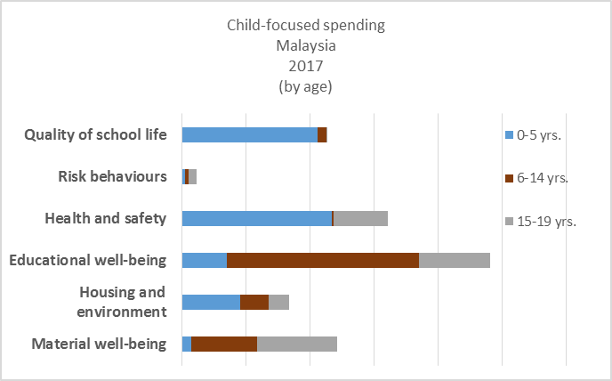
Proposed PF4C support/engagement
3) Developing a child spending analysis tool (cont.)
Gov. wide CRC-based (used by EPU in “Profile of Children in Malaysia”)
Examples of spending analysis
(simulated data)
Only examples – many other possibilities
Gov. wide based on Child Well-Being framework
Sector- focused analysis

