Slide 1





Sustainable Development Goals
Dr. Victor P. Karunan, Ph.D., Deputy Representative & Senior Social Policy Specialist
Nottingham University Malaysia
6 April 2016

Slide 2








Millennium Development Goals
MDG 1: Eradicate extreme poverty & hunger
3 targets; 9 indicators
MDG 5: Reduce maternal mortality
2 targets; 6 indicators
MDG 2: Achieve universal primary education
1 target; 3 indicators
MDG 6: Combat HIV/AIDS, malaria and other diseases
3 targets; 9 indicators
MDG 3: Promote gender equality & empower women
1 target; 3 indicators
MDG 7: Ensure environmental sustainability
4 targets; 10 indicators
MDG 4: Reduce child mortality
1 target; 3 indicators
MDG 8: Develop a Global Partnership for Development
7 targets; 7 indicators

Slide 3

2030 Sustainable Development Agenda
https://sustainabledevelopment.un.org/

Slide 4
Difference – MDGs & SDGs
The SDG agenda is fundamentally different to the MDGs
Targets are universal and closely interconnected
Global goals and targets are ‘aspirational’. Individual countries expected to adapt and apply according to context
169 targets, 99 relate to outcomes, 70 relate to means of implementation
This implies a large number of global indicators (100-300)
Calls for significant investment in national capacity for data collection and analysis

Slide 5
Post-2015: The Unfinished Business
Quality of development
Inclusiveness
Gender empowerment
Environment
Improving the quality of growth, recognizing multi-dimensionality of development
A targeted & focused approach to assist pockets of development needs that remain
Stereotyped gender roles that continue to exist & have implications for other development achievements
Pursuing sustainable consumption and development
Moving beyond basic needs; Focus on cost-effective outcomes
A strategic relook at the social protection system, bearing in mind that a multi-dimensional approach is needed
Gender empowerment that improves overall welfare of men and women
Green growth strategies and better management of natural resources

Slide 6
MDGs to SDGs
MDGs |  | SDGs
8 | Goals | 17
18 | Targets | 169
48 | Indicators | 229
Less comprehensive | Scope | Comprehensive
Macro Level Halve Targets | Aspirations | Leave no one behind Zero Targets
Individual Goals | Trade-offs | Interconnected and Cross-cutting goals

Slide 7
Categories – SDGs Indicators
Goal | Indicators
1 Poverty | 9
2 Hunger | 15
3 Health | 25
4 Education | 11
5 Gender | 14
6 Water | 10
7 Energy | 6
8 Economy and Labour | 15
9 Infrastructure and Innovation | 12
10 Inequality | 12
11 Cities | 13
12 SCP | 12
13 Climate Change | 5
14 Oceans | 10
15 Biodiversity | 15
16 Peace and Justice | 21
17 Means of Implementation | 24
TOTAL | 229
Dimensions | Indicators
People | 74
Prosperity | 58
Planet | 52
Peace and Justice | 21
Means of Implementation | 24

Slide 8



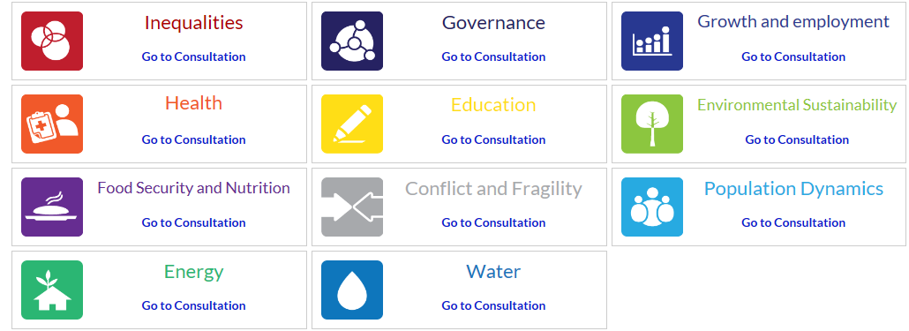

A Note on the Process Key players and voices in developing the SDGs
Individuals/Citizens
UN System
Civil Society
Private Sector
Academia
Member States
The Media

Slide 9
The High-Level Political Forum (HLPF)
Original mandate came from the Rio+20 Conference on Sustainable Development in 2012;
Central UN platform for the follow-up and review of the 2030 Agenda for Sustainable Development;
Meets:
yearly (in July) at Ministerial level, under the auspices of the ECOSOC, and
every 4 years at the level of Head of State / Government at the UN General Assembly;
Mandated to conduct national reviews and thematic reviews of the implementation of the Agenda, with inputs from other intergovernmental bodies and forums, relevant UN entities, regional processes, major groups and other stakeholders;
Key Asks and Principles for National Review Activities for UNICEF Country Offices and National Committees: Version 1.0
Separate follow-up and review for Addis Ababa Action Agenda on FfD – global and regional

Slide 10






















Countries Participating in HLPF Voluntary National Reviews in 2016
FURTHER INFORMATION
Q& A on National Reviews
More info on the HLPF process

Slide 11

Moving forward with the SDGs in Malaysia
Malaysia has achieved good human development outcomes over time through systematic, dedicated and sustained efforts of numerous stakeholders.
Within the MDG framework, Malaysia has also made much progress to ensure the sustainability of those achievements.
The strategic thrust of the 11MP on sustainability and inclusiveness, with a strong people focus, has strong coincidence with the objectives and spirit of the SDGs and the post-2015 agenda..
Operationalising the SDGs will require a focus on priorities, gaps and challenges and development according to Malaysia’s own pace and context.

Slide 12



ROLE OF NATIONAL STATISTICAL OFFICE (NSO)
FRAMEWORK & GOVERNANCE
Role of Department of Statistics, Malaysia (DOSM)
General
In SDGs (DOSM & Stakeholders)
Compilation of Statistics
Analysis/
Interpretation
Dissemination/Statistics Communication
Coordinate
Measure Development Progress
Effectively Participation in National Monitoring Programme
17 GOALS
Support government in development planning & monitoring by providing evidence-based statistics
169 TARGETS
229 INDICATORS
193 Countries
Malaysia
involve in various agencies

Slide 13
DATA ACCESSIBILITY Preliminary Review of Malaysia’s SDGs Indicators
SDGs (229 indicators)
GREEN (149 indicators)
GREY (80 indicators)
Available (76 indicators)
Available (7 indicators)
DOSM
32 indicators
(42%)
Agencies
44 indicators
(58%)
DOSM
4 indicators
(57%)
Agencies
3 indicators
(43%)
Not available and need further development of indicators
(73 indicators)
Not available and need further development of indicators
(73 indicators)
DOSM
6 indicators
(8%)
Agencies
67 indicators
(92%)
DOSM
3 indicators
(4%)
Agencies
70 indicators
(96%)

Slide 14
ISSUES & CHALLENGES AHEAD … of SDGs indicators compilation to suit the needs of global sustainable development
Financing
MDGs Lesson Learnt
Capacity building/
Support needed
Better Decision Making
More socio-economic indicators
Big Data
Data collection
& management activity
Capacity gaps
Requires major investment
More environmental–related indicators
Technology in statistical instrument
Better Targeting
Data limitation
Open Data
Data tapping
Coordination

Slide 15

WAY FORWARD
To create awareness and better understanding on development of SDGs
Collaboration from all related agencies is needed in order to ensure the monitoring & measurement of SDGs indicators 2016 -2030 on tracks:
Work plan agencies include SDGs priority;
Commitment;
Budget Allocation; and
Focal Point.
National Comprehensive Data Gaps
Study at National level
6 essential elements

Slide 16
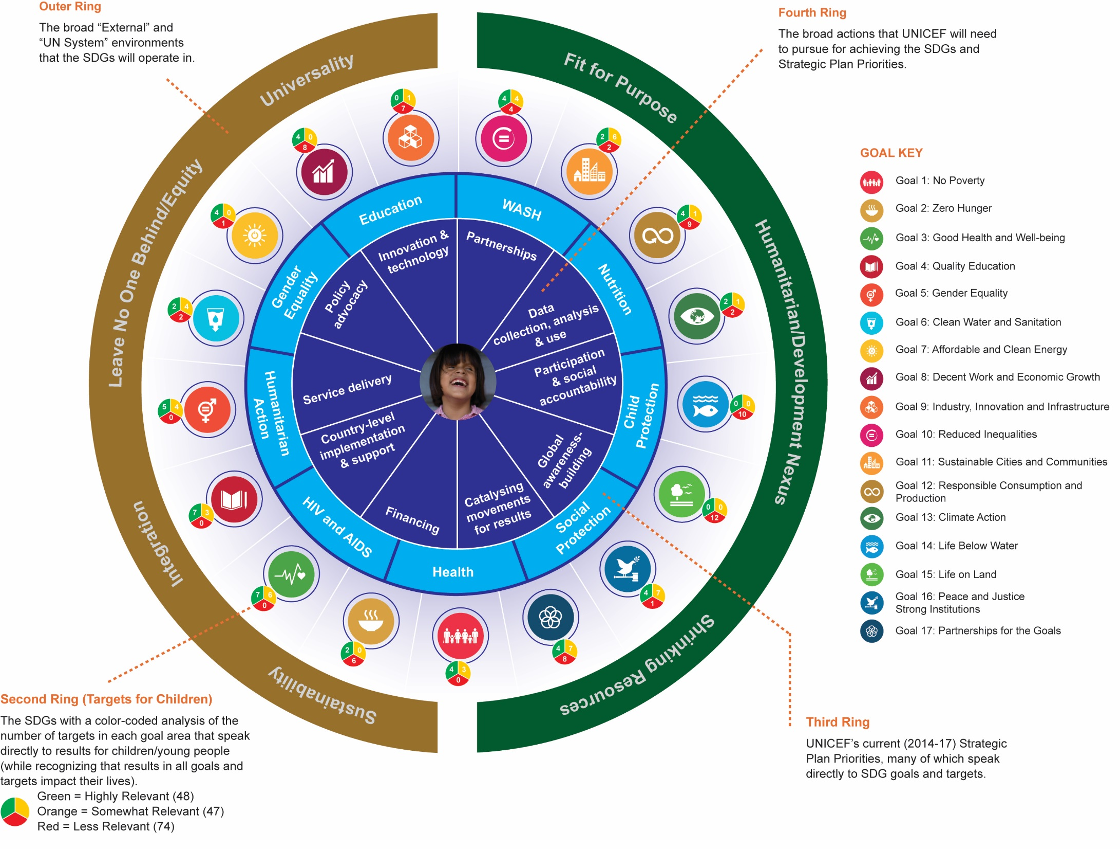

Slide 17
THANK YOU!
United Nations Children’s Fund
Wisma UN, Block C, 2nd Floor
Kompleks Pejabat Damansara Jalan Dungun, Damansara Heights
50490 Kuala Lumpur, Malaysia
www.unicef.org
© United Nations Children’s Fund November 2015

