Slide 1
Child Rights as Human Rights
Victor P. Karunan, Ph.D.
Visiting Lecturer, International Development Studies (MAIDS), Chulalongkorn University, Human Rights and Peace Studies, Mahidol University & Social Policy, Thammasat University.
Lecture for Human Rights in Southeast Asian Context, Southeast Asian Studies Programme, Chulalongkorn University
22 February 2017 , Bangkok

Slide 2
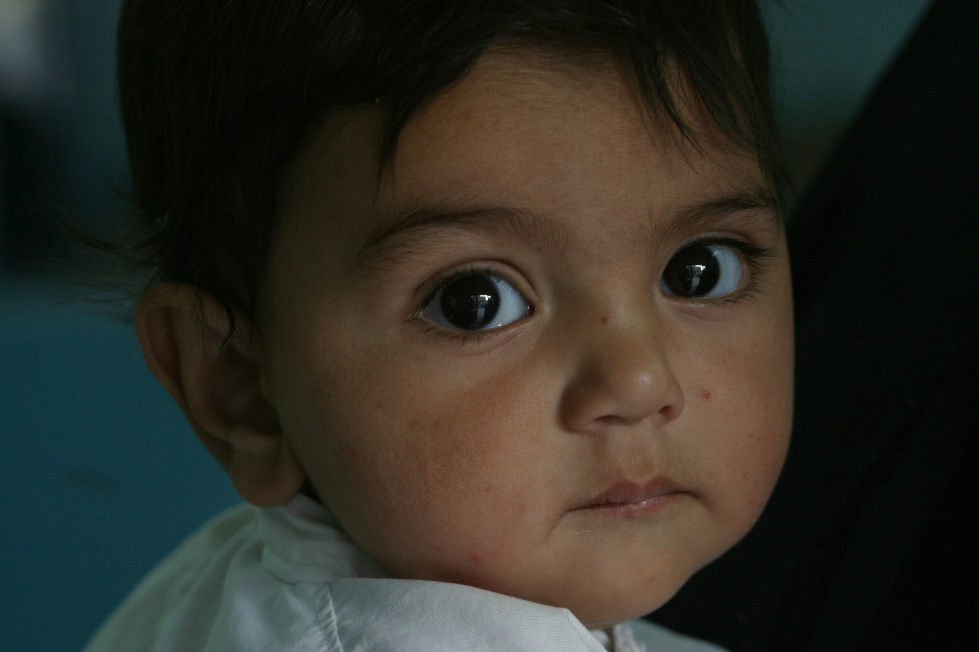
Our Children – Our Asset and Our Future

Slide 3
Learning Objectives
To enhance knowledge and understanding of child rights
To provide an overview of the UNCRC - its background and context
To review the principles and provisions of the CRC
To discuss some key child rights issues in the Southeast Asian context
To discuss opportunities and challenges

Slide 4
Session Outline
Introduction – Children’s Rights as Human Rights
Background and Context of the United Nations Convention on the Rights of the Child – UNCRC
Main Provisions of the CRC – SPPD
Key child rights issues in Southeast Asia
Lessons Learnt and Ways Forward

Slide 5
Definition – “Child”
“For the purposes of the present Convention, a child means every human being below the age of 18 years unless, under the law applicable to the child, majority is attained earlier”.
(Article 1)

Slide 6
Introduction – Child Rights as Human Rights
Children have the same human rights as adults
Children have particular rights that recognise their special need for protection
“Children are not made human beings – there are born human beings”
(Janusz Korczak – Poland)

Slide 7
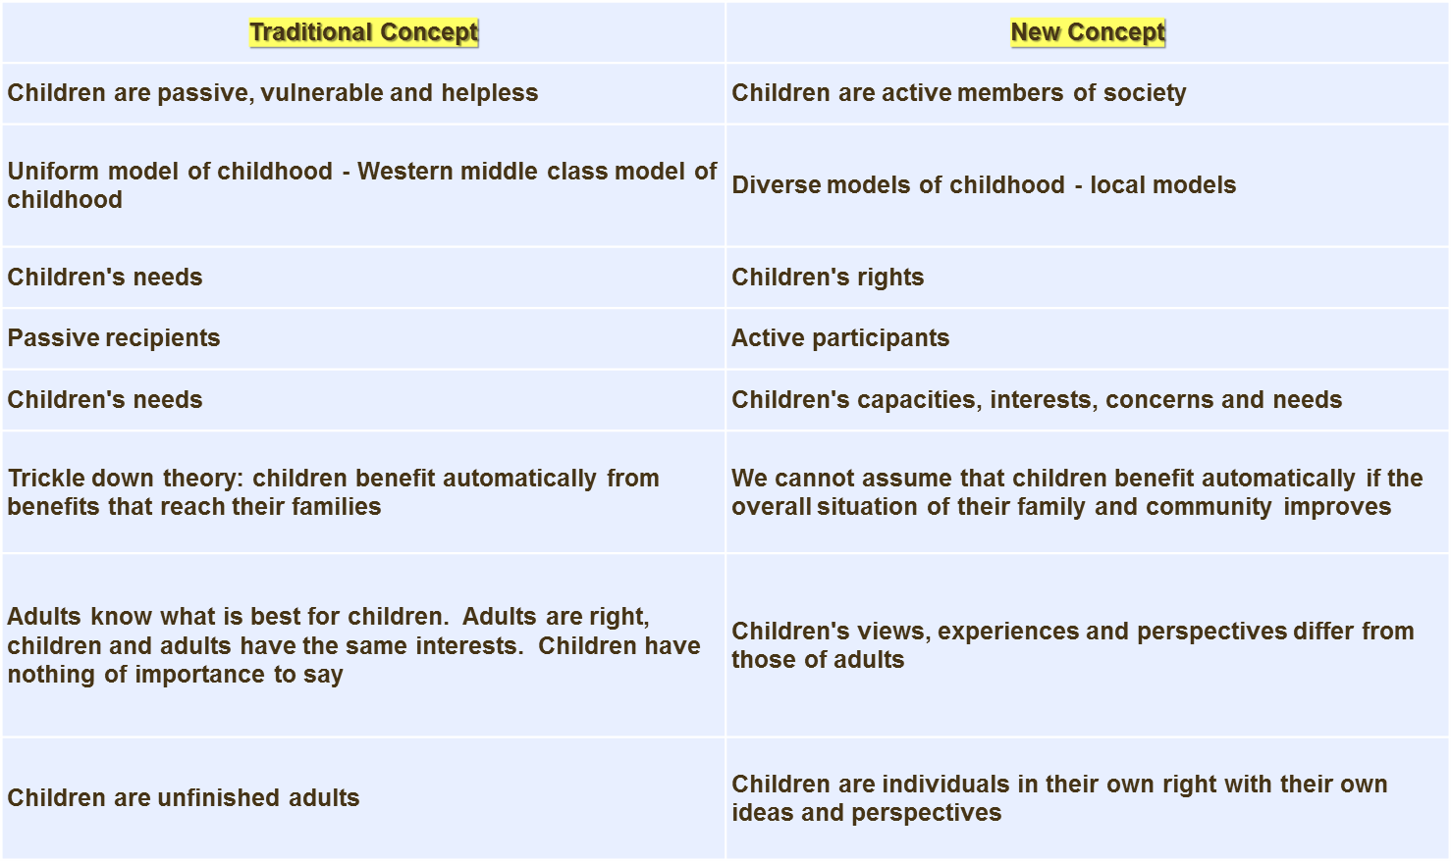

Slide 8
“Needs” to “Rights”
Both are based on a desire to help people survive and develop to their full potential.
Needs may vary with settings – Rights are universal.
Both seek to identify a range of assistance and actions that are needed to achieve this. But they differ in their underlying assumptions and the implications
Needs are associated with “promises” – Rights are associated with “obligations”. A rights-based approach adds legal and moral obligations and accountability.
In a rights-based approach, the holders of the rights are encouraged and empowered to claim them. This means that they are not seen as objects of charity (as they are in a needs-based approach) but as those claiming their legal entitlements.

Slide 9
“Needs” to “Rights…contd.”
From “needs” of children - to “rights of children”; from “charity/welfare” to “claims/entitlements”
A Holistic Approach : civil, political, economic, social and cultural rights
Rights are INDIVISIBLE, INTER-RELATED, INTER-DEPENDENT
A Continuum - Progressive Realisation of Rights

Slide 10
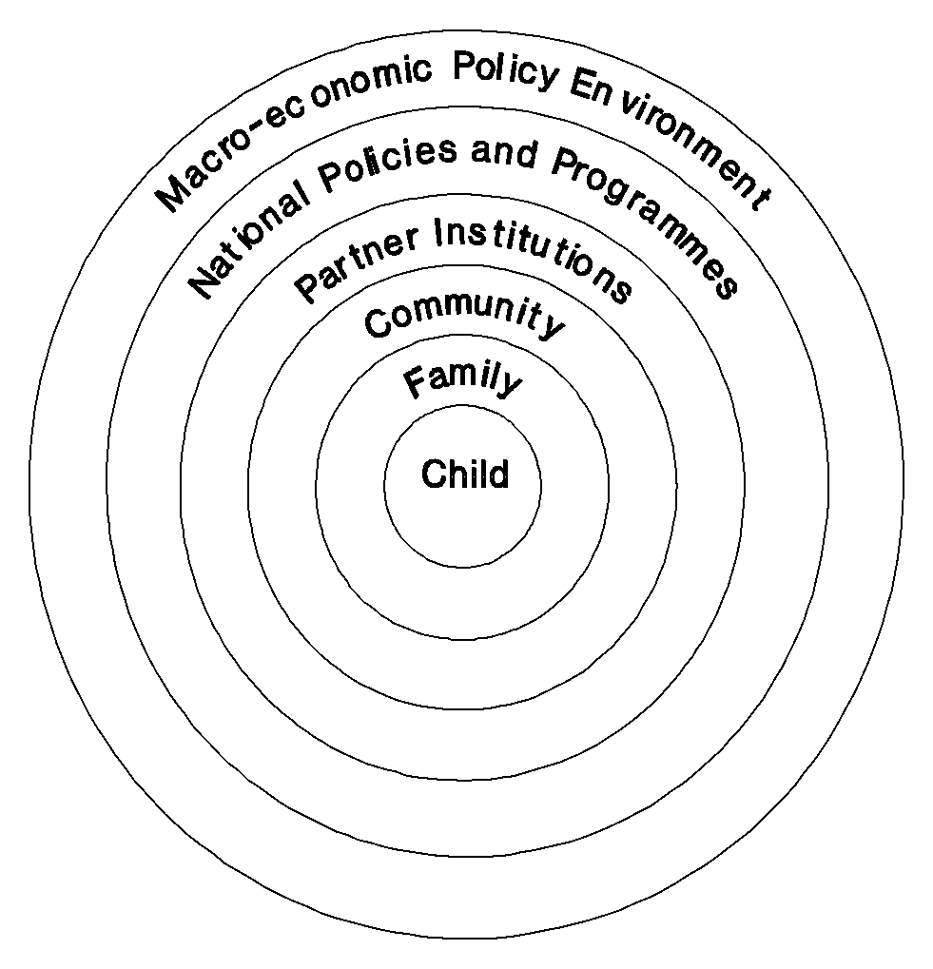

Slide 11
Principles
Human rights principles
CRC principles
Universality
Indivisibility
Participation
Accountability
Survival and development
Non-discrimination
Participation
Best interests of the child

Slide 12
Problem of Definition - Child
Minimum legal age of a child differs in national legislation
Examples: age of marriage, age of criminal responsibility, employment, sexual consent, military service, testimony in court, etc.

Slide 13
Background to UNCRC
1923 : Eglantyne Jebb, founder of Save the Children, developed 7 statements on the rights of the child
1924 : Rights were adopted by the League of Nations
1948 : UN General Assembly adopted Universal Declaration of Human Rights
1959 : UN General Assembly adopted a Second Declaration of Rights of the Child
1979 : The International Year of the Child
1989 : UN General Assembly adopted the Convention on the Rights of the Child
Notes:
‹#›

Slide 14
CRC
Most widely ratified UN Convention – 193 member-states – in 1989
CRC brings together children’s human rights articulated in other international treaties
Covers civil, political, economic, social and cultural rights
First international instrument to explicitly recognise children as social actors and active holder of their own rights
CRC and its Optional Protocols are international binding legal instruments – State Parties to report to the Committee on the Rights of the Child.

Slide 15
Four General Principles
Article 2: Non-Discrimination
Article 3: Best Interests of the Child
Article 6: Right to Life, Survival and Development
Article 12: Respect to the views of children

Slide 16
Four General Principles…contd.
1. Non-Discrimination (Art 2): children should not be denied their rights because of discrimination.
2. Best Interests of the Child (Art 3): when making decisions about children, the best interests of the child should be the most important criteria.
3. Survival and Development of the Child (Art 6): the life and survival of the child should be of the utmost importance to States in their activities, and they are obligated to ensure children develop into healthy adults.
4. Respect of the views of the child, or rights to participate (Art 12): children should be able to participate in decisions that concern them according to their age and maturity

Slide 17
Optional Protocols
An Optional Protocol is a separate treaty that provides additional procedures or addresses a substantive area
Three Optional Protocols:
OP1: “Optional Protocol to the Convention on the Rights of the Child on the Sale of children, Child Prostitution and Child Pornography” (OPSC), 2002
OP2: “Optional Protocol to the Convention on the Rights of the Child on the Involvement of Children in Armed Conflict” (OPAC), 2002.
OP3: “Optional Protocol on communication procedure”, 2011

Slide 18
4 CATEGORIES OF RIGHTS
SURVIVAL : right to life, health and medical care
PROTECTION : protection from violence, abuse, neglect, abandonment and refugee children
PARTICIPATION : express views, association
DEVELOPMENT : education and standard of living

Slide 19
Right to Participation Articles 12, 13 & 15

Slide 20
Right to Participation
Article 12
“the right of the child who is capable of forming his or her own views, to express those views freely in all matters concerning him or herself, with those views being given weight depending on the age and the maturity of the child”.
Notes:
‹#›
Corporate guilt? Genuine desire to do good?

Slide 21
Right to Participation
Article 13
“The child’s right to obtain and make known information, and to express his or her views, unless this would violate the rights of others”.

Slide 22
Right to Participation
Article 15
“The right of the child to meet with others and to join or set up associations, unless the fact of doing so violates the rights of others”.

Slide 23
HELPFUL LINKS
Access the UN Convention on the Rights of the Child here: http://www.ohchr.org/Documents/ProfessionalInterest/crc.pdf
Access the Optional Protocol to the Convention on the Rights of the Child on the sale of children, child prostitution and child pornography (OPSC) here: http://www.ohchr.org/Documents/ProfessionalInterest/crc-sale.pdf
Access the Optional Protocol to the Convention on the Rights of the Child on the involvement of children in armed conflicts (OPAC) here:
http://www.ohchr.org/Documents/ProfessionalInterest/crc-conflict.pdf
Access the Optional Protocol to the Convention on the Rights of the Child on a communications procedure here:
http://treaties.un.org/doc/source/signature/2012/CTC_4-11d.pdf
Access the Lists of States Parties to the Convention and its Optional Protocols here:
http://tbinternet.ohchr.org/_layouts/TreatyBodyExternal/Treaty.aspx?Treaty=CRC&Lang=en

Slide 24
The UN Committee on the Rights of the Child
The Treaty Body for the CRC is called the Committee on the Rights of the Child (the Committee) which consists of 18 independent experts in the field of child rights, nominated and elected by States Parties in the UN General Assembly.
The Committee meets in Geneva three times a year for a period of four weeks each session. The principal objective of its work is to review States Parties reports on implementation of the Convention. This is done during public constructive dialogues with official Government delegations. The Committee can only receive or consider information concerning countries which have ratified or acceded to the CRC. The Committee reviews on average 10 States during each session.

Slide 25
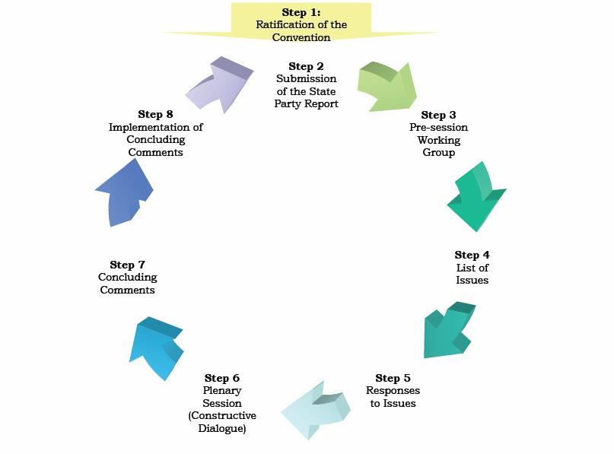

Slide 26
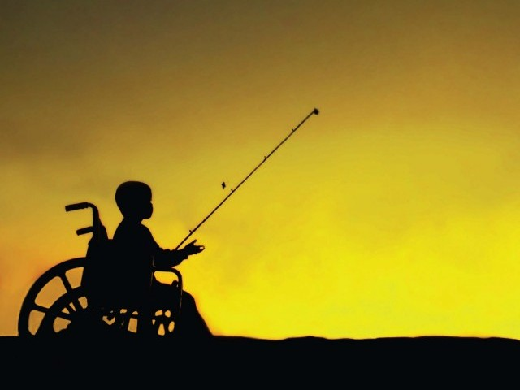
THANK YOU
Notes:
UNICEF Malaysia 2011-2015 CPMP
‹#›

