Slide 1
THE UN CONVENTION ON THE RIGHTS OF THE CHILD CHILDREN HAVE RIGHTS TOO
Presentation
VICTOR P. KARUNAN, Ph.D.
Chaplains and Animators Formation and Exchange (CAFÉ)
International Young Christian Students (IYCS)
Tue 8 March 2018
Nonthaburi, Thailand

Slide 2
OUTLINE
Understanding “childhood”
Defining “Children”
Children in Context
The UN Convention on the Rights of the Child
Child and Adolescent Participation
Children as “Social Agents”
Challenges and Ways Forward

Slide 3
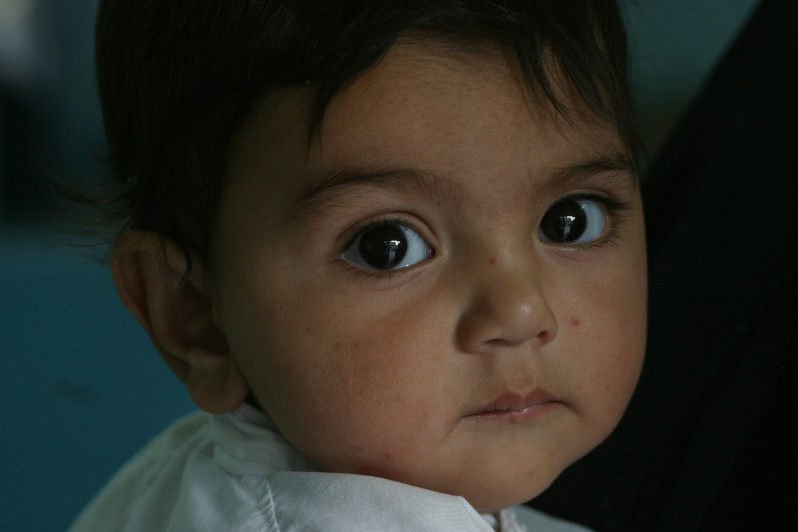
OUR CHILDREN – OUR ASSET AND OUR FUTURE
How much do we understand children?

Slide 4
UNDERSTANDING “CHILDHOOD”

Slide 5
The “Global Model” of Childhood
The dominant paradigm of childhood in the world today:
natural and universal division between adults and children based on biological and psychological features
children are defined as “smaller” and “weaker” than adults
children develop through “given” stages of development
the global model is superior to all other models particular to cultures
Children are dependent on adults and care-gives for their growth and development

Slide 6
Problems with a “Global Model” of childhood
The “global model” of childhood is based on a set of assumptions and values that view children as passive, vulnerable and dependent.
This model tends to ignore differences among children – rather it tends to promote universal categories – viz, “the child”, “the girl child”, “Asian children”, “Thai children”, etc.
It is therefore very important to distinguish between “global” (universal) models of childhood and “local” (particular) models of childhoods
The way childhood is experienced differs depending on the given history, culture, economic and social status, gender or ethnic group.

Slide 7
Understanding Childhood
Childhood is not determined only by age, or by biological and psychological factors - rather childhood is understood by reference to particular cultural and social contexts and to particular periods in history.
In many countries of the Global South, the child-rearing environment is characterised by large families and high infant mortality: a heavy emphasis on parents’ efforts to ensure the physical survival of their children means that parents must devote much of their time to economic and domestic activity, with many “parenting” tasks delegated to other people, often older children.
Many child-rearing practices also reflect particular cultural contexts: in some contexts in Asia, mothers may be quite protective of their children and as they grow up there may be an expectation of compliance and conformity, and an acceptance of adult authority: by contrast, many parents in Europe may encourage open, expressive, autonomous and assertive behaviour
Within a given context, or, in a country, childhood is often highly differentiated not only according to gender, but also according to social class, ethnicity, or caste.

Slide 8
Childhood & Child Rights
There is no universal definition of who is a child, adolescent or youth. Chronological age is not a sufficient criterion for establishing operational definitions.
Children and adolescents have needs and capacities that are significantly different from those of adults.
Some general features of child development are predictable, but there are significant cultural differences in the ways in which children and adolescents develop, and in the beliefs, goals and expectations and child-rearing practices that shape development.
Gender differences are especially significant, as are differences related to social status, class/caste and specific needs – e.g. related to disability.
Children and adolescents also have the capacity to be resilient in the face of adversity. The concept of resilience directs attention to those factors within the individual, the family and the wider context which help people to cope with adversity.
Conflict and migration can pose some particularly critical threats to the development and well-being of children and adolescents: these include experiences of violence and fear; separation from parents or other care-givers; exploitation and abuse; and involvement in fighting forces.
The “Best Interests of the Child” is an important principle in both legal and child development contexts.

Slide 9
DEFINING “CHILDREN”

Slide 10
WHO IS A “CHILD”?
“For the purposes of the present Convention, a child means every human being below the age of 18 years unless, under the law applicable to the child, majority is attained earlier”.
(Article 1: UN Convention on the Rights of the Child, 1989)

Slide 11
CONCEPTUAL CONFUSIONS
Children = 0 up to 18 years (CRC)
Adolescents = 10 to 19 years (WHO/UNICEF)
Youth = 15 to 24 years (UNGA-1995)
Young People = 10 to 24 years (UNGA-1995)
And, each country has its own definitions….

Slide 12

OVERLAPPING DEFINITIONS
Youth (15- 24)
Young people (10-24)
Adolescents (10-19)
Children (0-18)
1st Decade of life
2nd Decade of Life
10
15
20 25
Increasing agency, independence

Slide 13
CHILDREN IN CONTEXT

Slide 14
“NEEDS” TO “RIGHTS”
Both are based on a desire to help people survive and develop to their full potential.
Needs may vary with settings – Rights are universal.
Both seek to identify a range of assistance and actions that are needed to achieve this. But they differ in their underlying assumptions and the implications
Needs are associated with “promises” – Rights are associated with “obligations”. A rights-based approach adds legal and moral obligations and accountability.
In a rights-based approach, the holders of the rights are encouraged and empowered to claim them. This means that they are not seen as objects of charity (as they are in a needs-based approach) but as those claiming their legal entitlements.

Slide 15
“NEEDS” TO “RIGHTS…CONTD.”
From “needs” of children - to “rights of children”; from “charity/welfare” to “claims/entitlements”
A Holistic Approach : civil, political, economic, social and cultural rights
Rights are INDIVISIBLE, INTER-RELATED, INTER-DEPENDENT
A Continuum - Progressive Realisation of Rights

Slide 16
CHILDHOOD AND CHILD RIGHTS IN ASIA
Rapid and fundamental change under the impact of globalisation - direct effect on childhood and adults’ attitudes towards children
Child Rights is determined by human rights. Human Rights is a “sensitive” topic in many countries - in others it is selectively applied. The fact that children have rights is relatively new in Asia and many other parts of the Global South.
Attitudes towards child rights is determined by prevailing local conceptions of childhood and child development - in the context of diversity and disparities

Slide 17
CHILDHOOD (CONTD…)
Mainstream approaches view children as subordinates - children as one’s “property”.
Basic concepts of selfhood and experience of childhood are determined by the larger social and cultural context.
It is finally a question of “POWER” – between adults and children
This context determines attitudes towards and shapes the potential for the realisation of children’s rights in Asia.

Slide 18
THE UN CONVENTION ON THE RIGHTS OF THE CHILD

Slide 19
KEY PRINCIPLES
Human rights principles
CRC principles
Universality
Indivisibility
Participation
Accountability
Survival and development
Non-discrimination
Participation
Best interests of the child

Slide 20
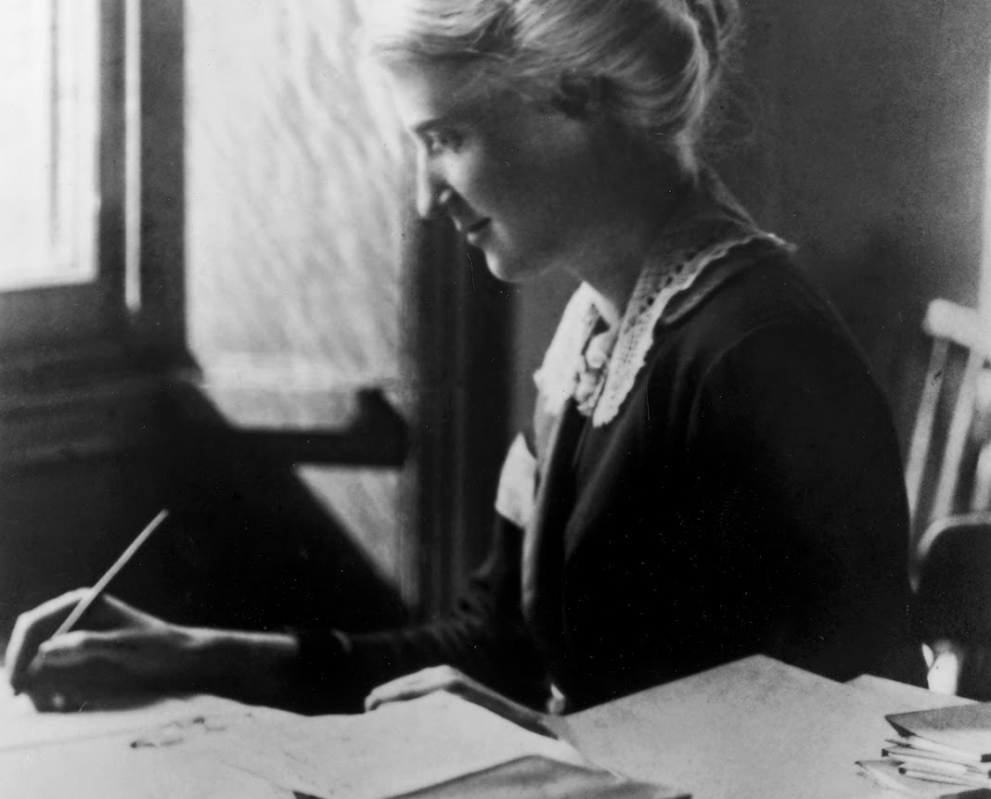
“RIGHTS” FOR CHILDREN?
Eglantyne Jebb – a British social reformer and founder of Save the Children
Drafted the “Declaration of the Rights of the Child” – adopted by the League of Nations 1924 & the United Nations in 1959
UN Convention on the Rights of the Child – adopted by the UN General Assembly, 20 November 1989

Slide 21
BACKGROUND TO UNCRC
1923 : Eglantyne Jebb, founder of Save the Children, developed 7 statements on the rights of the child
1924 : Declaration on the Rights of the Child was adopted by the League of Nations
1948 : UN General Assembly adopted Universal Declaration of Human Rights
1959 : UN General Assembly adopted a Second Declaration of Rights of the Child
1979 : The International Year of the Child
1989 : UN General Assembly adopted the Convention on the Rights of the Child

Slide 22
CRC
Most widely ratified UN Convention – 193 member-states (except USA)
CRC brings together children’s human rights articulated in other international treaties
Covers civil, political, economic, social and cultural rights
First international instrument to explicitly recognise children as social actors and active holder of their own rights
CRC and its Optional Protocols are international binding legal instruments – State Parties to report to the Committee on the Rights of the Child.

Slide 23
FOUR GENERAL PRINCIPLES
1. Non-Discrimination (Art 2): children should not be denied their rights because of discrimination.
2. Best Interests of the Child (Art 3): when making decisions about children, the best interests of the child should be the most important criteria.
3. Survival and Development of the Child (Art 6): the life and survival of the child should be of the utmost importance to States in their activities, and they are obligated to ensure children develop into healthy adults.
4. Respect of the views of the child, or rights to participate (Art 12): children should be able to participate in decisions that concern them according to their age and maturity

Slide 24
Four Categories of Child Rights
(SPPD)
Right to Survival
Right to Protection
Right to Participation
Right to Development
includes the right to life, the attainable standard of health, nutrition and adequate standard of living. It also includes the right to a name and nationality.
includes freedom from all forms of exploitation, abuse, inhuman or degrading treatment, and neglect including, the right to special protection in situations of emergency and armed conflict.
includes respect for the views of the child, freedom of expressions, access to appropriate information, and freedom of thought, conscience and religion.
the right to education, support for early childhood development and care, social security and the right to leisure, recreation and cultural activities.

Slide 25
OPTIONAL PROTOCOLS
An Optional Protocol is a separate treaty that provides additional procedures or addresses a substantive area
Three Optional Protocols:
OP1: “Optional Protocol to the Convention on the Rights of the Child on the Sale of children, Child Prostitution and Child Pornography” (OPSC), 2002
OP2: “Optional Protocol to the Convention on the Rights of the Child on the Involvement of Children in Armed Conflict” (OPAC), 2002.
OP3: “Optional Protocol on communication procedure”, 2011

Slide 26
CHILD AND ADOLESCENT PARTICIPATION

Slide 27
DEFINING “CHILD PARTICIPATION”
“Participation is a basic human right, and as such, it is not a gift or privilege bestowed by adults on children, but the right of every child capable of expressing a view. In other words, it is a fundamental right for all children – especially the most marginalized and vulnerable in society”

Slide 28
IN OTHER WORDS…..
For the child, it means :
Seeking information
Expressing the desire to learn even at a very young age
Forming views
Expressing ideas
Taking part in activities and processes
Being informed and consulted in decision-making
Initiating ideas, processes, proposals and projects
Analyzing situations and making choices
Respecting others and being treated with dignity
Forming groups, associations and acting together

Slide 29
CLUSTER OF “PARTICIPATION RIGHTS” - UN - CRC
Article 5 : “…evolving capacities of the child”
Article 12 (1) “…express views freely in all matters affecting the child, the views of the child being given due weight in accordance with the age and maturity of the child”
Article 13 (1) “…freedom of expression….freedom to seek, receive and impart information and ideas of all kinds….”
Article 14 (1) “…respect the right of the child to freedom of thought, conscience and religion”
Article 15 : “…freedom of association. and peaceful assembly”

Slide 30
THE RIGHT TO PARTICIPATION
Participation is a fundamental human right for all human beings - a means to an end, as well as an end in itself
Participation is a right for ALL - not the privilege of a FEW
Participation is voluntary
Resistance or non-participation can be an important form of participation
Participation challenges power relations and the status quo
Participation does not mean that each one can do as they wish –
Participation rights of one person influences/impacts on others.
Participation – includes “rights” and “responsibilities”

Slide 31
PRE-CONDITIONS FOR EFFECTIVE PARTICIPATION
Participatory approaches are most likely to succeed:
(i) where they are pursued as part of a wider political process;
(ii) where they are aimed specifically at securing citizenship rights and participation for marginal and subordinate groups; and
(iii) when they seek to engage with development as an underlying process of social change – rather than just technocratic interventions

Slide 32
PARTICIPATION AS CITIZENSHIP
Important to locate “participation” in a broader and more inclusive concepts of “citizenship” and “democracy” in society
Participation involves engagement with the wider issues of power and politics
Participation involves “empowerment” – a process linked with the given power structures and the democratic space in a society
Participation is based on a “social contract” between people (citizens) and authority (government)

Slide 33
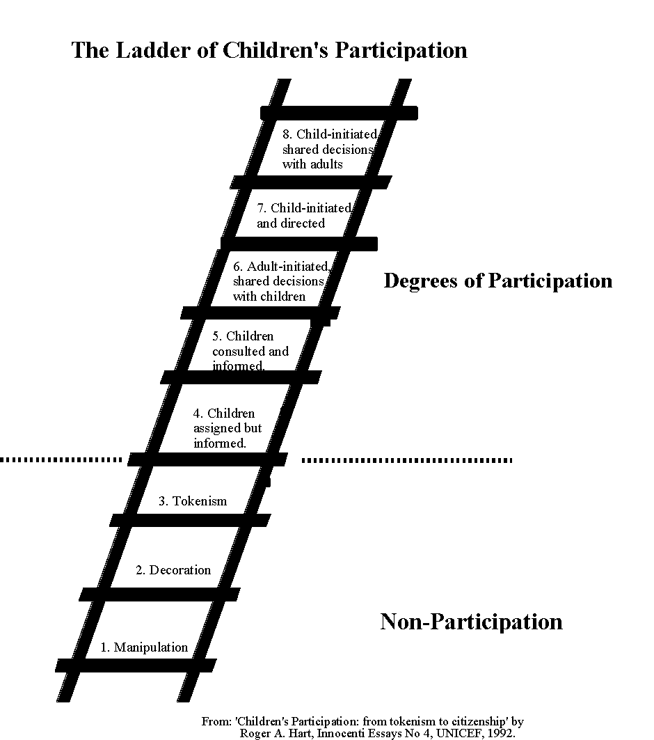
The Ladder of Participation – Roger Hart, 1992

Slide 34
DEFINING “MEANINGFUL” AND “ETHICAL” PARTICIPATION OF BOYS AND GIRLS
Must start from children and young people themselves – on their own terms
Based on their own life situations and realities
Aimed towards achieving their own visions, dreams, hopes and concerns
Valuing children in their own context and in relation to others (peers and adults)
Demands a radical shift in adult thinking and behaviour towards children

Slide 35
WHAT IS NEEDED?
Firstly, we need to make a “mind-shift” in the way we view children and adolescents/young people
Secondly, we need to work towards creating a “safe and supportive environment” - family, school, community, peer group, society
Thirdly, we need to build “equal partnerships” with young people.

Slide 36
CHILDREN AS SOCIAL AGENTS

Slide 37
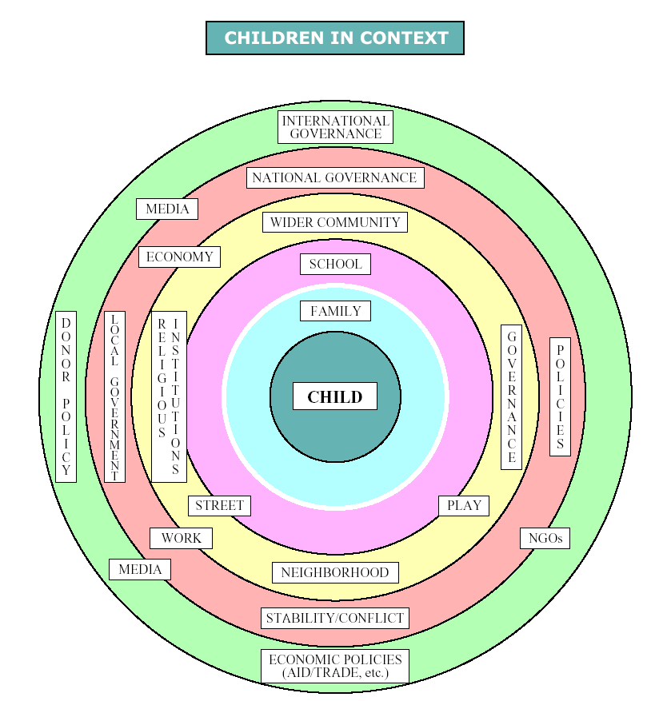

Slide 38
CHALLENGES AND WAYS FORWARD

Slide 39
SOME CHALLENGES
Conceptual clarity on age-definitions, non-discrimination, evolving capacities, best interests of the child
Awareness-raising and building capacity of both children (rights-holders) and adults (duty-bearers) on child rights
Creating an enabling environment for promoting meaningful participation – family, school, local councils, national institutions
Moving beyond “tokenistic and “one-off events” to a more sustained and integrated approach and practice in promoting child and adolescent participation

Slide 40
IN CONCLUSION...
“OUR PRESENT IS NOT ONLY HANDED DOWN BY OUR ANCESTORS
(that is history)…
BUT IT IS LEASED FROM OUR CHILDREN”. (which is a debt we owe them)
Thank You!

Slide 41
READING LIST
Implementation Handbook for the Convention on the Rights of the Child – UNICEF, New York, Revised edition 2007
Advocacy Theme Pack – Child Rights and Advocacy – Victor P. Karunan, Save the Children, Southeast Asia and Pacific Regional Office, Bangkok, 1997
Advocacy Toolkit – UNICEF, New York, 2010
The role of NGOs in reporting, monitoring and followup - International Save the Children Alliance CRC Training Kit, London, 1998)
A guide to Non-Governmental Organisations Reporting to the Committee on the Rights of the Child - The NGO Group for the Convention on the Rights of the Child, Geneva, 1994

Slide 42
HELPFUL LINKS
Access the UN Convention on the Rights of the Child here: http://www.ohchr.org/Documents/ProfessionalInterest/crc.pdf
Access the Optional Protocol to the Convention on the Rights of the Child on the sale of children, child prostitution and child pornography (OPSC) here: http://www.ohchr.org/Documents/ProfessionalInterest/crc-sale.pdf
Access the Optional Protocol to the Convention on the Rights of the Child on the involvement of children in armed conflicts (OPAC) here:
http://www.ohchr.org/Documents/ProfessionalInterest/crc-conflict.pdf
Access the Optional Protocol to the Convention on the Rights of the Child on a communications procedure here:
http://treaties.un.org/doc/source/signature/2012/CTC_4-11d.pdf
Access the Lists of States Parties to the Convention and its Optional Protocols here:
http://tbinternet.ohchr.org/_layouts/TreatyBodyExternal/Treaty.aspx?Treaty=CRC&Lang=en

